Slide 1
P3 Contracts
Morteza Farajian, Ph.D.
November 2016

Slide 2
What is a Public-Private Partnership (P3)?
Notes:
October 2014 – CTB May 2014 Resolution Report Back
PPTA Implementation Manual and Guidelines – steps taken to produce 2014 version
Risk Management Guidelines – next steps - revision
Public Engagement Guidelines – next steps – new document
Value for Money Guidelines – next steps - revision
November 2014 – CTB Resolution recommending VDOT and DRPT adopt 2014 version of PPTA Implementation Manual and Guidelines (Guidelines)
March 2015 – General Assembly introduces legislation (HB 1886) to enhance transparency and accountability

Slide 3
Overview of P3s Definition
P3 Defined
A P3 involves a partnership between the public and private sector to share the risk and rewards of constructing, financing, operating, and/or maintaining what are traditionally publicly-owned assets in order for projects to be completed faster, on budget, and at an enhanced value for money to the owner
Why Utilize P3s?
Innovation leading to more cost effective delivery and long term operations
Flexibility through private financing and funding regimes
Economies of scale
Integrated services
Outcome-based performance
Budget certainty over the ‘whole life’ of an asset
Accelerated project delivery
Competition, accountability, and transparency
Risk transfer to the private sector

Slide 4
Overview of P3s Typical P3 structure
Public Sector
Users (if user fee project)
State/Federal tax
State Appropriation
Grant of right
Project revenue (tolls, fares, fees…)
Tolls/Fares
Payments
(AP/Milestone)
Asset &
Service
Service
Equity
Special Purpose Vehicle (Developer)
Bond or loan proceeds
Lenders
Revenue (after O&M and debt service)
Financing
Tax
Residual revenue
Paid before equity
Termination
Security
Appropriations
Equity funding
Debt Service
Progress
Payments
Asset
Service
Payments
O&M services
DB Contractor
O&M Contractor
Cost overruns
Time/Delays
Design
Defects
Cost overruns (shared)
Delivery of O&M
Availability/Performance

Slide 5
Overview of P3s Delivery Models
Design-Bid-Build
Design-Build
Design-Build-Operate-Maintain
Design-Build-Finance
Design-Build-Finance-Operate-Maintain
Full Concession/ Development Rights
A
Delivery Model
B
Risk Allocation
Public Responsibility
Private Responsibility
C
Consultancy Contracts
Service
Contracts
Management Contracts
DBF
Contracts
DBFO
Contracts
Lease
Full Concession/ Development Rights
Contractual Structure
D
Payment Mechanism
Milestone Payment
Availability Payment
Revenue/Demand Based
E
Financial Structure
Public Contributions
Capital Markets Debt
Private Equity
Infrastructure Funds
Bank Debt

Slide 6
Overview of P3s Value for Money
A VfM analysis is undertaken to help identify whether a P3 delivery option provides value as compared to a traditionally-financed approach (Public Sector Comparator or “PSC”) on both a quantitative and qualitative basis.
VfM
PSC Delivery Model
P3 Delivery Model
Public sector financed
DBB approach, operated and maintained by MTA
Limited transfer of risk to private sector
Private sector financed
DBFOM responsibilities performed by private sector
Allows risk transfer to private sector
In general, long term value for money can be achieved by:
Accelerating delivery of projects
Proper allocation/transfer of risks
Providing incentives to the private sector for the delivery of quality services
Encouraging innovative delivery solutions by use of an “outputs” specification approach
A long-term partnership contract provides a degree of cost certainty to government and revenue (availability payments) security to the bidder

Slide 7
Overview of P3s Value for Money
Value for money is presented on a total net present value basis
Risks Retained by the Public Sector
Value for Money
Risks Retained by the Public Sector
Operations & Maintenance Costs
Project Costs
Operations & Maintenance Costs
Financing Costs
Private Sector Efficiencies
Financing Costs
Capital Costs
Capital Costs
PSC
Shadow Bid
Private Sector Efficiencies
= Innovation + Competitive Tension of Whole Life Cost
Pursue P3 delivery only if it offers a better value

Slide 8
Overview of P3s Considerations
Clear authority for alternative delivery
Project champion
Dedicated internal contacts
Good governance
Best value vs. lowest price
Risk allocation; shift to private sector can raise costs; identify optimal risk allocation
Public Policy and Regulatory
Environment
Funds to cover long-term operations and financing
Organized Structure
Public sector Vs Private sector
Workforce
Open and frank discussions
Detailed Business Plan with Clear Goals and Strong Project Justification
Establish robust competitive procurement
Reasonable return on investment reflecting risk
Embed monitoring of performance into contract
Revenue Stream
Proactively communicate project benefits
Stakeholder Support
Pick Your Partner Carefully
Communication

Slide 9
Overview of P3s Typical Financial Structures
 | Term | Initial Leverage (Debt) | Initial Leverage (Equity) | WACC | Residual Cash | Upside Revenue | Downside Revenue | Control Over Tolling
Publicly financed without toll revenue | N/A | N/A | N/A | N/A | Yes if tolled | Yes if tolled | No | H if tolled
Publicly financed with toll revenue | M | H | N/A | L | H | H | M | H
Availability Payments | M | H | L | M | H | H | M | M
Toll Concession | H | H | H | H | N/A | L | N/A | L
63-20 corporation (without equity) | M | M | N/A | M | H | H | L | M
Short-term DBF | L | H | N/A | L | N/A | N/A | N/A | N/A

Slide 10
Overview of P3s Typical Risk and Reward Allocation
The P3 contract describes the responsibilities of each party in the delivery of the project:
Design and Construction
Financing
Project cost
Project completion schedule
Site conditions/environmental
Regulatory/permitting
Interfaces with third parties
Changes in project scope
Liability/latent defects
Credit quality of financing structure (incl. counterparty)
Interest rates and market conditions generally
Appropriation
Debt service
Range and adequacy of available financing options
Tax treatment
Refinancing gain sharing
Operation and Maintenance
Revenue
Asset performance
Reporting requirements
Monitoring and evaluation
Costs and escalation
Handback
Rate setting policy
Revenue collection
Ability to meet debt service obligations
Ability to meet O&M obligations
Return on investment is subject to risk
Revenue sharing

Slide 11
Case Study: Transform 66 P3 Project (Virginia)
Notes:
October 2014 – CTB May 2014 Resolution Report Back
PPTA Implementation Manual and Guidelines – steps taken to produce 2014 version
Risk Management Guidelines – next steps - revision
Public Engagement Guidelines – next steps – new document
Value for Money Guidelines – next steps - revision
November 2014 – CTB Resolution recommending VDOT and DRPT adopt 2014 version of PPTA Implementation Manual and Guidelines (Guidelines)
March 2015 – General Assembly introduces legislation (HB 1886) to enhance transparency and accountability

Slide 12
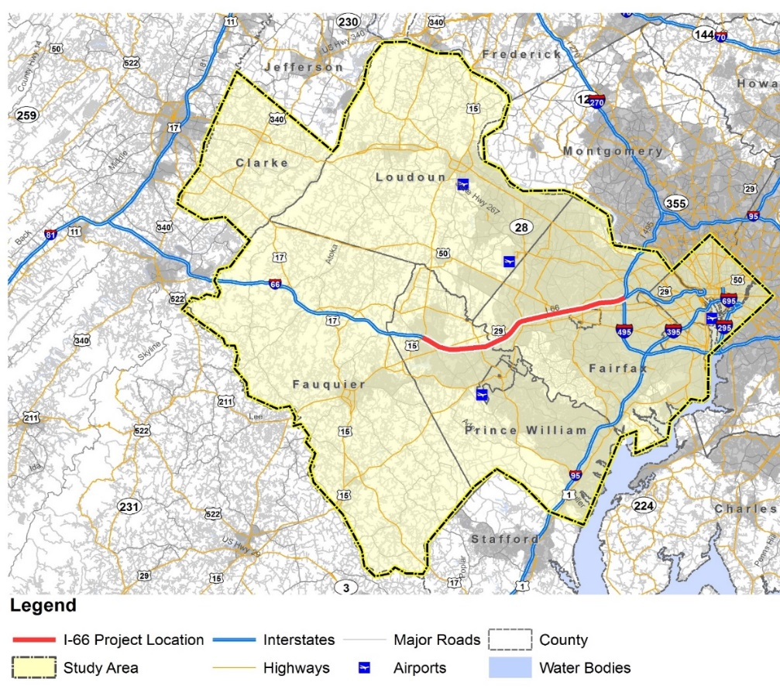
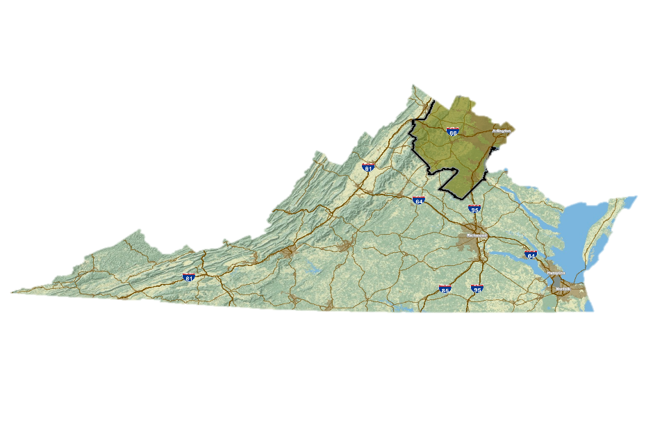
Case Study
I-66 Express Lanes (Outside the Beltway):
Primary commuter route in Northern Virginia
25 miles in length
Runs in an east-west direction between US15 in Prince William County, VA, and I-495 (Capital Beltway) in Fairfax County, VA
Dynamically tolled
Nine Toll Segments

Slide 13
Preferred Alternative Mainline Cross Section
Flexible barrier with buffer, median for potential future transit
(with auxiliary lanes, if needed)

Slide 14
Project Timeline
Summer 2011 – Environmental Process Initiated (NEPA)
November 2013 – Record of Decision (ROD) issued on Tier 1 NEPA
August 2015 – Commissioner makes Finding of Public Interest (FOPI) to initiate procurement under PPTA based on three delivery models (DBFOM, DBOM and DB-ATC)Transportation Public-Private Partnership Advisory Committee concurs with Commissioner’s FOPI
September 2015 – CTB authorizes VDOT to proceed with the procurement, Request for Qualifications.
October 2015 – VDOT received 13 Statement of Qualifications (SOQ)
December 2015 – VDOT receives indicative financial proposals from Short-Listed Proposers and selects toll concession as the preferred delivery model
December 2015 – VDOT briefs CTB and Transportation Public-Private Partnership Advisory Committee
December 2015 – VDOT posts a draft request for Proposals (RFP)

Slide 15
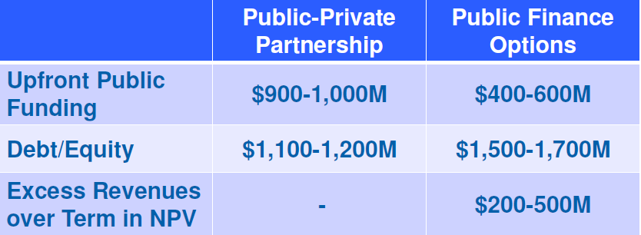
Process from RFQ to RFP

Slide 16
Process from RFQ to RFP
Delivery Model
DB-ATC
DBOM
DBFOM
Step 1: SOQs
Short-List Proposers
5
5
3
Step 2: Conceptual Financial Proposals
5
5
3
Delivery Model Selected;
Qualified Proposers Announced
Stipends paid to responsive Short-Listed Proposers for non-selected delivery methods
RFP
Outcome: Delivery Methods reduced from 3 to 1

Slide 17
Summary of Requirements
Maximum amount of Commonwealth contribution is $600M.
Other sources of Project financing include:
Private equity
TIFIA
Private Activity Bonds (PABs)
Commonwealth receives funding (fixed amounts) for transit elements of Project.
Commonwealth receives $350,000,000 in net present value over term of contract from the Developer that can be used for future corridor enhancements.
Commonwealth will receive a share of the revenue if Project generates more revenue than expected.

Slide 18
Summary of Results
 | Proposals Meeting Key Requirements
Requirements | Concession | DBOM | DB-ATC
Upfront Public Funding (within $600 million) | 3 of 3 | 2 of 5 | 1 of 5
Required Transit Funding | 3 of 3 | 5 of 5 | 5 of 5
Support for Corridor Improvements (min $350 million PV) | 3 of 3 | All Excess Toll Revenue | All Excess Toll Revenue

Slide 19
Questions?
www.FarNiaAdvisors.com
www.InfraShares.com
Morteza@InfraShares.com

