Slide 1
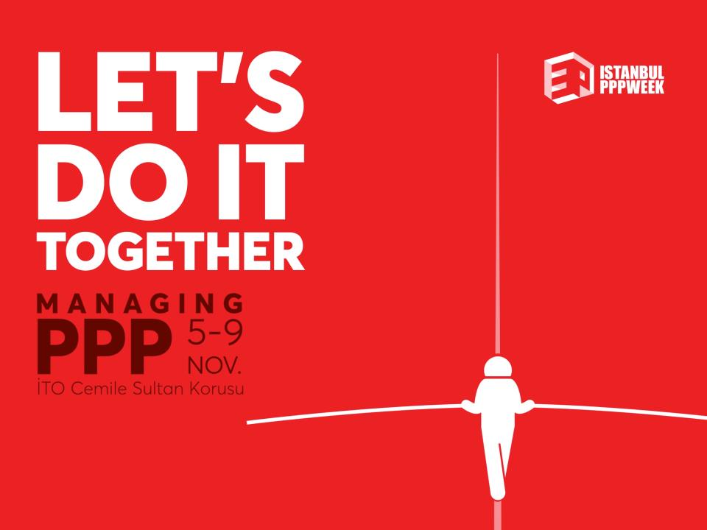

Kingdom of Morocco
Ministry of Equipment, Transport, Logistics and water
PPP INVESTMENT OPPORTUNITIES IN MOROCCO
Mr. M’bark FANCHA
Regional Director of Equipment, Transport, Logistics and Water, Agadir, Morocco
November 2018

Slide 2
The plan
1
Morocco Overview
2
Ministry of Equipment, Transport, Logistics and Water Mission
3
Current Achievements and Future Programs
4
Potential Public-Private Partnership (PPP) Projects
Notes:
Greetings ladies and gentlemen. I'm here today to give you un idea about the numerous(many) investment opportunities in infrastructures within PPP framwork in the Kindom of Morocco
As you can see,he presentation is in 4 parts

Slide 3
1
Morocco Overview

Slide 4
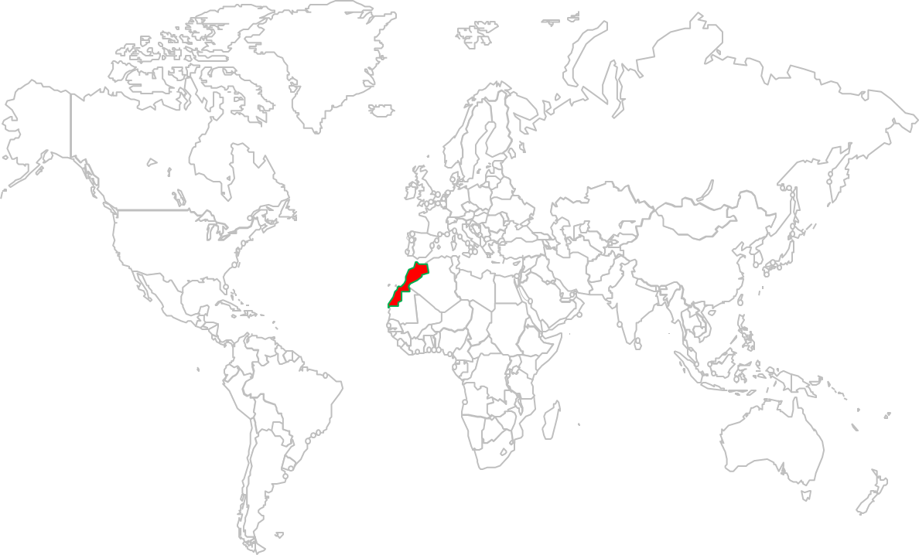

Morocco Overview
  One of the oldest Kingdoms in the world
  Crossroad of civilizations
Europe
Atlantic Ocean
Morocco
Mediterranean
Arabo-Islamic
World
Africa
المــــــــغــــرب
Morocco

Slide 5
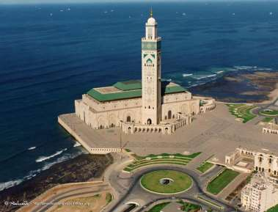
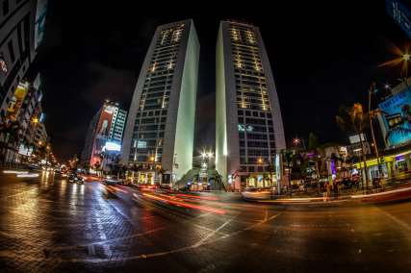
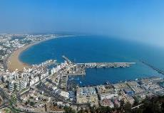
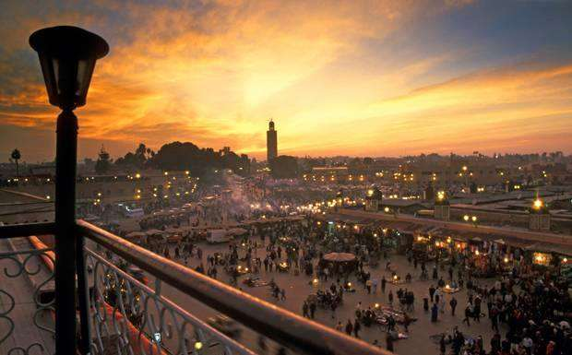

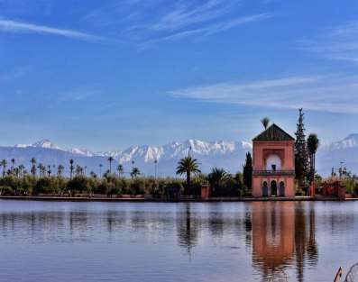

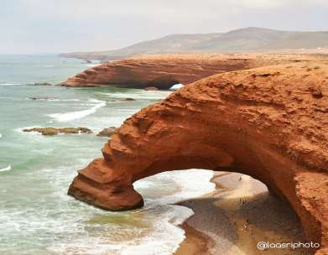
Morocco Overview
Capital | Rabat
Institutional System | Constitutional Monarchy
Area | 710 850 km²
Population | 34.5 million (2016)
Time Zone | GMT (GMT+1 in summer)
Languages | Arabic and Amazigh (official) French, Spanish, English
Climate | Continental – Mediterranean
Currency | Dirham (1USD ≈ 10 MAD & 1€ ≈ 11 MAD)
GDP | 1016 Billion MAD (2016) ≈US$ 110 Billion
GDP per capita | 29450 MAD/ inhabitant (2016) ≈US$ 3100
Average growth | 4% (over the last 5 years)
GDP Distribution (2016) | Primary Sector | 12%
 | Secondary Sector | 26%
 | Tertiary Sector | 50%
Inflation Rate | 1.2% (2016)
Source: Haut Commissariat au Plan et Office des Changes

Slide 6
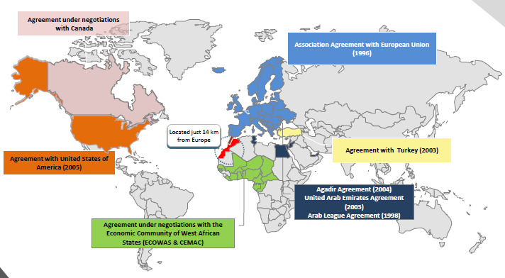
Morocco Overview
Strengths and Opportunities
Easier access to a free trade market of 55 countries representing one billion consumers
Notes:
Morocco offers investors

Slide 7
Morocco Overview
Strengths and Opportunities
Located on the principal international trade corridors and close to big markets of production and consumption
Notes:
Morocco is

Slide 8
Morocco Overview
Strengths and Opportunities
Strong and stable political, economic and social situation
Cost competitiveness
International standards infrastructure
Skilled human capital
Ambitious sectoral strategies
Favorable business environment

Slide 9

Morocco Overview
Strengths and Opportunities
Africa’s economic and commercial potentials are insufficiently exploited by investors.
Morocco provides a platform for countries and businesses seeking easier access to the markets of the Maghreb and Africa.
Morocco offers the main advantage of its increasing ability to meet the quality standards for manufacturing complex products.

Slide 10
1
Morocco Overview
2
Ministry of Equipment, Transport, Logistics and Water Mission
3
Current Achievements and Future Programs
4
Potential Public-Private Partnership (PPP) Projects

Slide 11
2
Ministry of Equipment, Transport, Logistics and Water Mission

Slide 12
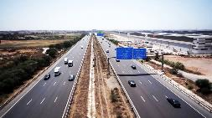
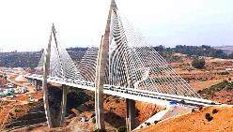
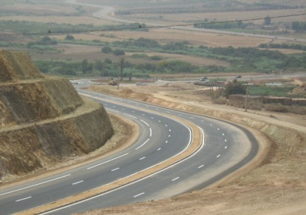

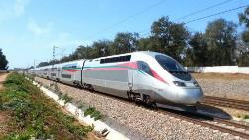

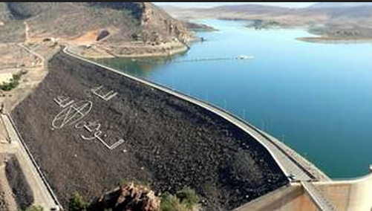
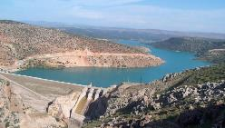
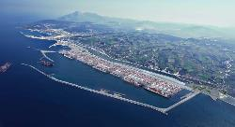
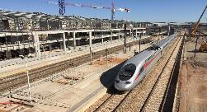
Ministry of Equipment, Transport , Logistics and Water Mission
To develop, coordinate and implement the government policy in the:
transport infrastructure sector (roads, motorways, seaports, railways)
water sector
modes of transport (road, rail and sea)
Logistics sector
Notes:
12

Slide 13
Ministry of Equipment, Transport , Logistics and Water Mission
Strategic Axes of the Ministry
Institutionnal reform
Competitiveness, Sustainable, Equitable Development
Regulatory reform
Basic infrastructure
Financing and public-private partnership
Quality and Safety in Transport Services
Transparency, Good Governance and Effeciency
Safety and security of transport
Economic activities accompanying the sector
Roads – Transport – Ports – Railways – Logistics - Water
Development of public and Quarries
Building and public works
Human resources and training
Notes:
The policy of the government is implemented by the MELTE through 3 axes in diverse sectors as per the following(comme suit).As you can see ladies and gentlemen the PPP is a crucial component of the ministry’s vision
13

Slide 14
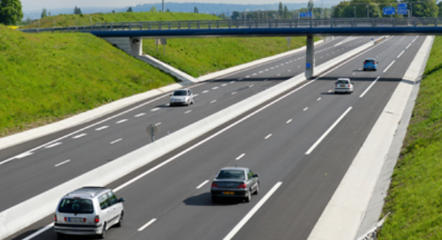


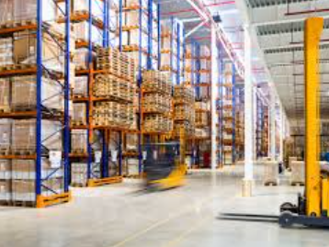
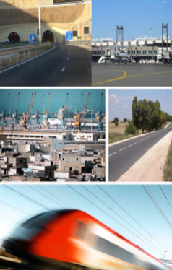
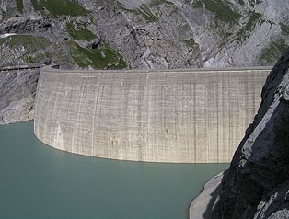
Ministry of Equipment, Transport , Logistics and Water Mission
Sector plans offering important growth facilities
Road Plan for 2035
National Port Strategy
By 2035
Rail Plan 2040
Roads, Motorways
and Urban Transport
Valorisation of port infrastructures and existing connections
LGV,
Classic Train
and RER
National Strategy of develmopment of the logistical competitiveness by 2030
Reform and Liberalization of different modes of Transport
National Plan of Water
Development of an integrated national network of logistic zones
and Optimisation of freights flow
National Mobility master plan by 2020 and 2035
Dams

Slide 15
1
Morocco Overview
2
Ministry of Equipment, Transport, Logistics and Water Mission
3
Current Achievements and Future Programs
4
Potential Public-Private Partnership (PPP) Projects

Slide 16
3
Current Achievements and Future Programs
Roads and Motorways
Railways
Ports
Development of Logistics Competitiveness

Slide 17
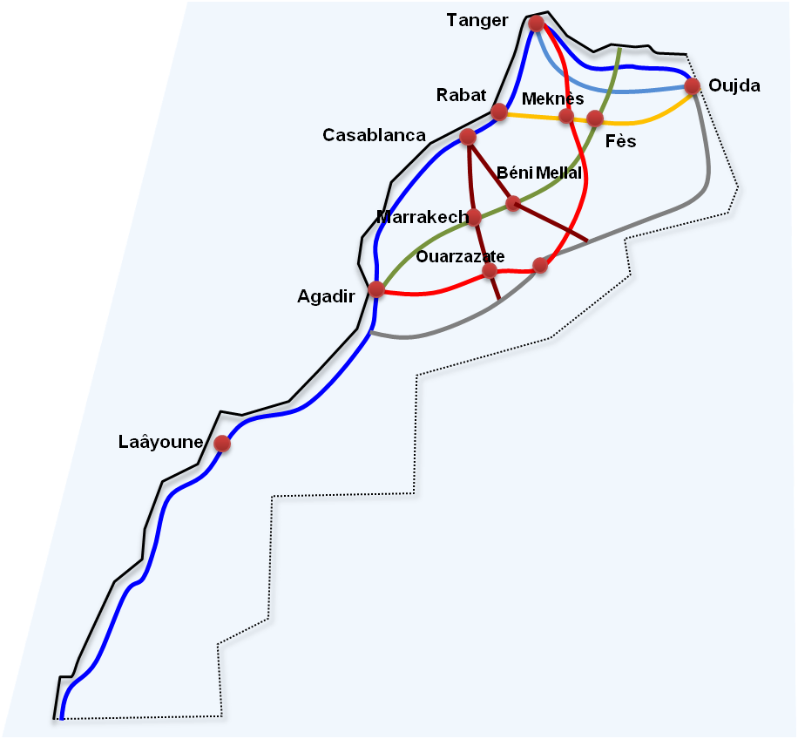
Current Achievements and Future Programs
Road Network
Current Achievements
Road network 60000km 44000 km of paved roads 16000 km of unpaved roads Expressways : 1066 km Rural Roads : 26000 km Engineering structures : 10000 unit
Future Programs
Road Master Plan by 2035 Expressways :2000 km (1560 Km under construction – 1.3 BUSD) Structured national roads: 7000 km Rural Roads : 24 000 km A program for the maintenance of more than 2,000 km per year.
Notes:
17

Slide 18
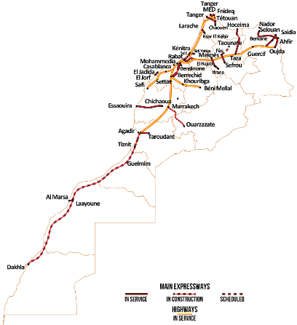
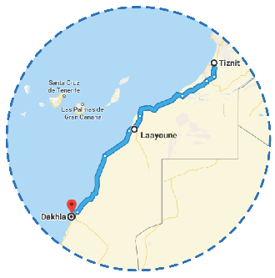
Current Achievements and Future Programs
Road Network
Main Project Under Construction
NR1 : Tiznit–Laayoune Expressway & Enlargement and Reinforcement of Laayoune – Dakhla Expressway
Total length : 1055 KM
Global coast : 850 MUSD

Slide 19
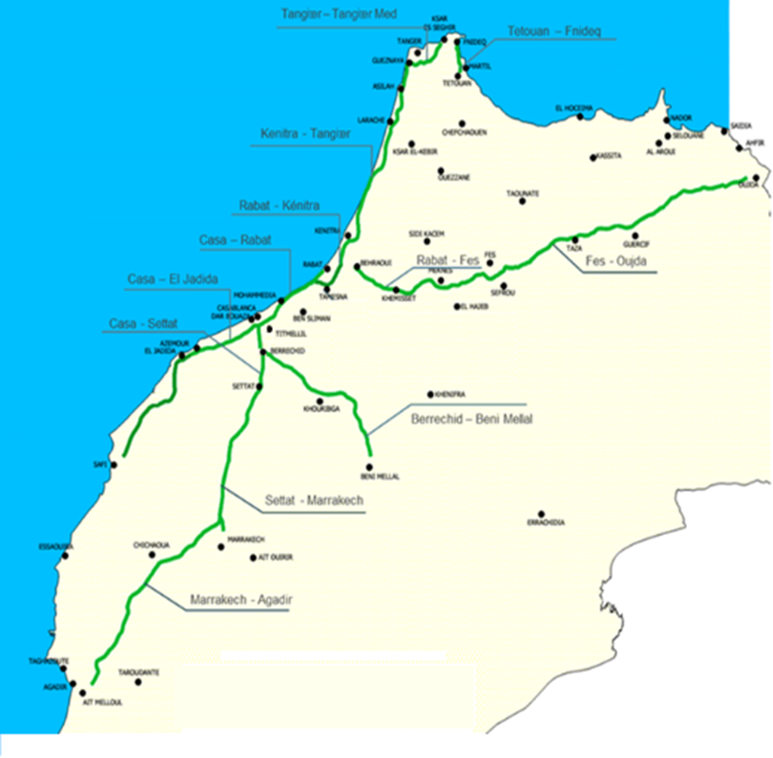
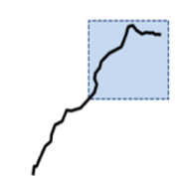
Current Achievements and Future Programs
Motorway Network
Current Achievements
Motorways : - 1.800 km in service by 2016.
Future Programs
Road Master Plan by 2035 The Motorways program is to reach 3000 km to connect all destinations and major cities of Morocco, as well as major airports and ports.

Slide 20
3
Current Achievements and Future Programs
Railways

Slide 21
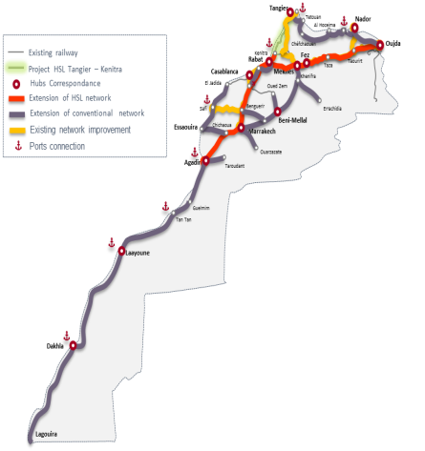
Current Achievements and Future Programs
Railways
Current Achievements
Current railway network : 3600 km The high-speed train line between Tangier and Casablanca : 200 km 40 Million passenger in 2017 30 Million tons transported Freight 630 MUSD of investement : 270 MUSD : Tangier-Casablanca HSR 360 MUSD : projects to modernize the network
Future Programs
Moroccan Rail Master Plan by 2040 Extension of conventional network: 3800 km - 20 Billion $ High-speed lines projects : 1200 km - 13.5 Billion $ -Existing network improvement 1500 Km - 2.5 Billion $

Slide 22
3
Current Achievements and Future Programs
Ports

Slide 23
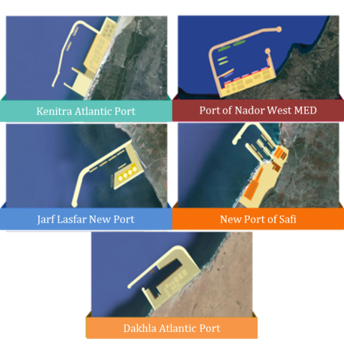
Current Achievements and Future Programs
Ports
Current Achievements
3500 km of Coastline 41 ports on the coastal strip: - 13 ports for international trade - 21 fishing ports - 7 Marinas
Future Programs
National Port Strategy by 2035 4 New ports under construction 2 Billion USD 3 New ports under study 2.2 Billion USD 4 Big extension to existing ports 1.2 Billion USD 5 Integration of Ports into their Urban Environments

Slide 24
3
Current Achievements and Future Programs
Development of Logistics Competitiveness

Slide 25
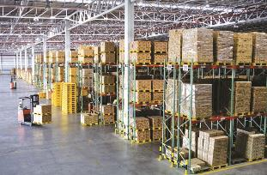
Current Achievements and Future Programs
Development of Logistics Competitiveness
Current Achievements
Developed logistics areas : 600 ha Operational areas : Zenata logistic Zone Mita logistic zone
Future Programs
National Strategy of develmopment of the logistical competitiveness by 2030 Total land requirements: 3,300 ha Estimated investment : $ 7 billion (excluding land cost) 5 types of logistics areas: Containers ; Distribution and logistics services ; Agri-marketing; Cereals; Building materials.

Slide 26
1
Morocco Overview
2
Ministry of Equipment, Transport, Logistics and Water Mission
3
Current Achievements and the Future Programs
4
Potential Public-Private Partnership (PPP) Projects

Slide 27
4
Potential Public-Private Partnership (PPP) Projects

Slide 28
Investment in Transport Infrastructure
Evolution of the Volume of Investments
34 billion USD of investments in transport infrastructure during the 20 last years
x6
x2
x1.6
77 billion USD of investments during the next 20 years
Amount in Billion USD

Slide 29

Investment in Transport Infrastructure
Ambitious Development Perspectives with Limited Budget
Ambitious programmes requiring collossal investments
Limited public budget
Necessity for new financing resources to develop public infrastructure
The government considers the Public- Private Partnership (PPP) among the solutions.

Slide 30
Public-Private Partnership (PPP) in Morocco
The objectives of the development of PPP
Economic efficiency
The most effective use of public resources
Benefit from the expertise and innovation of private sector
The maintaining of the infrastructure balance
Benefit from the private sector's financing capacity
Notes:
30

Slide 31
Public-Private Partnership (PPP) in Morocco
Favorable Conditions for PPP Development
The stability of macro-economic framework
An adequate legal framework for developing private investment
Restructuration and liberalization of some of the vital sectors
Development of a local financial (with a regional character) market
Adoption of a new Law No. 86.12 related to public - private partnership (Official Bulletin 6328 dated January 22 :2015)
The availability of sectoral laws for some public institutions under the guardianship of the Ministry
Notes:
31

Slide 32

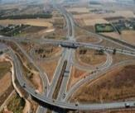
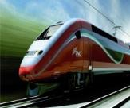
Public-Private Partnership (PPP) in Morocco
Potential PPP Projects
Ports
Kenitra Atlantic
Marinas projects
Jorf Lasfar
Dakhla Atlantic
Motorways
Bypass of Agadir
Tangier-Tétouan
Nador - Port Nador Motorway Guercif-Nador
Continental Rabat-Casablanca
Marrakech-Safi
Marrakech-Beni Mellal
Railways
Khouribga-Beni Mellal Classic railway line
Tanger-Melloussa-Tétouan Classic railway line
Casablanca – Oujda High-speed line

Slide 33
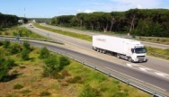
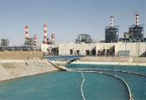
Public-Private Partnership (PPP) in Morocco
Potential PPP Projects
Logistics Areas
Development of logistics Zones
Casablanca
Fez
Meknes
Marrakech
Transport
Establishment of vehicle testing and approval laboratory
Installation and management of fixed radar speed control
Management of the activity of registration centers
Water
Seawater desalination plant Casablanca-Settat
A study is being carried out to identify projects that could be financed under PPPs in the water sector

Slide 34
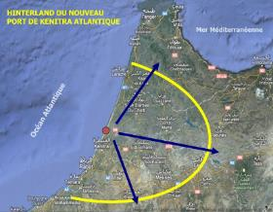
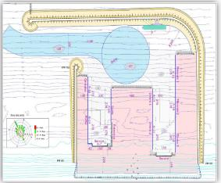
Public-Private Partnership (PPP) in Morocco
Project Under Study
Kenitra Atlantic Project
Contracting authority | Ministry of equipment, Transport, Logistics and Water
Geographical location | North-west region north of the city of Rabat
Objectives | To capture the different flows mainly those from and to west regions, Sais and Loukoust, in addition to free zones like Kenitra Atlantic Free Zone or tangier free Zone To attract a part of the traffic from Casablanca port and to improve the port services supply along Tanger-jorf Lasfer Support to the project Car factory.
Project Composition | A main breakwater 2.720 meters and a lateral breakwater 220 meters; A-12.5m deep and 1160 meters long quay to receive solid and liquid bulk, cereals and various goods A-12,5m deep and a 220m long quay for coal The possibility to build two centers for hydrocarbons with a deep of -14.5m The possibility to build a yard for shipbuilding an repair
Studies | Prefeasibility study: achieved PPP Preliminary assessments : on going
Estimated cost | 800 M$
Project duration: | 2017-2021
Notes:
34

Slide 35
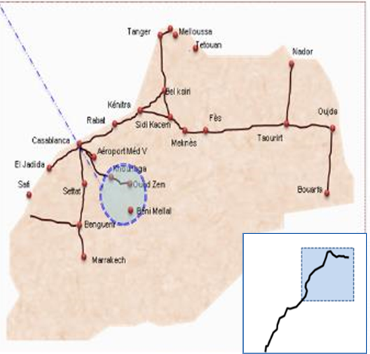
Public-Private Partnership (PPP) in Morocco
Project Under Study
Railway: Khouribga-Beni Mellal
Contracting authority | The National Railways Company
Geographical location | Tadla-Azilal in the center of Morocco
Objectives | Connecting Beni Mellal to the country’s railway network in support of development strategies in the region(Tourism, agriculture, food industry…)
Project Composition | 80 kms of railway track Construction of bridges and roads restoration Opening of five new stations between Khouribga and Beni Mellal
Studies | Prefeasibility study: achieved Definition studies : achieved PPP Preliminary assessments : on-going
Estimated cost | 300 M$
Project duration | 04 years
Notes:
35

Slide 36
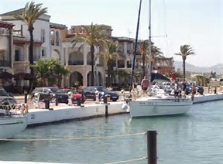
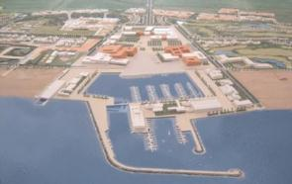
Public-Private Partnership (PPP) in Morocco
Project under study
6 Marinas Projects
Contracting authority | Ministry of equipment, Transport, Logistics and Water
Geographical location | Eastern region of Morocco
Objectives | Improve Moroccan seaside tourism
Project Composition | The sites identified on the Mediterranean are the following: Cala Charranes Site Sidi Lahcen Site Issly Site Tala Youssef Site Oued El Marsa Site
Studies | PPP Preliminary assessments : on going
Estimated cost | 180 M$
Project duration | 04 years
Notes:
36

Slide 37
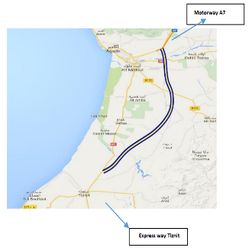
Public-Private Partnership (PPP) in Morocco
Project Under Study
Motorway Bypass of Agadir
Contracting authority | Ministry of equipment, Transport, Logistics and Water
Geographical location: | Agadir in the mid-southern of Morocco
Objectives | increase the supply of trade between the north and the south of the Kingdom support of development strategies in the region(Tourism, agriculture, food industry…)
Project Composition | 2 * 2 lane motorway in own site on 80 Km Restoration works on existing roads and tracks Exchangers Rest and service areas
Studies | Prefeasibility study: achieved Definition studies :achieved Trafic studies :achieved PPP Preliminary assessments : achieved
Estimated cost | 370 M$
Project duration | 02 years
Notes:
37

Slide 38
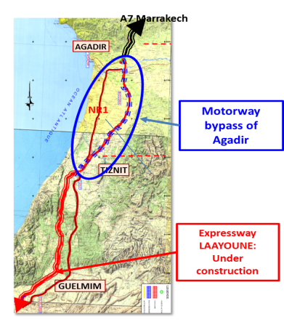
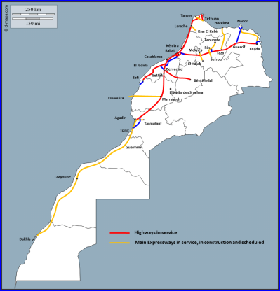
Motorway bypass of Agadir
Project Location
Notes:
38

Slide 39
Motorway Bypass of Agadir
Project Opportunities
At the international level: this axis is part of the Maghreb motorway itinerary and the Tangier-Lagos axis;
At the National level: This project increases exchanges between the north and south of the Kingdom;
At the Regional level: It will provide better service to the two regions concerned: Souss-Massa and Guelmim-Oued Noun because the project is a link between the A7 motorway and the Tiznit-Laayoune expressway;
At the Local level: It will constitute a natural bypass for the city of Agadir from the East for North-South flows and will improve the transport offer to Tiznit
Notes:
39

Slide 40
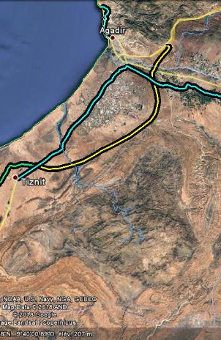
Motorway Bypass of Agadir
Project Description
The motorway bypass of Agadir is being developed over a 87 km length of road
Estimated cost : 370 MUSD
Progress of the studies:
    Technical study : Definition study approved
    PPP study: Feasibility study achieved
Technical specifications :
Category | L1
Earthworks | Length 87 Km in 4 sections
Excavated material : 6.4 MM3 | A7 – Express way : | 8.2 Km
Embankment : 4.8 MM3 | Express way – Biougra : | 16.4 Km
 | Biougraa – Belfaa : | 28.8 Km
 | Belfaa – Tiznit north : | 33.2 Km
Bifurcation | 1
Exchangers | 4
Service areas | 1
Crossings | 2( oueds Souss et Massa)
Operating system | Closed system
Operating center | 1
Toll station | 1 BPV + 4 BSE
Motorway bypass of Agadir
Notes:
40

Slide 41
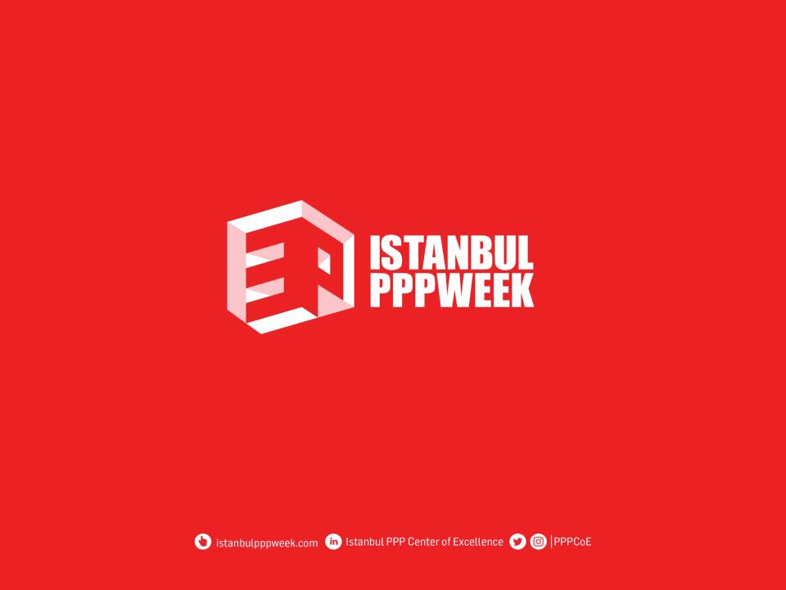
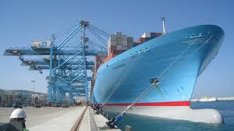

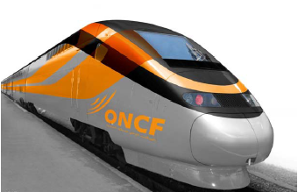

THANK YOU FOR YOUR ATTENTION
Mail: fancha@mtpnet.gov.ma

