Slide 1
Value for Money Assessments for Public-Private Partnership Projects
Istanbul PPP Week 2021
6 December 2021
Mark M. Moseley
Principal, MMM Infra
Mark.Moseley@MMMInfra.com

Slide 2
Outline of the Presentation
Introduction to Value for Money (VfM) Assessments
When are VfM Assessments Done during the PPP Project Cycle
Conducting Different Types of VfM Assessments
Issues with VfM Assessments
Resource Materials for VfM Assessments
Five main topics
MOSELEY INFRASTUCTURE ADVISORY SERVICES
Notes:
This slide outlines the five main sections of the presentation.
I also want to emphasise that there will be an opportunity for Q&A discussions at the end of the presentation, And com accordingly, I would very strongly encourage everyone in the audience to think of questions or comments that they would like to raise at the end of the presentation.

Slide 3
I. Introduction to Value for Money (VfM) Assessments
the new EPEC Guide to Public-Private Partnerships*, published by the European PPP Expertise Centre, states that a VfM assessment, in a PPP context, is a tool which allows a Contracting Authority to compare the value of a PPP project with other alternatives
this might involve, for example:
comparing a proposed PPP project with the alternative of a Traditional Infrastructure Procurement (TIP); or
comparing the proposal of one PPP bidder with that of another bidder
maximising Value for Money is a key objective of the PPP policy of many governments
accordingly, many countries require VfM assessments to be made for every PPP project
(*available at https://www.eib.org/en/publications/epec-guide-to-public-private-partnerships)
What is a VfM assessment and why is it important
MOSELEY INFRASTUCTURE ADVISORY SERVICES
Notes:
This slide introduces the VfM concept, using the definition found in the new EPEC Guide to Public-Private Partnerships.
(Note that VfM is a comparative tool).
The final bullet makes the point that VfM is critically important for PPP projects.

Slide 4
I. Introduction to VfM Assessments (cont.)
a VfM assessment involves looking at the risk-adjusted costs and benefits of the alternative delivery options, over the entire life of an infrastructure project
a VfM assessment attempts to compare the net present value of the costs/benefits of competing project options, taking into account the quantity and quality of infrastructure services being delivered, over time
a proper VfM assessment should include both:
a quantitative assessment (with complex financial model spreadsheets, showing adjusted costs/benefits, discounted to the present time); and
a qualitative assessment, dealing with those costs/benefits – such as environmental and social costs/benefits – which are difficult to quantify
The scope and nature of VfM assessments
MOSELEY INFRASTUCTURE ADVISORY SERVICES

Slide 5
I. Introduction to VfM Assessments (cont.)
because a VfM assessment considers the risk-adjusted costs and benefits over the entire life of an infrastructure project it is a particularly useful tool, at the initial stages of the Project Cycle, when comparing a PPP option with a TIP option
it forces the Contracting Authority to go beyond simply looking at ‘upfront’ costs of the TIP Public Sector Comparator (PSC) vs those of a PPP option
VfM assessments can be either forward-looking or retrospective
retrospective VfM assessments are often used by government performance auditors, after a PPP project has been completed, to assess whether taxpayer money has been spent efficiently and effectively
Examples of how VfM assessments are used
MOSELEY INFRASTUCTURE ADVISORY SERVICES

Slide 6
I. Introduction to VfM Assessments (cont.)
a VfM assessment is not the same as a Cost Benefit Analysis (CBA), although they have some similar features
a CBA is used to assess an individual project – unlike a VfM assessment, which is a comparative tool
both use quantitative and qualitative evaluations, and some of the evaluation processes are similar
VfM assessment considers the impact of financing structures on the total project cost – which is generally not done in a CBA
Value for Money is not the same as affordability
a project that is affordable (to the Contracting Authority and/or end-users) may still be poor Value for Money
assessing the prospective Value for Money of a project is not the same as achieving Value for Money
achieving VfM involves the Contracting Authority paying careful attention throughout the entire Project Cycle
Some common misperceptions
MOSELEY INFRASTUCTURE ADVISORY SERVICES

Slide 7
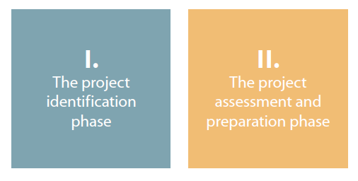
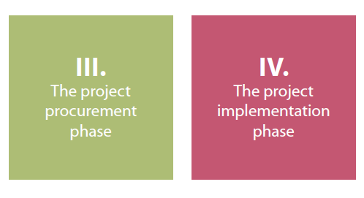
II. When are VfM Assessments Done
VfM assessment should be done throughout the PPP Project Cycle
the EPEC Guide to Public-Private Partnerships divides the PPP Project Cycle into four phases:
Phase I: the Project Identification Phase, during which the Contracting Authority identifies the proposed project and makes a preliminary determination as to whether it should be delivered as a PPP project
Phase II: the Project Preparation Phase, during which feasibility studies are prepared, risk allocation plans are developed and the proposed PPP Contract is drafted
Phase III: the Project Procurement Phase, during which the Project Company is competitively selected, followed by the Commercial Close and the Financial Close
Phase IV: the Project Implementation Phase, during which the Project Company constructs and operates the project, followed by the handback to the Contracting Authority
VfM assessments are used at key decision points in each of these four phases
MOSELEY INFRASTUCTURE ADVISORY SERVICES

Slide 8
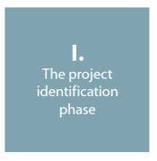
II. When are VfM Assessments Done (cont.)
during the Project Identification Phase, VfM assessments are primarily used by Contracting Authorities to make a preliminary, high-level, determination as to how the identified project might be delivered – as a TIP project, a PPP project, or by some other means
this ensures that, if the PPP option is chosen, the motivations to use a PPP approach are clearly defined
during this initial phase of the Project Cycle, quantitative data will be extremely limited – and the preliminary determination as to whether to use a PPP approach will, primarily, be based upon a qualitative VfM assessment
MOSELEY INFRASTUCTURE ADVISORY SERVICES

Slide 9
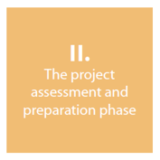
II. When are VfM Assessments Done (cont.)
during the Project Preparation Phase, VfM assessments are especially important
using additional information (gained through feasibility studies, market soundings and other means), a more informed, detailed and quantitative VfM assessment can be prepared to confirm – or reject – the initial determination to use a PPP delivery model for the project
the more detailed VfM assessment can also help inform the Contracting Authority’s affordability assessment
in addition, the more detailed VfM assessment can help to refine the risk allocation analysis, and thereby assist with the process of drafting the proposed PPP Contract
MOSELEY INFRASTUCTURE ADVISORY SERVICES

Slide 10
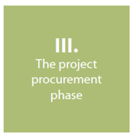
II. When are VfM Assessments Done (cont.)
VfM assessments are also used during the Project Procurement Phase
VfM assessments can be used as part of the bid evaluation process, to compare the competing bids, so as to ascertain which proposal presents the greatest value to the Contracting Authority
VfM assessments can also be used by the Contracting Authority during any negotiations – or competitive dialogue processes – with the bidders
many countries require that an updated VfM assessment to be done before making a decision to proceed to Commercial Close, i.e., the signing of the PPP Contract with the winning bidder
MOSELEY INFRASTUCTURE ADVISORY SERVICES

Slide 11
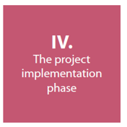
II. When are VfM Assessments Done (cont.)
VfM assessments can also be useful during the Project Implementation Phase
if a Contracting Authority receives, from the Project Company, a request for a renegotiation of the PPP Contract during the implementation of the project, a VfM assessment can help to guide the Contracting Authority as to the acceptability of any proposed modifications to the existing agreement between the parties
in addition, VfM assessments are frequently used by government performance auditors – as part of the standard implementation evaluation process – to determine if a PPP project has provided better value than the Public Sector Comparator, and to extract ‘lessons learned’ for future PPP transactions
MOSELEY INFRASTUCTURE ADVISORY SERVICES

Slide 12
III. Conducting VfM Assessments
most ‘forward looking’ VfM assessments are conducted either by the Contracting Authority itself or by a specialised team within the central government PPP Unit (as indicated, retrospective VfM evaluations are usually done by government performance auditors)
in any event, it is important for the Contracting Authority to ‘own’ the VfM assessment, in the sense of having a thorough understanding of both the details of the assessment process and the results of the analysis
as indicated, VfM assessments can be both qualitative and quantitative, on the basis that the assessments which take place early in the PPP Project Cycle are usually more qualitative in nature
Overview of the VfM assessment process
MOSELEY INFRASTUCTURE ADVISORY SERVICES

Slide 13
III. Conducting VfM Assessments – Qualitative Assessments
there are two types of qualitative VfM assessments:
suitability tests, to determine if a PPP approach is appropriate
assessments of unquantifiable benefits and costs
for a suitability test, a checklist is often used, to see if a PPP approach should be chosen, taking into account factors such as:
the country’s PPP legal and regulatory framework
public/private sector capacity to deliver the project as a PPP
public and political support for using a PPP approach for the project
when assessing unquantifiable benefits and costs, the Contracting Authority should start by identifying key objectives, such as, for example:
achieving improved quality and better service delivery
piloting new ways to reduce a project’s carbon footprint
Photo credit: Ernesto Eslava, on Pixabey
MOSELEY INFRASTUCTURE ADVISORY SERVICES

Slide 14
III. Conducting VfM Assessments – Quantitative Assessments
as indicated, quantitative VfM assessments can be used to compare a PPP approach with a TIP approach, and can also be used to compare different PPP proposals
during the initial phases of the Project Cycle, when comparing PPP vs TIP approaches, the key question is whether the value of the risks transferred to the Project Company outweighs the additional costs of private sector financing
it is important to compare the same levels of service delivery quality over the same period of time
during the Procurement Phase, quantitative VfM assessments can be used to compare the received bids against the ‘shadow bid’ developed by the Contracting Authority, and can also be used to compare the bidders’ proposals against one another
Photo credit: StockSnap, on Pixabey
MOSELEY INFRASTUCTURE ADVISORY SERVICES

Slide 15
III. Conducting VfM Assessments – Quantitative Assessments (cont.)
quantitative VfM assessments involve calculating the costs of each delivery option on a net present value basis
this is especially important when comparing PPP vs. TIP options, given the very different time profiles of costs payable by the Contracting Authority
accordingly, careful attention needs to be paid to the selection of an appropriate discount rate, to recognise the ‘time value of money’
project risks are usually reflected as adjustments to the anticipated cash flows associated with the project
the calculations for a quantitative VfM assessment are usually presented in sophisticated financial model spreadsheets
Photo credit: StockSnap, on Pixabey
MOSELEY INFRASTUCTURE ADVISORY SERVICES

Slide 16
IV. Issues with VfM Assessments – Qualitative VfM
qualitative VfM assessments involve the application of discretionary professional judgement – which can make such assessments susceptible to manipulation, in order to achieve a preferred result
great care must be taken to select the criteria on which to base the qualitative VfM assessment – and to properly weigh the relative priorities of the selected criteria
for example, should greater weight be given to social impact criteria vs. environmental impact criteria
the available evidence, on which to base a judgement, may be weak or non-existent
Photo credit: andreas160578, on Pixabey
MOSELEY INFRASTUCTURE ADVISORY SERVICES

Slide 17
IV. Issues with VfM Assessments – Quantitative VfM
a quantitative VfM assessment uses a long-term cash flow financial model to determine the net present value of the projects costs and revenues – which involves making multiple complex assumptions, including :
the adjustments to costs and revenues that should be made to recognise risk transfers to the private sector Project Company
the relative costs of product sector financing
the discount rate to be used to recognise the ‘time value of money’
because quantitative VfM assessments are presented in the form of detailed spreadsheets, they can provide a false perception that the assessments are highly accurate – when, in fact, they are dependant on a number of critical assumptions, as noted above
Photo credit: Goumbik, on Pixabey
MOSELEY INFRASTUCTURE ADVISORY SERVICES

Slide 18
IV. Issues with VfM Assessments – General
timing is critical:
if a VfM assessment is carried out too early in the Project Cycle, sufficient data may not be available – even for a preliminary qualitative assessment
if it is carried out too late, the assessment may not have any impact, since key decisions may have already been made
Vfm assessments are complex tasks, and the cost of undertaking the necessary work (particularly for quantitative assessments) may not be justifiable for a small project
because many countries require VfM assessments for all PPP projects, Contracting Authorities may regard them as a burdensome duty – with the result being that the assessments are not conducted with due diligence
Photo credit: 14995841, on Pixabey
MOSELEY INFRASTUCTURE ADVISORY SERVICES

Slide 19
IV. Issues with VfM Assessments – Recommendations
it is now considered ‘best practise’ to use both qualitative and quantitative VfM assessments to evaluate PPP projects and compare them with other project delivery options
for quantitative assessments, costs can be reduced by using standardised spreadsheet models; standardised risk adjustments; and standardised PPP Contract terms – but his must be done with care, recognising the diversity of PPP projects
having a specialised team undertake all of the comparative VfM assessments allows Contracting Authorities to benefit from the team’s prior experience with these complex tasks
Photo credit: delphinmedia, on Pixabey
MOSELEY INFRASTUCTURE ADVISORY SERVICES

Slide 20
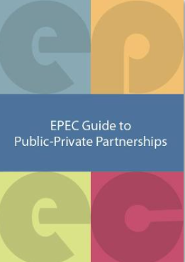
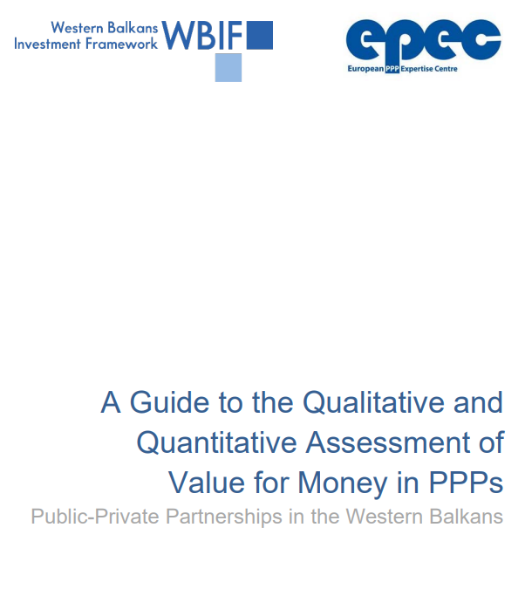
V. VfM Resource Materials
the EPEC Guide to Public-Private Partnerships, EPEC (2021) – available at https://www.eib.org/en/publications/epec-guide-to-public-private-partnerships
this very recent publication describes (in Chapter 2) how VfM assessments are used during the various phases of the PPP Project Cycle, and also provides a separate discussion (in Chapter 3) of the key issues associated with qualitative and quantitative VfM assessments
A Guide to the Qualitative and Quantitative Assessment of Value for Money in PPPs, EPEC (2018) – available at https://www.wbif.eu/storage/app/media/Library/8.%20Public%20Private%20Partnership/2.%202-Value-for-Money-Assessment-Guide-FINAL-310818.pdf
this additional EPEC guidance, designed for use in the Western Balkans, provides a series of tools and checklists for undertaking VfM assessments
MOSELEY INFRASTUCTURE ADVISORY SERVICES

Slide 21
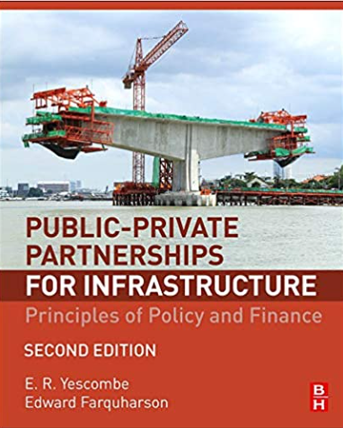
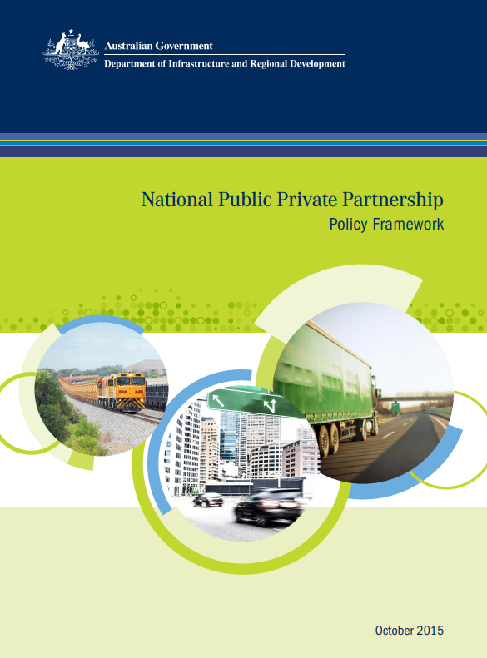
V. VfM Resource Materials (cont.)
Public-Private Partnerships for Infrastructure: Principles of Policy and Finance, Second Edition, by E. R. Yescombe and E. Farquharson (2018) – published by Butterworth-Heinemann, ISBN: 9780081007662
Chapter 8 of this book provides guidance on the use of VfM assessments throughout the PPP Project Cycle
National PPP Policy and Guidelines, Government of Australia (2015) – available at https://www.infrastructure.gov.au/sites/default/files/migrated/infrastructure/ngpd/files/National-PPP-Policy-Framework-Oct-2015.pdf
Volume 1 of this policy document discusses various delivery options for infrastructure projects, and explains how VfM assessments can be used as decision-making tools
Volume 4 provides a detailed description of the Public Sector Comparator test
MOSELEY INFRASTUCTURE ADVISORY SERVICES

Slide 22
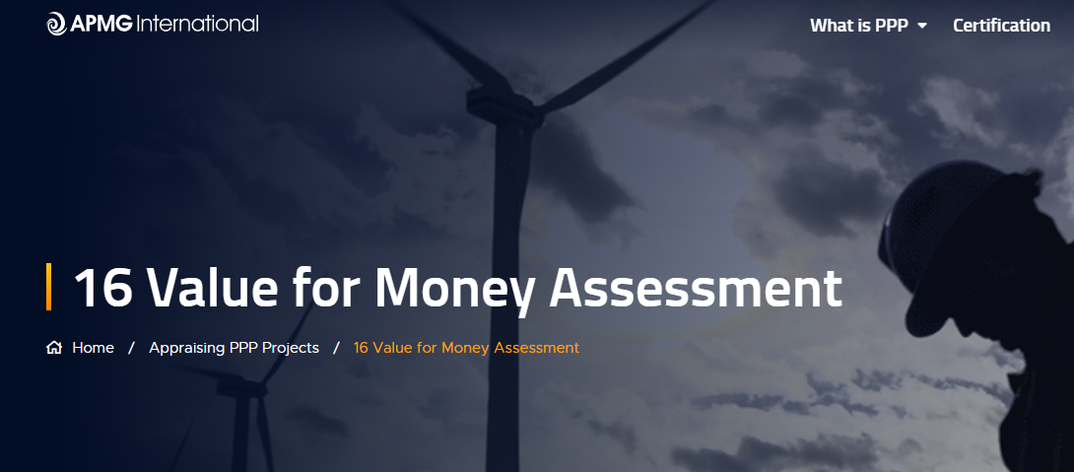
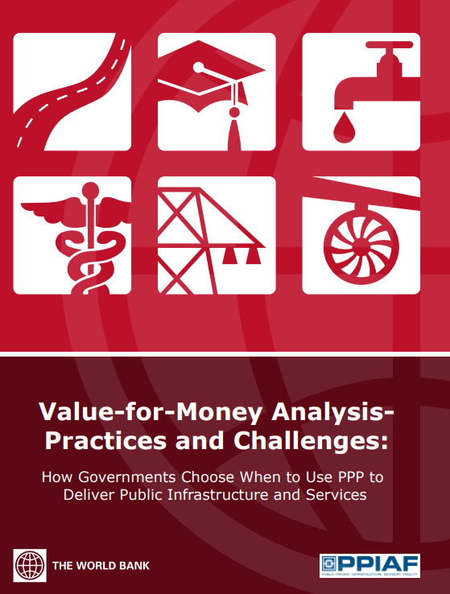
V. VfM Resource Materials (cont.)
the APMG Public-Private Partnership Certification Guide, APMG (2016) – available at https://ppp-certification.com/ppp-certification-guide/16-value-money-assessment
Chapter 4 of the Guide, dealing with “Appraising PPP Projects”, contains – in Section 16 – an outline of the processes used to conduct quantitative and qualitative VfM assessments
Value for Money Analysis – Practices and Challenges: How Governments Choose When to Use PPP to Deliver Public Infrastructure and Services, World Bank Group/PPIAF (2013) – available at https://documents1.worldbank.org/curated/en/724231468331050325/pdf/840800WP0Box380ey0Analysis00PUBLIC0.pdf
this World Bank report presents the findings from a debate amongst PPP practitioners, from both developed and emerging markets
MOSELEY INFRASTUCTURE ADVISORY SERVICES

Slide 23
Value for Money Assessments for Public-Private Partnership Projects
Istanbul PPP Week 2021
6 December 2021
Mark M. Moseley
Principal, MMM Infra
Mark.Moseley@MMMInfra.com
Notes:
And with that, I am very much looking forward to discussing any questions or comments which any of you may have in regard to the presentation.
Thank you for your attention.

