Slide 1
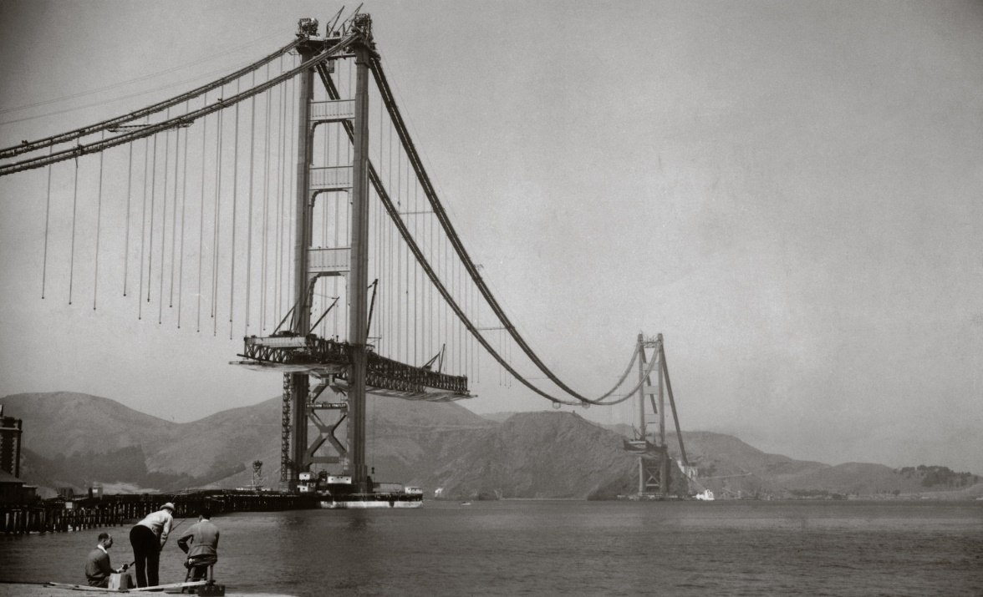
The Direct Employment Impact of Public Investment
December 7, 2021
Dr. Mariano Moszoro
Fiscal Affairs Department
NOT FOR QUOTE OR DISTRIBUTION

Slide 2
  Contribution to Chapter 2: “Public Investment for the Recovery” and Online Appendix 2.4
  Special thanks to David Amaglobeli, Raphael Espinoza, Paolo Mauro, and Cathy Pattillo for comments and suggestions, to Mouhamadou Sy for sharing his dataset, and to Juliana Gamboa and Riki Matsumoto for priceless research assistance

Slide 3
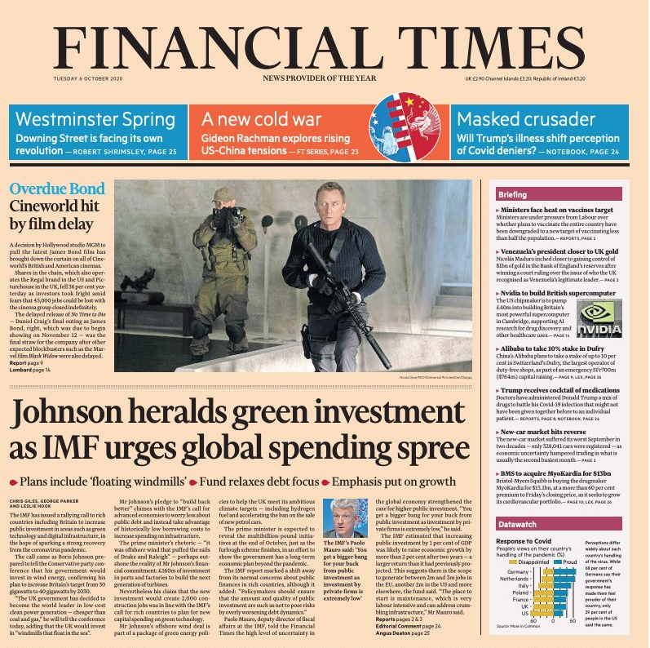
  Ample press coverage
  Disclaimer: No relation between the frontpage news ;)

Slide 4
Background and key question
  COVID-19: record-high unemployment, ~495 million FTE jobs lost in 2Q2020 (ILO 2020, September)
  Public works programs: Great Depression, ARRA...
  How many jobs can be created by increasing
  public investment?
    By sector
    By income group

Slide 5
Overview
  Scope
    Education/health, electricity, roads, and water & sanitation
    AEs and EMEs; extrapolation to LIDCs
4 sectors,
3 groups
  Methodology
    Public works contracted to construction companies (rarely government payroll)
    Large micro panel of construction companies: 1999-2017, +48k observations
    Estimate employment impact per US$1 million invested
micro
  Results
    Δ US$1 million → 3–7 jobs in AE, 10–17 jobs in EME, and 16–30 jobs in LIDC
    Green investment and R&D component → higher employment effect
    1% of GDP in public investment → +7 million jobs worldwide
macro

Slide 6
Data and methodology (1/2)

Slide 7
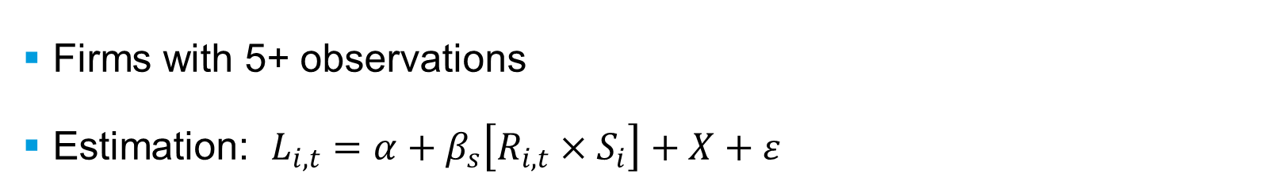
Data and methodology (2/2)
  Firms with 5+ observations
  Estimation: $L_{i,t}=α+β_{s}\left[R_{i,t}×S_{i}\right]+X+ε$
sector dummies
employment
avg immediate job content by sector
revenues

Slide 8
Immediate job content—EMEs
high labor mobility
low labor mobility

Slide 9

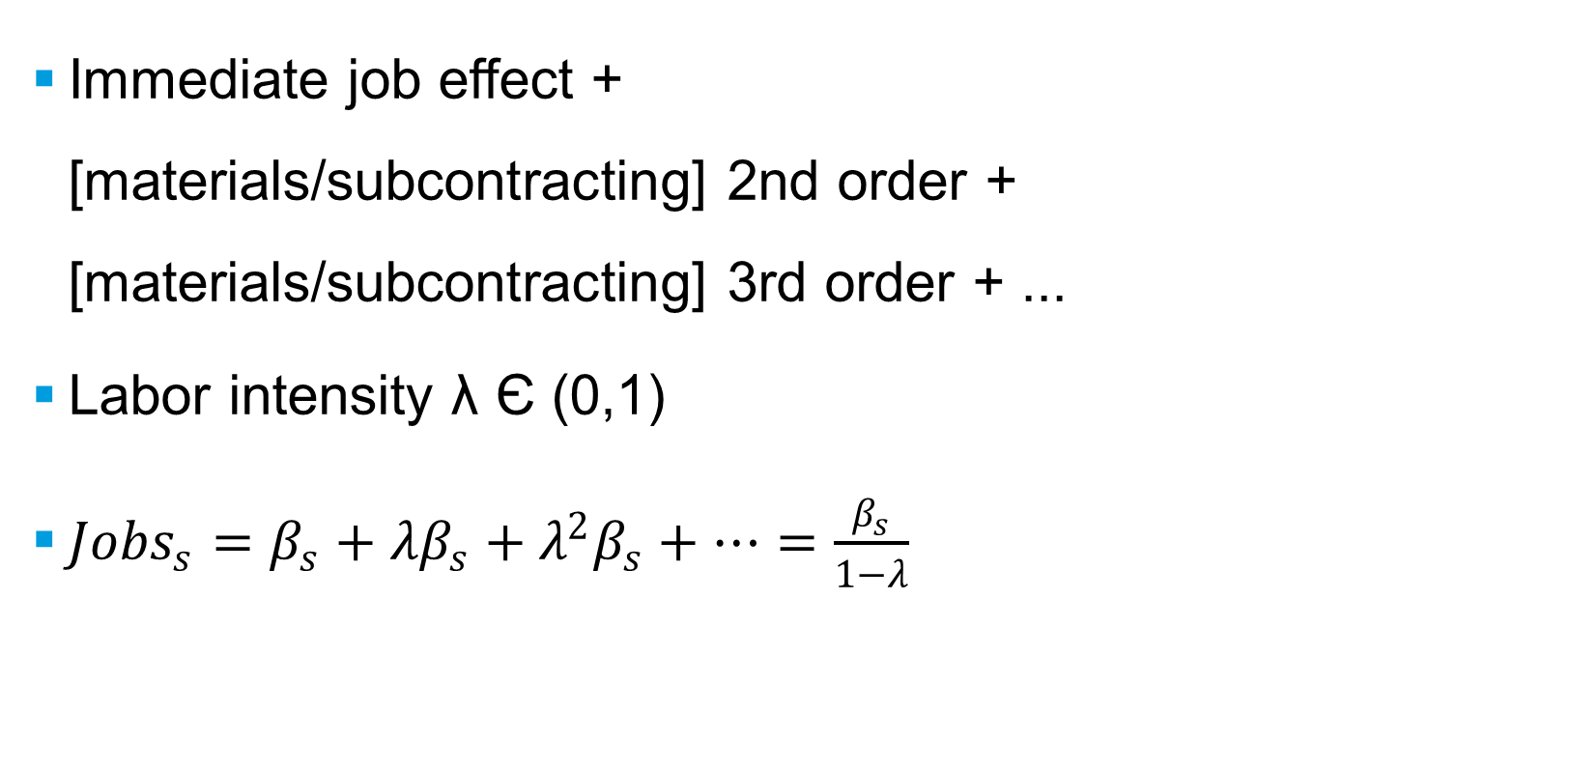
Supply-chain effects
  Immediate job effect +
  [materials/subcontracting] 2nd order + [materials/subcontracting] 3rd order + ...
  Labor intensity λ Є (0,1)
  ${Jobs}_{s}=β_{s}+{λβ}_{s}+{λ^{2}β}_{s}+…=\frac{β_{s}}{1−λ}$

Slide 10
Job content by sector—EMEs
β from models 1 & 2
and midpoint
example
λ = 0.65, 0.5, 0.35

Slide 11
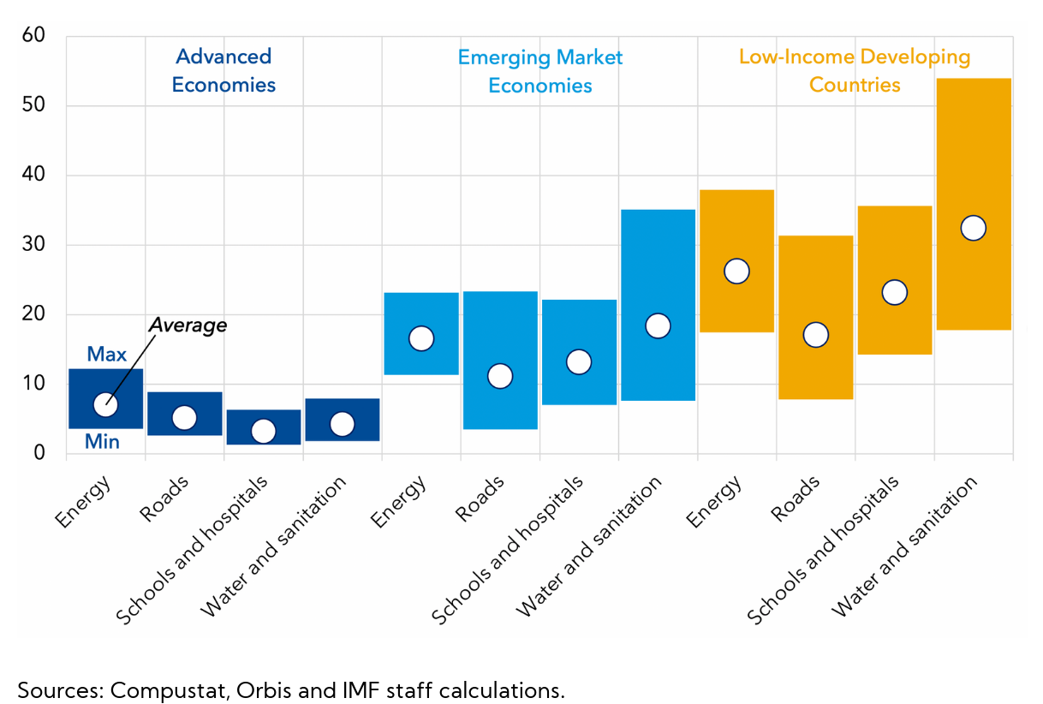
Summary—Job content per US$1 million

Slide 12
Job content in R&D—OECD counties

Slide 13
Welfare and political economy considerations
  State-Owned Enterprises (SOEs)
    3% of labor force, on average 30% higher job intensity than private firms
  PPPs not panacea for limited fiscal space
    ≠ “free” money: pecking order driven by profitability and enforcement of property rights
    Fiscal space ↔ state capacity necessary for effective regulation
    ... but if no fiscal space, state capacity likely weak too → private sector unlikely to fill void
  Policies on greening the recovery ought to be carefully designed to avoid backlash
    Short-term labor intensive (Garrett-Peltier 2017); but not all (Popp et al. 2020)
    Some green investment also not job rich in the long term and require specific skills
    Green investment = global welfare gains (Hicks-Kaldor); debatable Pareto efficiency for LIDCs

Slide 14
Conclusions
  US$12T in fiscal actions, 1/2 above the line: ~2X than in GFC 2008-2009
  1% of GDP in public investment in AEs and EMEs → 7M jobs worldwide
  Green and R&D content → higher employment effect
  Estimates likely underestimated:
    5+ observations (filtered cyclical companies)
    Effect convex in 1/income (for LIDCs)
    Indirect labor impact and spillovers (incl. Keynesian multipliers)
    Maintenance likely higher than new projects
  Tool for policymakers and for country advice (TA, country teams)

Slide 15
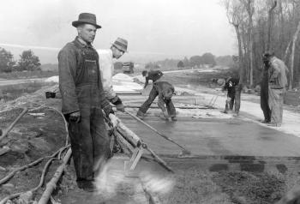
Thank you!

Slide 16
Links
  Working paper: “The Direct Employment Impact of Public Investment”
  https://www.imf.org/en/publications/wp/issues/2021/05/06/the-direct-employment-impact-of-public-investment-50251
  IMF Chart of the Week: “Putting Public Investment to Work”
  https://blogs.imf.org/2021/08/11/putting-public-investment-to-work/

Slide 17
Supportive materials

Slide 18
Immediate job content—AEs

Slide 19
Job content by sector—AEs

Slide 20
Job content by sector—LIDCs

Slide 21
Summary—Job content per US$1 million

