Slide 1
ISTANBUL PPP WEEK November 2020
Overview of Turkish PPP Market &
The Role of the Ministry of Treasury and Finance
Kerem Dönmez
Republic of Turkey
Ministry of Treasury and Finance
General Directorate of Foreign Economic Relations
Head of PPP Department

Slide 2
Content
Infrastructure GAP & Need for PPPs
PPPs as a Tool for Private Participation in Infrastructure
Overview on Turkish PPP Market
Credit Enhancement Tools: De-risking PPP Projects
Turkish Treasury’s Role
Transactions under “Debt Assumption Commitment”
Major PPP Projects in the Portfolio

Slide 3
Infrastructure GAP & Need for PPPs
Rapid urbanization and population growth
Need for more schools, hospitals, roads and clean energy grids...
Need for Closing the infrastructure gap as quickly as possible
Higher Economic Growth
Better Human Capital, connectivity within the country and across the border.
Underinvestment due to budget constraints.
Sustainable development of the country directly depends on building cost efficient, smart, and sustainable infrastructure.

Slide 4
PPPs as a Tool for Private Participation in Infrastructure
Feasible projects, reasonable IRR, stable or guaranteed revenue
An attractive tool to increase private sector’s participation
less construction time, better value for money for citizens
Less pressure on governments budget
Knowledge sharing, reach broader investors
IFI’s involvement
Clear, conducive, easy to implement
Institutional and legal frameworks

Slide 5
Overview of PPP Market in Turkey
Source: Presidency of Strategy and Budget https://koi.sbb.gov.tr/Main_EN.aspx

Slide 6
Overview of PPP Market in Turkey
Build-Operate-Transfer (115 projects, 46%)
Law no 3996, 3465, 3096
Motorway, airport, customs, power plant
Transfer of Operating Rights (109 projects, 44%)
Law no 4046, 5335, 3096, 4458
Airport, port, power plant, electricity distribution
Build-Lease-Transfer (20 projects, 8%)
Law no 6428, 5396, 652, 351
Hospital complex, dormitory, school
Build-Operate (5 projects, 2%)
Law no 4283, thermal power plant
Source: Presidency of Strategy and Budget https://koi.sbb.gov.tr/Main_EN.aspx

Slide 7
Overview of Turkish PPP Market in Turkey
TRANSPORT
HEALTH
CUSTOMS
ENERGY
PUBLIC INSTITUTIONS
MINISTRY OF TRANSPORT AND INFRASTRUCTURE
MINISTRY OF HEALTH
MINISTRY OF TRADE
MINISTRY OF ENERGY AND NATURAL RESOURCES
DECISION
AUTHORITY
PRESIDENTIAL DECREE
RELATED
INSTITUTIONS
PresIdency of Strategy and Budget
MINISTRY OF TREASURY AND FINANCE
PPP PREPERATION
FEASIBILITY & APPROVAL
Technical
Financial
Economic
TENDER
CONTRACTING
Strategy Papers
Medium Term Program
Sector Strategies
Social
Contract Drafting
Technical Specification
Debt Assumption Procedures
SPV Establishment
Land Delivery
Financial Closure
CONSTRUCTION & OPERATION

Slide 8
Credit Enhancement Tools: De-risking PPP Projects
Implementing Agencies: Revenue Guarantee
Energy Operation oriented input / output guarantee, payment obligations
Transportation Minimum revenue guarantee, land expropriation etc.
Health Lease and service payments, several compensations etc.
Overall Conditional specific compensations, several project specific liabilities
Ministry of Treasury and Finance
Debt assumption commitment
VAT, stamp taxes & duty exemptions
Other
«Step-in» rights for lenders
English law
International arbitration
Funds
Lender
Borrower
Repayment
Credit Enhancements
Capital Sources

Slide 9
Turkish Treasury’s Role by Function
Contingent liability management
Feasibility reviews in terms of economic and financial conditions
Monitoring of withdrawals and repayments of financing
Analysis of the potential impact of contingent liabilities
Provision of debt assumption commitment
Pre and Post Tender Contract Assessment
Negotiations on the Finance Documents
Financial Closure, Debt Assumption Commitment and Hedge Cost Limits
Surety from shareholders equal to at least 110% of the highest debt service amount
Accounting for and reporting debt assumption commitments

Slide 10
Turkish Treasury’s Role
Pre-tender Measures
Feasibility reviews in terms of economic and financial outcomes
Limits on Eligibility: Minimum of 1 billion TL investment, (500 million TL for healthcare and education projects)
Capital Requirements
No less than 30 % of the project must be financed with capital
Post-tender Measures
Debt Assumption Commitment
Full debt assumption in case of SPV default
Two-sided monitoring: Financiers and Rewarding Agency
Monitoring responsibility shared with the most qualified Financial Intermediaries

Slide 11
Transactions under Debt Assumption Commitment
Project Name | PPP Model | Debt Assumption Agreement Date | Total Project Cost | Loan Amount | Loan Amount (USD equivalent)
Eurasia Tunnel | BOT | 12.11.2012 | $ 1.239.863.000 | $ 960.000.000 | 960.000.000
Northern Marmara Motorway (Odayeri-Paşaköy inc. Bridge) | BOT | 05.13.2014 | $ 3.456.244.239 | $ 2.318.000.000 | 2.318.000.000
 |  | 03.11.2016 |  | $ 420.000.000 | 420.000.000
Gebze - Orhangazi - İzmir Motorway (inc. Bridge) | BOT | 06.05.2015 | $ 6.312.392.047 | $ 4.956.312.328 | 4.956.312.328
Çanakkale - Malkara Motorway | BOT | 03.16.2018 | € 3.159.721.036 | € 2.265.000.000 | 2.799.993.000
Ankara - Niğde Motorway | BOT | 06.07.2018 | € 1.462.628.902 | € 1.114.962.012 | 1.310.749.341
Northern Marmara Motorway – Kurtköy-Akyazı Section | BOT | 16.09.2019 | $ 3.661.656.404 | $ 2.840.000.000 | 2.840.000.000
Northern Marmara Motorway – Kınalı-Odayeri Section | BOT | 16.09.2019 | $ 2.072.257.009 | $ 1.595.000.000 | 1.595.000.000
TOTAL = |  |  |  |  | 17.200.054.669

Slide 12
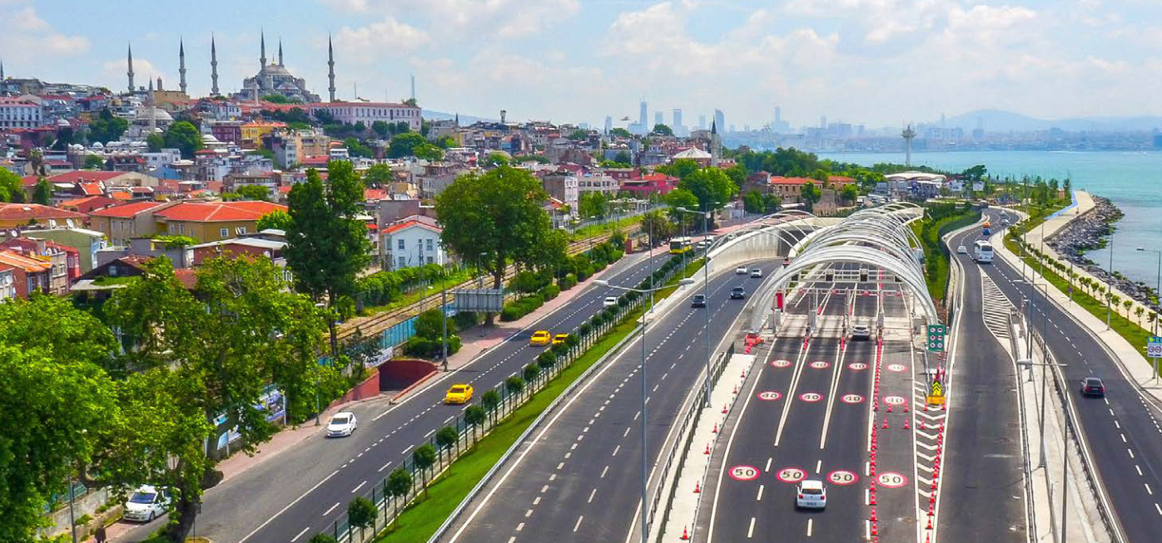
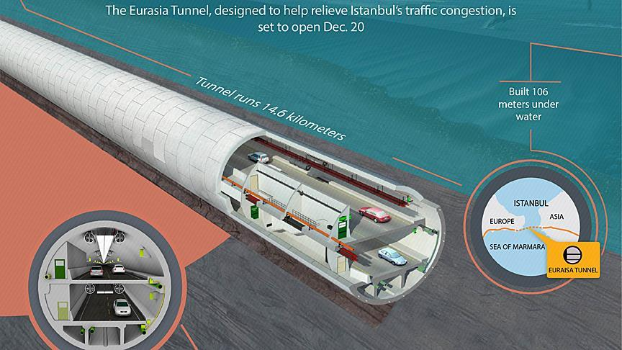
EURASIA TUNNEL
BOT model
Double-deck underwater tunnel connecting
Asia & Europe in Istanbul
Cost USD 1.2 bln, loan USD 960 mln
Construction started in 2011
Operation started in 2016
Operation period: 26 years

Slide 13
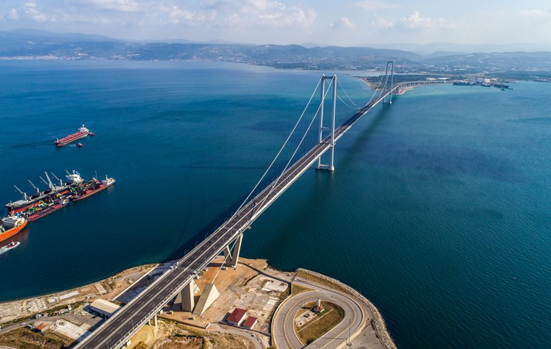
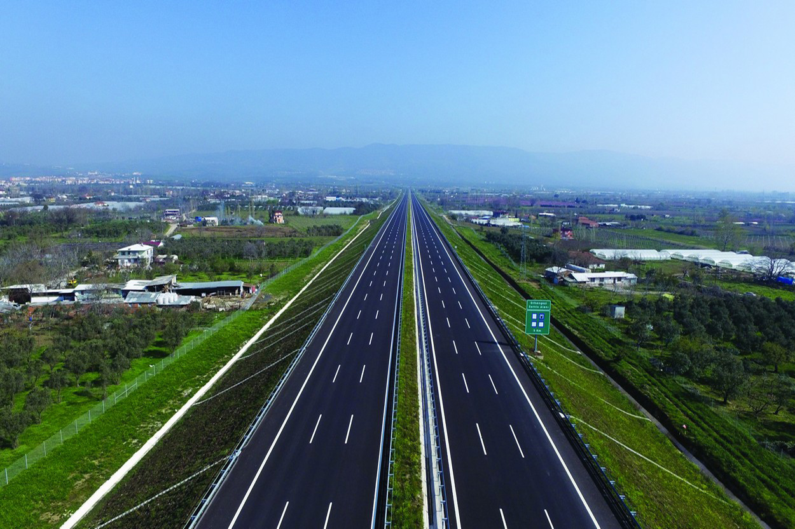
GEBZE IZMIR MOTORWAY
BOT model
Over 400 km of motorway - Connecting İstanbul, Bursa and İzmir
İzmit Bay Suspension Bridge - 4th longest in the world
Total Investment Amount: USD 6.3 bln, Loan: USD 5 bln
Partial financing is applied and in 2015 financial closure with refinancing
Operation period: 15 years

Slide 14
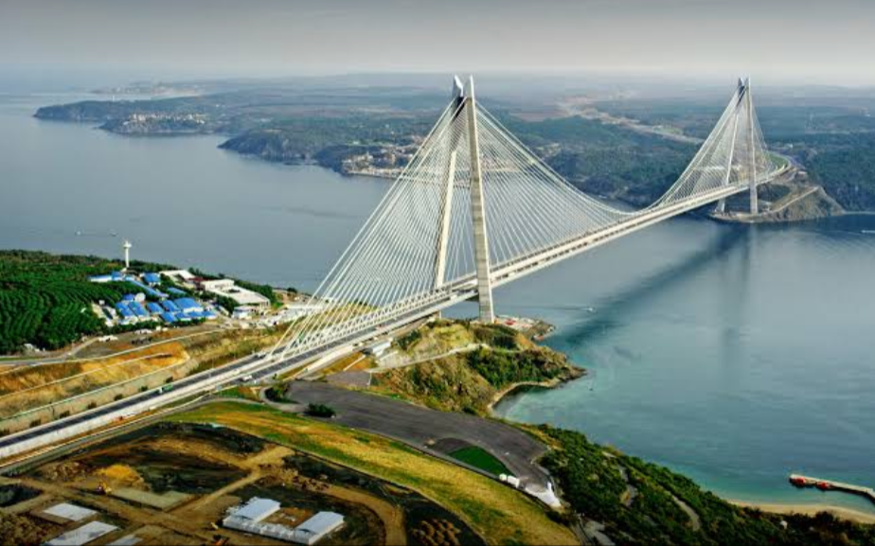
Yavuz Sultan Selim Bridge
Total length is 95 km including 3rd Bosphorus Bridge
Total project cost USD 3.5 bln / Loan amount USD 2.7 bln
It has 2x4 lanes of motorway and 2x1 lanes of railway
Inauguration was in Aug. 2016
Operation period: ~ 7 years and 9 months

Slide 15
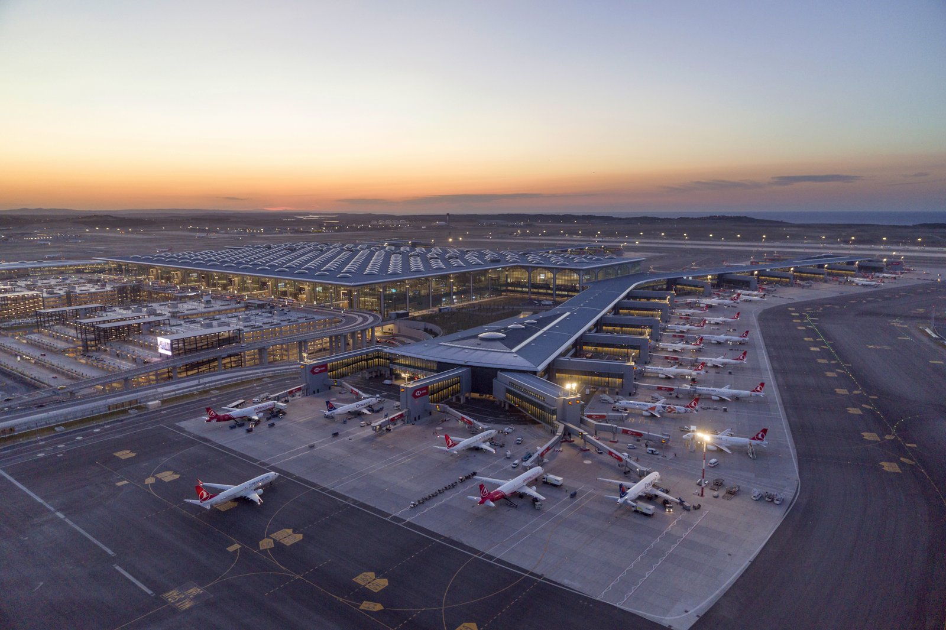
ISTANBUL AIRPORT
BOT model
Debt assumption for €4.5 bln is provided by the Administration (SOE)
25 years operation period, contracted in 19 Nov. 2013
Contract Value: EUR 22 bln (excl. VAT)
4 phases of construction, initial phase completed
150 million passengers annual capacity, initially 90 million passengers per year

Slide 16
Thank you for your attention

