Slide 1
Albania The role and magnitude of PPPs
PPP WEEK ISTANBUL
DECEMBER 6-10, 2021
Ms. Ina Zeqaj, Head of Concession/PPP Monitoring Unit

Slide 2
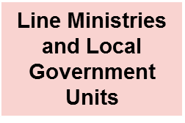
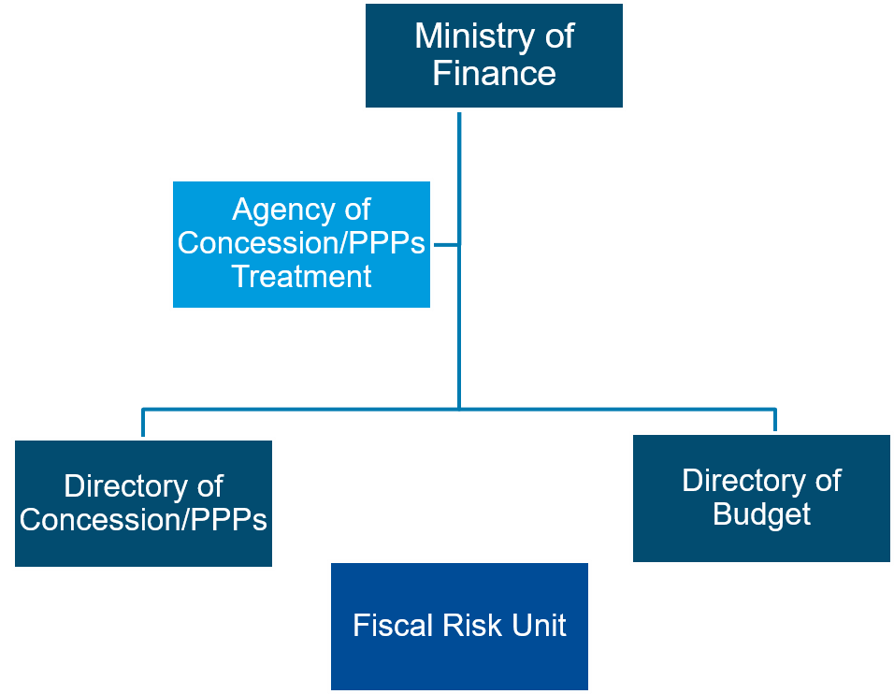
LEGAL FRAMEWORK
Legal framework for Concession/PPPs in Albania | Institutional framework for Concession/PPPs in Albania
Law no. 125/2013 “On Concessions and Public Private Partnership” (amended with Law no.50, dated 18/07/2019). The PPP legal framework amendment consist on: Repeal of unsolicited proposal disposal on most of the sectors starting from 1st of October 2019; Repeal of bonus points disposal for unsolicited proposals Repeal of exclusion disposal from law 125/2013 for roads of national interest Strengthening the control of fiscal implications of concession/PPP contracts; Major project preparation technical support shall be approved by a committee composed of several Ministers
2. Decision no. 575, dated 07/10/2013 “On approval of rules for evaluation and awarding of concessions / public private partnerships”(amended)

Slide 3
TREND OF CONCESSION/PPP PROJECTS IN ALBANIA
After the 2000s, there was a great demand for the application of concessions and public-private partnerships by the Albanian government, in order to finance public investments and build public infrastructure.
During the years 2005-2013, in order to increase the energy production capacity of the Albanian economy, a considerable number of contracts have been signed for the construction of new HPPs in unused hydro resources.
After 2013, a total of 50 concession / PPP contracts were signed in sectors with significant impact on economic development and ensuring sustainable economic growth such as education, health, environment and fiscal control.

Slide 4
CONCESSION/PPP CONTRACTS SIGNED
In 2020, the total number of concession / PPPs contracts = 226 (35 % of GDP for 2020).
There are 14 government funded, and 212 user funded Concession/PPP Contracts.
17 % of the contracts approved in total are solicited proposal by the contracting authorities. 83 % are unsolicited proposal.
The amended law ‘For Concession/PPPs’ has removed unsolicited proposals for roads and restricted the use of unsolicited proposals for the distribution of ports, airports, the generation and distribution of electricity or heat, and the distribution of natural gas. This has been emphasized by the various missions of the World Bank and the IMF in the previous meetings held at the Ministry of Finance and Economy and various state institutions.

Slide 5
INVESTMENT VALUE TO GDP
The cumulative investment weight for concession / PPP projects to GDP has been increasing over the years, and currently this portfolio accounts for about 35% of GDP for 2020.

Slide 6
CONTRACTS BY CONTRACTING AUTHORITY
The Contracting Authority that has the majority of signed contracts is Ministry of Infrastructure and Energy and the sector that has the largest share of contracts in number and value is the energy sector with 186 contracts, worth 419.4 billion ALL.

Slide 7
ROLE OF MINISTRY OF FINANCE AND ECONOMY
In project selection/appraisal and prioritization:
The amended law no.50, dated 18/07/2019, aims to increase the control of the Ministry responsible for Finance during the preparation phase of the Concession / PPP projects, to keep under control the fiscal commitments undertaken by the Contracting Authorities in order to minimize their impact on the budget. The Ministry responsible for Finance evaluates, approves concession/ PPP projects in relation to fiscal, individual or group implications for budget expenditures, budget deficit, public debt sustainability and contingent liabilities.
Project approval:
Any substantial change in the feasibility study phase of the project (which is reflected in draft-contract) but also in the concession / PPP contracts, should be evaluated and approved in advance by Ministry responsible for Finance.
Fiscal risks monitoring:
In order to strengthen financial discipline and monitor fiscal and budgetary risks, including the risks arising from concession / PPP contracts, and to eliminate any unforeseen implications of the State Budget the Contracting Authorities report to the Concession/PPP Directorate according to the Guideline no.35 date 12.12.2019 of Minister of Finance and Economy, regarding the performance of the concession contract and the risks these contracts implicate. According to the provisions of article 10 of Law no.125/2013 “On Concessions/PPPs” as amended, Ministry of Finance and Economy through Concession Directorate elaborate the information reported from Authorities and make recommendations where appropriate.
Reporting of PPPs:
In order to enhance the transparency to the public prepares, the Law no.125/2013 “On Concessions/PPPs” as amended foresees that according to the periodical information received from the Contracting Authorities, MoFE prepares an annual report on the progress of active concession / PPP contracts, as an annex to the annual budget implementation report, in accordance with the legislation in force for the management of the budget system

Slide 8
FISCAL RULES
The Law no.9936 date 26.06.2008 “For budget system management in the Republic of Albania” as amended, foresees two fiscal rules regarding the concession/ppp contracts
The total amount of annual net payments, made by general government units, which result from the concession contract or public private partnership (PPP), as a rule, should not exceed the limit of 5 percent of the actual tax revenue of the year budget predecessor.
The Assembly, in the annual budget law, approves the ceiling of the total value of contracts as a percentage of Gross Domestic Product (GDP), for all existing concession projects / PPPs and those recently contracted during the current budget year.

Slide 9
FISCAL RULES

Slide 10
ISSUES, CHALLENGES, RECOMMENDATIONS OF INTERNATIONAL INSTITUTIONS
The International Monetary Fund, through ongoing technical assistance missions, has made ongoing recommendations regarding the improvement of the legal framework for concessions / PPPs and the gatekeeper role of the Ministry of Finance and Economy in relation to these projects.
Recommendations | Actions
Better align process for assessing, prioritizing and approving PPPs and major public investment projects | This recommendation is addressed through the amendment of law no. 125/2013, which has strengthened the role of the Ministry of Finance and Economy in approving of these projects.
Enhance the value for money assessment of major projects | MoFE has requested the assistance of the IMF for the development of a methodology with detailed steps for the evaluation of projects which includes value for money
Strengthen the gatekeeping role of the MFE | MoFE has update the template of Annexes whereby the Authorities report the progress of contracts and the risks that are materialize or are likely to materialize.
Enhance the coverage, transparency and user-friendliness of the PPP/Concessions Register | Working on. Collecting missing contractual data and financial annexes.
Expand the coverage and scope of PPP monitoring report | MoFE has prepared the first Concession/PPPs Monitoring Report for 2019 which includes information for 10 concession / PPP contracts. For 2020, MoFE has expanded the coverage and information for 52 concession / PPP contracts was included in the Annual Report. For the future the aim of MoFE is to prepare an annual summary report on the monitoring of all concession/PPP contracts.

Slide 11
THANK YOU!

