Slide 1
ESTHER LODUGNON
DEPUTY EXECUTIVE SECRETARY
NATIONAL PPP STEERING COMMITTEE
IVORY COAST

Slide 2
PROMOTIONAL PPP PIPELINE PROJECT PRESENTATION
NAME OF PROJECT
LINE 1 OF ABIDJAN METRO
NAME OF GOVERNMENT SPONSOR
MINISTRY OF TRANSPORT
DEFINE THE SECTOR
TRANSPORT SECTOR
PROJECT TYPE
GREENFIELD PROJECT
ESTIMATED PROJECT RETURN
Not available

Slide 3
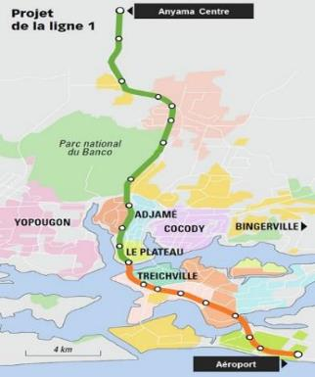
PROMOTIONAL PPP PIPELINE PROJECT PRESENTATION
VALUE of PROJECT
1,6 BILLION USD
PROJECT LOCATION :
CITY OF ABIDJAN, FROM THE NORTH TO THE SOUTH
OPPORTUNITY FOR PRIVATE SECTOR INVOLVEMENT
DESIGNING
BUILDING
OPERATING
MAINTAINING
LAST UPDATED FILE RELATED TO PROJECT
SEPTEMBER 2018

Slide 4
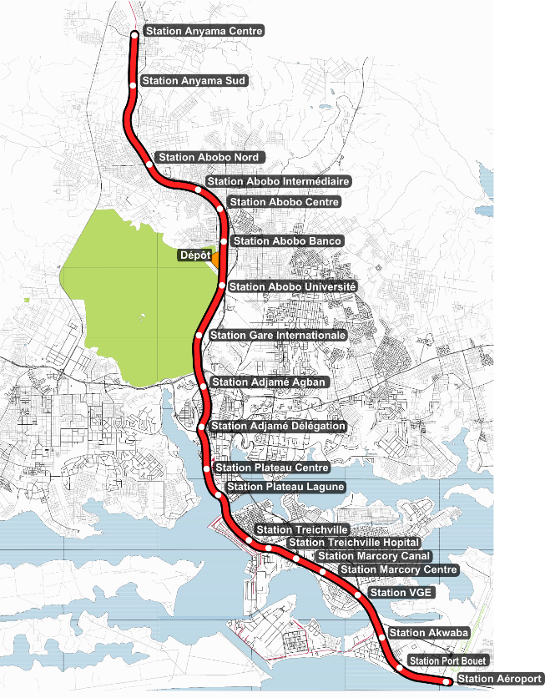
PROJECT DESCRIPTION
Design, realization, operation and maintenance of a dedicated railway platform on the north-South Axis Railway of urban transit along the north-south axis of the city of Abidjan
37.5 km of railroad tracks built in 2 phases:
First phase of the station in the Centre of the station at the lagoon Plateau, giving rise to the commissioning No. 1 (Mes 1) in September 2022
Second phase of the station Plateau Lagoon at the airport station, giving rise to the commissioning No. 2 (Mes 2) in November 2023
20 stations
7 communes served
More than 500 000 passengers per day
Average price of ticket selected for studies and sizing: 500 f CFA zonal.

Slide 5
Project Stage Info
Stage 1: Initial Government Announcement
PROJECT LOOKING FOR ADDITIONAL PPF ASSISTANCE NO
PROJECT LOOKING FOR ADDITIONAL MDB ASSISTANCE NO
IS PROJECT MULTI JURISDICTIONAL? NO

Slide 6
Stage 2: Project Investigation
VALUE 1.6 BILLION USD
INDICATIVE FUNDING SOURCE LOAN FROM THE FRENCH TREASURY + COMMERCIAL LOAN GUARANTEED BY FRENCH IMPORT/EXPORT AGENCY
HAVE ANY EXTERNAL ADVISORS BEEN APPOINTED YET YES
DETAILS OF ADVISORS APPOINTED
- Legal advisers (2)
- Finance advisers (2)
- Technical advisers (1)
IS THE PROJECT CONTAINED IN NATIONAL/SUB NATIONAL INFRASTRUCTURE PLAN OR STRATEGY YES

Slide 7
Stage 3: Start of Project Feasibility / Business Case
LEGAL ADVISORS APPOINTED FIDEIS LEGAL
FDKA
FINANCIAL ADVISORS APPOINTED E&Y
AXELCIUM
TECHNICAL AND OTHER ADVISORS (INC PROJECT PREPARATION FACILITY) APPOINTED SETEC
IS A BUSINESS CASE BEING PREPARED? Yes
BUSINESS CASE PREPARED BY Government and its Advisors

Slide 8
Stage 4: Project Feasibility / Business Case Complete
IS THE BUSINESS CASE COMPLETE? NO
BUSINESS CASE COMPLETION DATE DECEMBER 2018

Slide 9
Stage 5: Government Approval / Procurement Stage
GOVERNMENT APPROVALS OBTAINED Government approvals have been obtained.
REVENUE SOURCE Availability Payment
REVENUE SOURCE DESCRIPTION To be determined
LENGTH OF CONTRACT (YEARS) 7 Years
LENGTH OF CONTRACT ADDITIONAL INFORMATION The length can be increased according to the feedback from the first 7 years of operations.

Slide 10
Stage 6: Successful / Preferred Proponent
ROLE OF 3RD PARTIES Design, Build, Operate
SUCCESSFUL PROPONENT/CONSORTIUM STAR (consortium)
LEADING CONSTRUCTION COMPANIES
Bouygues Construction
Alstom
Colas Rail
OPERATORS
Keolis

Slide 11
Stage 6: Successful / Preferred Proponent
ESTIMATED CONSTRUCTION COMMENCEMENT August 2019
CONSTRUCTION PROGRAM TIMELINE Construction phase of 3-4 years :
First phase from August 2019 to September 2022
Second phase from Auguts 2019 to November 2023
ESTIMATED OPERATING/OPERATING CONTRACT COMMENCEMENT September 2022

Slide 12
PROMOTIONAL PPP PIPELINE PROJECT PRESENTATION
NAME OF PROJECT
ORE TANKER TERMINAL AT THE PORT OF ABIDJAN
NAME OF GOVERNMENT SPONSOR
MINISTRY OF TRANSPORT
DEFINE THE SECTOR
TRANSPORT SECTOR
PROJECT TYPE
BROWNFIELD PROJECT
ESTIMATED PROJECT RETURN
Not available

Slide 13
PROMOTIONAL PPP PIPELINE PROJECT PRESENTATION
VALUE of PROJECT :
USD MILLION 133
PROJECT LOCATION :
CITY OF ABIDJAN
OPPORTUNITY FOR PRIVATE SECTOR INVOLVEMENT :
FINANCING
BUILDING
OPERATING
LAST UPDATED FILE RELATED TO PROJECT:
MAY 2018

Slide 14
PROJECT DESCRIPTION
OBJECTIVE: Modernizing the existing infrastructure, in order to:
increase the port’s operational capacities
cater for bulk carriers with a 12-meter draught
meet the demand of the mining operators from the hinterland
TYPES OF ORES:
Cement
Zinc
Maganese
Nickel
TWO-PHASE PROJECT:
Phase #1: Emergency investments and infrastructure works (Deepening of berths 13 and 14, dredging works, renovating storage areas)
Phase #2: Complementary extension works (building 2 new berths with a 14-meter draught, developing an 8 ha ore handling area, building a storage warehouse, installing conveyor belts, procuring equipement)

Slide 15
Project Stage Info
Stage 1: Initial Government Announcement
PROJECT LOOKING FOR ADDITIONAL PPF ASSISTANCE NO
PROJECT LOOKING FOR ADDITIONAL MDB ASSISTANCE NO
IS PROJECT MULTI JURISDICTIONAL? NO

Slide 16
Stage 2: Project Investigation
VALUE USD MILLION 133
INDICATIVE FUNDING SOURCE EQUITY, SENIOR DEBT AND SUBORDINATED DEBT
GOVERNMENT PARTICIPATION
HAVE ANY EXTERNAL ADVISORS BEEN APPOINTED YET YES
IS THE PROJECT CONTAINED IN NATIONAL/SUB NATIONAL INFRASTRUCTURE PLAN OR STRATEGY YES

Slide 17
Stage 3: Start of Project Feasibility / Business Case
LEGAL ADVISORS APPOINTED FIDEIS LEGAL
FINANCIAL ADVISORS APPOINTED AXELCIUM
TECHNICAL AND OTHER ADVISORS (INC PROJECT PREPARATION FACILITY) APPOINTED TERRABO
IS A BUSINESS CASE BEING PREPARED? YES
BUSINESS CASE PREPARED BY GOVERNMENT - PRIVATE SECTOR

Slide 18
Stage 4: Project Feasibility / Business Case Complete
IS THE BUSINESS CASE COMPLETE? YES
ESTIMATED RETURN ON EQUITY (%) 12.11%

Slide 19
Stage 5: Government Approval / Procurement Stage
GOVERNMENT APPROVALS OBTAINED GOVERNMENT APPROVALS HAVE BEEN OBTAINED.
REVENUE SOURCE ORE-RELATED TRAFFIC
REVENUE SOURCE DESCRIPTION USER PAYMENTS
LENGTH OF CONTRACT (YEARS) 20 YEARS
LENGTH OF CONTRACT ADDITIONAL INFORMATION

Slide 20
Stage 6: Successful / Preferred Proponent
SUCCESSFUL PROPONENT/CONSORTIUM SEA INVEST
EQUITY INVESTORS
SEA INVEST
LEADING CONSTRUCTION COMPANIES SEA INVEST
OPERATORS
SEA INVEST

Slide 21
Stage 6: Successful / Preferred Proponent
ESTIMATED CONSTRUCTION COMMENCEMENT Q1 2019
CONSTRUCTION PROGRAM TIMELINE PHASE #1: 24 MONTHS
PHASE #2: 18 MONTHS
ESTIMATED OPERATING/OPERATING CONTRACT COMMENCEMENT Q4 2022

Slide 22
THANK YOU!
E-MAIL

