Slide 1
Dr. Emmanuel Onwodi, Ph.D.
DIRECTOR, TRANSPORT INFRASTRUCTURE DEPARTMENT
INFRASTRUCTURE CONCESSION REGULATORY COMMISSION

Slide 2
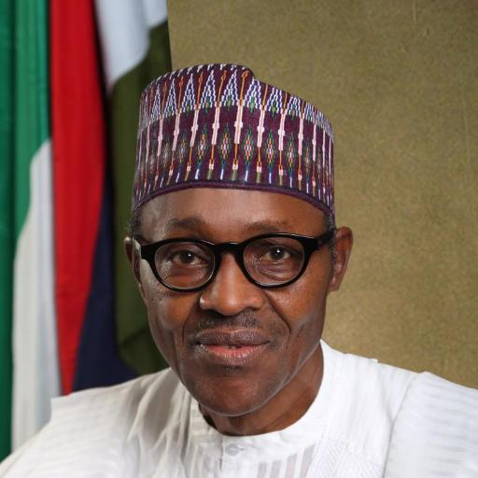
Political Commitment
EXCERPTS OF SPEECH OF PRESIDENT
MUHAMMADU BUHARI
AT THE
THE 55TH GENERAL CONFERENCE OF THE NIGERIAN BAR ASSOCIATION
AUGUST 23, 2015
“It becomes even more important that our legal system is made to function smoothly speedily and effectively. Nigeria is now in a situation where it obviously has to diversify its economy. We also have a huge infrastructure deficit for which we require foreign capital and expertise to supplement whatever resources we can marshal at home. In essence, we seek public private partnerships in our quest for enhanced capital and expertise.”

Slide 3
Introduction
Infrastructure is the capital stock that propels the provision of public goods and services in an economy.
It produces various effects, including those on production activities and quality of life for households which thus permeate the entire society and economy of the nation at large.
It is evident, that the absence of robust infrastructure will therefore hamper much needed efficient and effective economic activities to enhance growth, wealth and job creation and overall national development.
Infrastructure stock is key to improving our national productivity. By improving productivity, investments in infrastructure reduce poverty.

Slide 4
Introduction
Infrastructure is the capital stock that propels the provision of public goods and services in an economy.
It produces various effects, including those on production activities and quality of life for households which thus permeate the entire society and economy of the nation at large.
It is evident, that the absence of robust infrastructure will therefore hamper much needed efficient and effective economic activities to enhance growth, wealth and job creation and overall national development.
Infrastructure stock is key to improving our national productivity. By improving productivity, investments in infrastructure reduce poverty.

Slide 5
Investment Needs & Opportunities
Based on a 30-year National Integrated Infrastructure Masterplan (NIIMP) :
Nigeria requires an expenditure of US$ 3.10 trillion in 30 years.
The sectors covered are energy, transport, agriculture & water resources, social infrastructure and security.
48% of planned investment of US$ 3.10 trillion is expected from the private sector by way of PPP arrangements
The expenditure requirement for the first five years of the plan comprises Energy (US$13bn), Transport (US$11bn), Agric. (US$3.2bn) and ICT (US$3.7bn). Others are Housing (US$1.4bn), Social Information (US$2.1bn) and Vital Registration & Security (US$ 0.6bn).
Source: NPC

Slide 6
Nigeria’s infrastructure deficit
What it costs the Economy
The National Integrated Infrastructure Master Plan (NIIMP) estimates that USD 3trillion will be required for infrastructure development over the next 30 years, averaging about USD 33billion per annum, for the period 2014 – 2019.
The infrastructure deficit is underscored by macroeconomic indicators which suggest that, with a population of 170million (est.), a large portion (70%) of which are youths in the 15 – 30 age bracket; the nation’s greatest social challenge is perhaps creating gainful employment for her teeming youth population that stream into the labour force every year.
Nigeria’s stock of basic infrastructure largely falls short of the minimum required to engender sustainable economic growth. Water supply, sewerage, sanitation, drainage, roads, electricity, security and most urban infrastructure, all suffer from years of neglect and under-funding.

Slide 7
Nigeria’s Projection and Plans for the Future
Based on the rebased GDP figures and the country’s economic growth aspirations, it is estimated that a total investment of USD 3.0 trillion1 will be required over the next 30 years to build and maintain infrastructure for Nigeria.
In the preferred growth path, Nigeria would need to increase investments in infrastructure from the current USD 10 billion p.a. to USD 15.9 billion p.a. in 2014 and USD 51.1 billion in 2018, averaging USD 33 billion p.a. (5.4% of GDP) for the 5-year period 2014–18.
Thereafter, the investment rate should further increase to 7.9% of GDP by the 2019–23 period, and remain above or close to 7% of GDP for the rest of the 30-year plan until 2043.

Slide 8
Cont’
Based on sector growth strategies, outcome targets, and international benchmarks, the total investment of USD 3.0 trillion over 2014–43 should comprise investments in:
Energy – USD 1,000 billion, 33% of total;
Transport – USD 775 billion, 25% of total;
Agriculture, Water and Mining – USD 400 billion, 13% of total;
Housing and Regional Development – USD 350 billion, 11% of total;
ICT – USD 325 billion, 11% of total;
Social Infrastructure – USD 150 billion, 5% of total;
Vital Registration and Security – USD 50 billion, 2% of total.
In the next 5 years, investments in Energy, Transport, Social Infrastructure, and Housing should be given the majority of the largest attention due to their current relative level of underinvestment.
It is expected that the investments will grow over the next 5 years at an annual growth rate of 50% for Energy, 39% for Transport, 32% for Social Infrastructure, and 23% for Housing. Other sectors to grow at lower growth rates of 6-16%

Slide 9
Cont’
As a result, the investments required for the first 5 years of the plan would be USD 60 billion in Energy; USD 51 billion in Transport; USD 22 billion in ICT; USD 18 billion in Water, Agriculture and Mining; USD 7 billion in Social Infrastructure; USD 5 billion in Housing; and USD 2.5 billion in Vital Registration and Security.
The investments across the regions should be aligned with socio-economic priorities for each region.
The total investment of USD 3.0 trillion across Nigeria is required across the regions as follows: North West: USD 481 billion, North East: USD 316 billion, North Central: USD 482 billion, South West: USD 717 billion, South East: USD 419 billion, South South: USD 585 billion.
Whilst increased investments are required in all regions, a relatively larger proportion of total investments would be required in the Northern Regions (43% of total, up from current level of 31%) to bridge the current gap.

Slide 10
ICRC
ICRC-MDA Interface
Pre-Contract
Post-Contract
Policy, Regulation, Capacity Building
Ensure Bankability
Recommend OBC Approval
Ensure VFM and Appropriate Risk Sharing
Create a Robust PPP Market Interface
Recommend FEC Approval
Take custody and Ensure Compliance with Terms and Conditions of Agreement
Contract management
Preliminaries
Development Phase
MDA
Procurement Phase
Implementation Phase
Identification
Prioritization
Selection
MDA; NPC; BOF; MoF
Needs Analysis
PPP Options appraisal
Value for Money
Affordability
Sustainability
Prelim Risk Matrix
Viability/Bankability
VGF assessment
OBC approval
Transaction adviser
EoI and RFP
Bidding
Bidders Conference
Bid Evaluation
Value for Money Test
Preferred Bidder
Full Business Case
FEC Approval
Technical Adviser
Project Monitoring
Commissioning Test
Verify Output Requirements
Contract management

Slide 11
PPP Projects Pipeline (Social Infrastructure Sector)

Slide 12
Rehabilitation, Management and Operation of the National Trade and International Business Centre, Lagos (NTIBC):
The development of the NTIBC was conceived against the background of the FGN’s desire to develop one-stop investment hubs in order to sustain economic growth by encouraging export, enterprise and investments.
Establishment of the Mechanic’s Villages (National Automotive Council:
The objective for the establishment of the mechanic’s villages is, among other things, to stimulate the growth and development of the mechanic business in a specialized and orderly manner. The project is aimed at developing the automotive value chain via the provision of 6 pilot modern mechanic villages in the nation’s 6 geopolitical zones
Development of 23 Industrial Development Clusters (IDCs) Small and Medium Enterprises Development Agency of Nigeria (SMEDAN) :
The objective of the project is to redevelop 23 Industrial Development Centers (IDCs) into Industrial Clusters across Nigeria (in 6 geopolitical zones) using the PPP Model.

Slide 13
Federal Ministry of Industry Trade and Investment Abuja Head office Building Project:
The Federal Ministry of Industry Trade and Investment is desirous to build their Abuja Head Office through a PPP Procurement method. Project Conceptualization is currently on-going.
Development of World Class Training Centre of Excellence (National Automotive Council):
The National Automotive Design Development Council wishes to develop a World Class Training Centre of Excellence through a PPP.
Small & Medium Dams (Federal Ministry of Power, Works & Housing):
This involves the development of hydroelectric power from small & medium dams across the country to generate about 45MW of off-grid power for the dam environments. The dams involved are Ikere Gorge, Bakalori, Doma, Omi-Kampe, Challawa, Tiga, Jibiya and Zobe dams.

Slide 14
Gurara 1 Multi-Purpose Dam, Kaduna State (Federal Ministry of Water Resources):
This involves the Operations and Maintenance of 30MW hydroelectric power from Gurara 1 multi-purpose dam, Kaduna State. The construction has been completed, while the evacuation facilities are at advanced stage.
Gurara 2 Greenfield Multi-Purpose Dam (Federal Ministry of Water Resources):
The Concession of the Gurara 2 Greenfield multi-purpose Dam, Niger State includes 300MW of hydropower components of the dam.
Other PPP Projects (Federal Ministry of Water Resources):
Development of Tede Dam for Hydro power and other purposes.
Concession of Oturkpo Dam for Hydro Power and other purposes.
Development of Dasin Hausa Dam for Hydro power and other purposes.
24 Silo Storage Complexes (Federal Ministry of Agriculture and Rural Development ):
This will involve the Concession and leasing of grain storage facilities (24 silos across the country), to optimally operate and maintain the silos for an agreed period of time.

Slide 15
Correctional facilities in three (3) locations in Nigeria (Nigerian Prisons Services):
Develop new correctional facilities in three (3) locations in Nigeria on a land (value) swap basis at Lagos, Owerri and Kaduna.
Other Projects involving PPPs (Nigerian Prisons Services):
Prison Integrated Farm Facility at Ozala (Edo State), Kujama (Kaduna State) and Lakushi (Plateau State).
Refurbishment of existing laundry facility in Kuje and establishment of industrial laundry facility in other prison locations nationwide.
Construction of Prison Officers Homes at various locations in Nigeria.
The Aba Shoe Project, for production of Made in Nigeria products.

Slide 16
Abuja Medical Mall/City (Federal Ministry of Health):
This involves the development of a tertiary medical facility (Medical Mall/City) on a greenfield site in Abuja to harness the potential of the private health sector and provide high quality alternatives to Nigerians who require specialist medical care in the country.
Warehouse in a Box Project (Federal Ministry of Health):
The WIB Project seeks to provide physical infrastructure – an insulated warehouse, made up of pre-engineered modular components (prefabricated insulated expanded polystyrene sandwiched panels) – as well as the fittings and operating components, including offices, furnishings, racking, kitting, security and office equipment (Lagos and Abuja), for refrigeration of health commodities like vaccines etc and subsequent distribution to needed locations.

Slide 17
Development of Oncology Centre of Excellence for Cancer Care in 8 Teaching Hospitals across the Geopolitical zones (Federal Ministry of Health):
The FGN through the Federal Ministry of Health seeks to procure and manage Oncology equipments in Federal Teaching Hospitals across the Country.
Orthopedic Hospital, Dala- Kano (Federal Ministry of Health):
The proposed PPP seeks to construct staff quarters within the premises, conversion of existing bungalow within the hospital premises to commercial guest house, equipping of the Hospital mortuary building and Equipping, Furnishing and Operation of a Private wing of the Hospital.
Automated Parking Centres Federal Capital Development Authority (FCDA):
This involves the construction of Automated Parking Centres in designated car parks in the FCT.

Slide 18
Marina Quayside Strip Project (Federal Ministry of Power, Works & Housing):
The proposed project is a transformative urban/waterfront development Project intended to be a tourism centre that will provide Hotels, Condominiums, Commercial Complexes, Water Sports, Restaurants, Art Galleries, Cinemas, Shops, Car Parks, Bus Transport Terminals, Museums, Offices, Residential buildings, Rented Houses, Theme parks, Parks, Port Authorities, Cruise Ship Facilities, Jetties, Boardwalks, Marinas, Aquaria, Sports Complexes, Casinos, Medical Facilities and Marine Transport.
New Eko Development Project, (Lagoon City) in Lagos (Federal Ministry of Power, Works & Housing):
The project proposal involves the Sand-filling and reclamation of water bodies within the vicinity of existing Banana Island Estate. The project would redefine the Banana Island landscape and complement the development of Lagos lagoon to reflect its mega-city status.

Slide 19
National Theatre:
The project involves the development of 65 hectares of the 134 hectares fallow land around the National Theatre by building 5-star hotel, office buildings, leisure Park, shopping mall and Multi Level car park.
PPPs involving the following projects under (Federal Ministry of Education / Federal University of Gusau ):
Proposed construction of Students Hostel, 500-Units of Staff Housing, Roads & Drainages, Shopping Mall, Staff/Students Cafeteria, Bio-gas Electricity Power plant and Poultry Farm
On-line application System for e-registration platform, Computation / compilation of Students’ results, e-Learning and web portal development.
Proposed construction of Vice Chancellor’s Lodge, Pro-Chancellor’s Lodge, Principal Officers’ Quarters, Senior Staff Housing, Junior Staff Housing, External Electrification, Borehole & Overhead Tanks, etc

Slide 20
Development of National Council for Arts and Culture’s land through PPP (Ministry of Information and Culture):
The Council is desirous of developing an edifice on its parcel of Land located at Central Business District, Abuja through PPP that will comprise the following:
Culture and Arts Theatre
Office Development for use by NCAC
Conference and event exhibition hall; and Shopping Mall
Development of commercial hub at National Open University of Nigeria (Federal Ministry of Education):
The National Open University of Nigeria is desirous of building a commercial hub for the University Community within the campus at Jabi, Abuja using the PPP arrangement. The complex will have the following facilities Banking malls, Supermarket, Restaurants, Bookstore, retail shops etc

Slide 21
Development of Students Hostel at University of Abuja (Federal Ministry of Education): The University of Abuja is desirous to build hostels for its teeming students as well as staff housing estate through PPP procurement methodology.
Establishment of a bamboo value chain (Federal Ministry of Environment): Establishment of a Bamboo Value Chain Business including maintaining, managing and scaling up the Bamboo factory in Lokoja, Kogi state under PPP

Slide 22
PPPs offer Nigeria a dependable and sustainable funding option, increased accountability, accelerated infrastructure provision and faster implementation of projects.
Nigeria’s huge infrastructure deficit is an opportunity to partner on a win win basis with the private sector in virtually all economic and social infrastructure spaces.
Project preparation and development is key and PPP also stands for Preparation Preparation Preparation and Patience Patience Patience
The Federal Government should mobilise the relevant agencies and parastatals to make available incentives, such as land use reforms, subsidies, building materials, cost reduction programs, and tax exempt status that will ensure increased housing delivery in the appropriate price bracket.

Slide 23
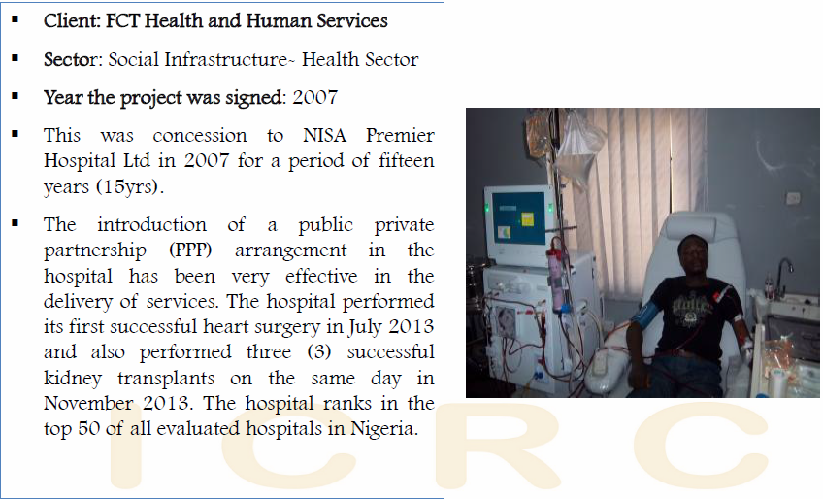
Garki Hospital Abuja

Slide 24
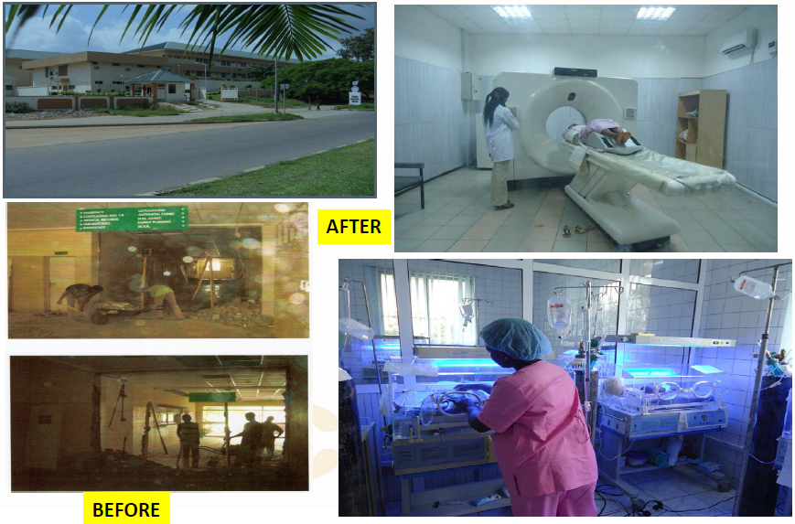

Slide 25
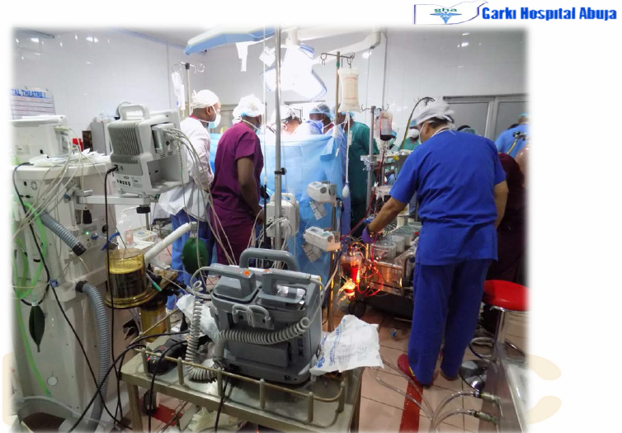
PPP Theatre: One Of Our 3 Theatres (June 2015 Cardiac Surgery)

Slide 26
Recent Successes - Hydro

Slide 27
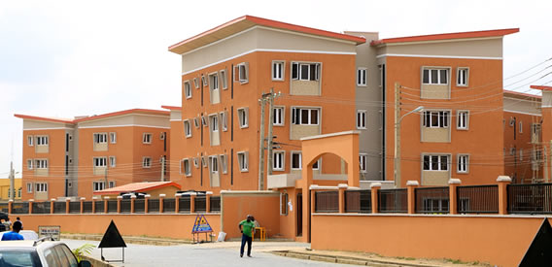
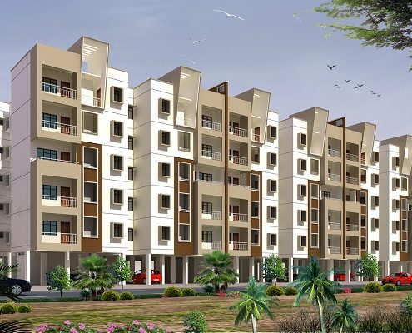
Housing Crisis in Nigeria ...At a Glance
160 million population with rapid urban population growths (48% by 2009)
Low disposable incomes - GDP per capita at US$2,500
14 million units housing deficit
Fragmented development efforts, mostly provided by informal/individual efforts,
52% i.e. 65 million households within the affordability gap (33% of income is insufficient to meet mortgage payments)
Dearth of long term financing for housing, mortgage & infrastructural financing
High cost components (land, finance etc)

Slide 28
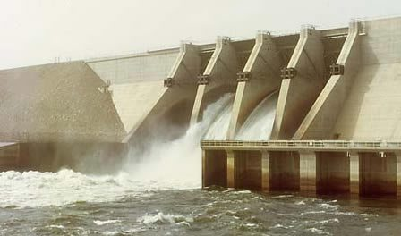
PIPELINE PROJECTS – DAMS & HYDROPOWER
DAMS AND HYDROPOWER PPP Projects
Project Name | Dams and Hydropower Projects
Sector | Water Resources & Power
Department/ Ministry | Federal Ministy of Water Resources and Federal Ministry of PW & H
Implementing Agency | Federal Ministy of Water Resources and Federal Ministry of PW & H
Location | Gurara I Hydro Power Plant (30 MW), Kaduna State Gurara II Hydro Power Plant (300 MW), Niger State Dasin Hausa Dam (150 MW), Adamawa State 6 Key Lots of Transmission Company of Nigeria (TCN) Major Transmission Projects across the entire country
Estimated Capital Cost | ⎕ < $10m ⎕ $11-50m ⎕ $51-100m ⎕ $101-200m ⎕ $201-300m ⎕ $301-400m ⎕ $401-500m ⎕ > $500m
Revenue Sources | ⎕ Users ⎕ Purchase Agreement ⎕ Government Payments
Background | Need to address Nigeria's Electricity Problems
Objective | To provide Power
Project Scope | Multi purposes dams for water basin management, power generation and transmission lines to wheel power

Slide 29
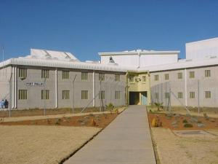
DEVELOPMENT OF NEW PRISONS THROUGH PPP
6 Integrated Prisons Facilities spread across Nigeria.
Some will be structured under a Land Swap Arrangement.
A modern Prison in Africa

Slide 30
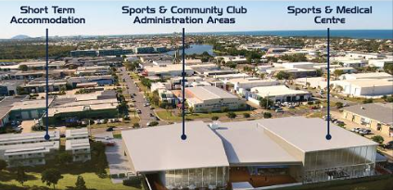
THE ATHLETES HOSTEL, ABUJA
Project Description
Uncompleted as part of Abuja Stadium Complex. It has 200 bedrooms, reception lounge with offices, shops, kitchen, restaurant, banquet hall, water pools and fountains, provision of 2 numbers lifts shafts and other facilities at various stages of development.

Slide 31
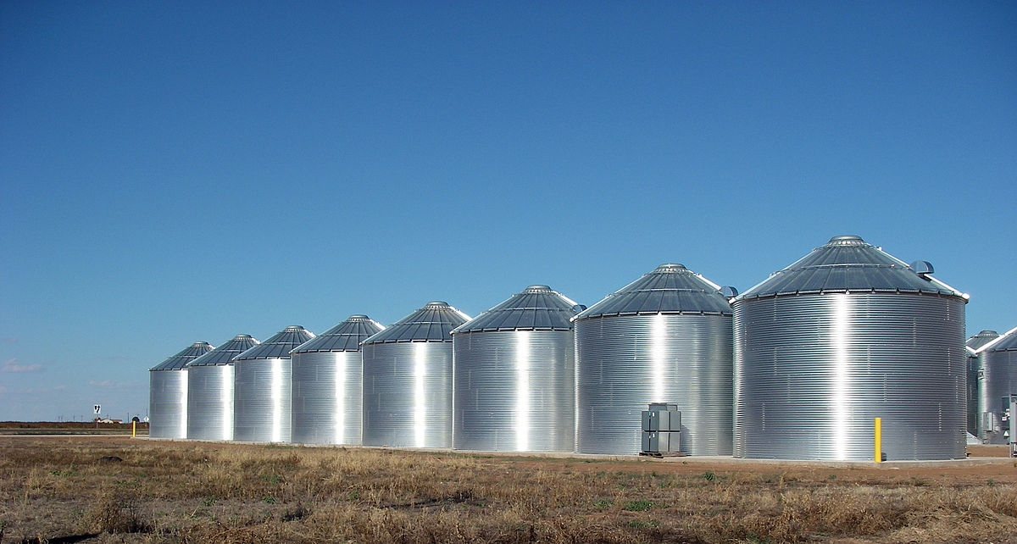
SILOS CONCESSION
Concession and Leasing of Grain Storage Facilities ( across the country)
Description: The FGN wishes to concession the O & M of 33 silo facilities across the country. Of the original complement of silo complexes, FMARD retained six. Therefore twenty-four(24) complexes was advertised in the National Dailies.
The concession period is for 10 years.
Status/Achievement: FEC granted approval to the Concession on 19 September, 2018 . Commercial close reached and project under implementation.
Total face value due to government is NGN33billion.

Slide 32
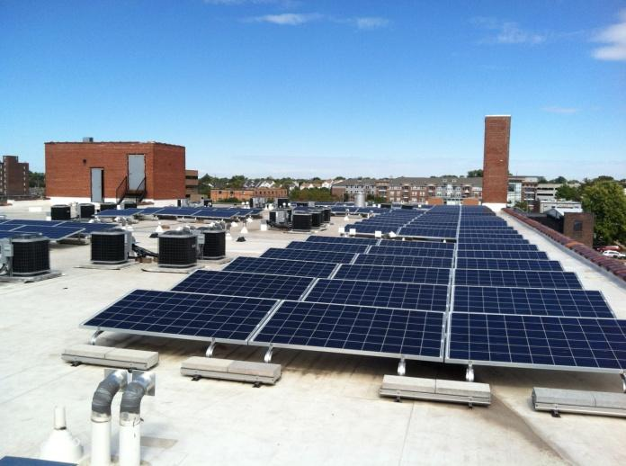
FMWPH ROOFTOP SOLAR PPP
Project Name: Solar Power Generation Facilities.
Description: The Federal Ministry of Power, Works and Housing (Power Sector) has procured a private investor to develop, install and operate photovoltaic solar power at the Ministry’s office otherwise known as Power House, Maitama.
A joint OBC and FBC certificate of compliance was issued 27th February 2018 for PPP Contracts to “Messrs Proserve Energy Services Consortium Limited

Slide 33
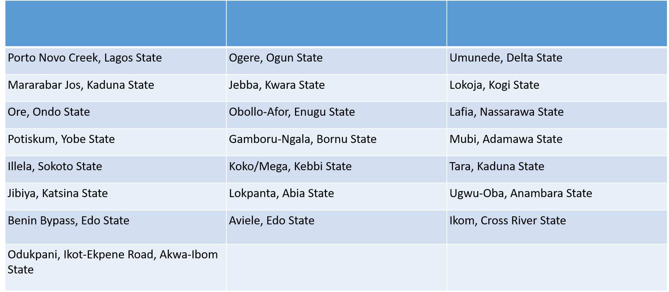
APPROVED LOCATIONS FOR TTPS

Slide 35
THANK YOU
Infrastructure Concession Regulatory Commission
Email: info@icrc.gov.ng
Website: www.icrc.gov.ng

