Slide 2
PPP Project Life-Cycle Monitoring and Lessons Learned
Istanbul PPP Week 2021
December the 6th
Presented by David Baxter
Steering Committee of the World Association of PPP Units and Professionals (WAPPP) and the International Sustainable Resilience Center (ISRC)

Slide 3
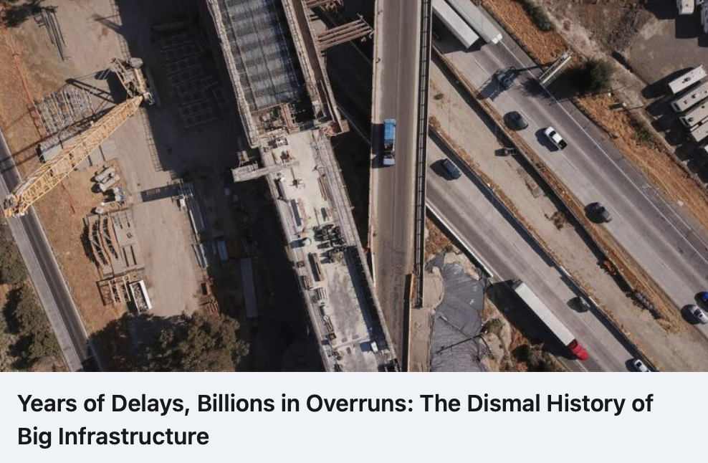
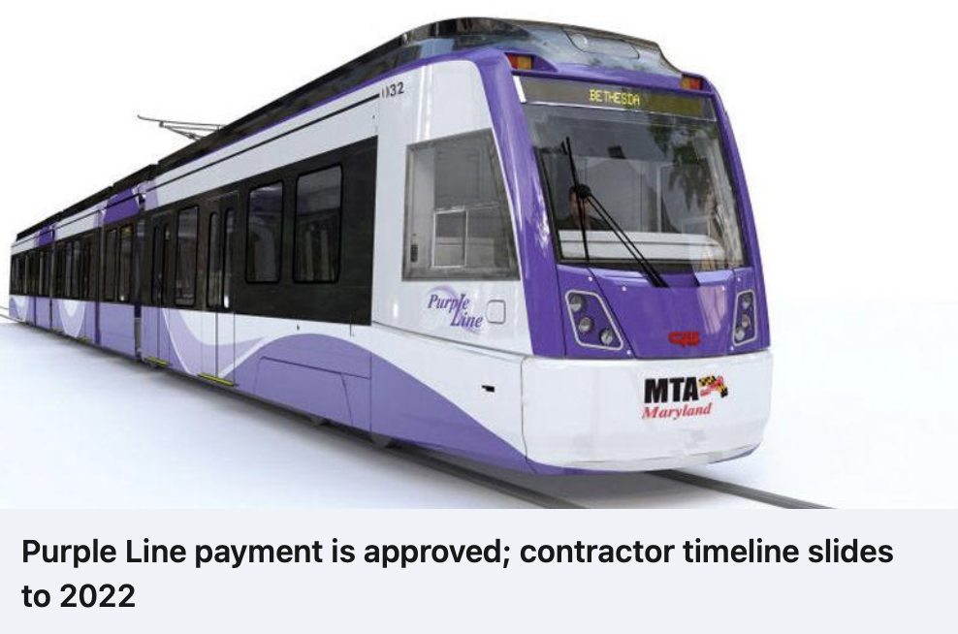
PRESENTATION OUTLINE
Introduction
Components of PPPs
Life-cycle challenges for PPPs
Monitoring challenges
Construction and O&M monitoring
Risk
Two Case Studies
Conclusions

Slide 4
INTRODUCTION
As the nation sets out on a national spending spree fueled by the $1.2 trillion infrastructure bill signed by President Biden this month, the job ahead carries enormous risks that the projects will face the same kind of cost, schedule and technical problems that delayed benefits to the public and driving up the price tag that taxpayers ultimately will bear
Challenges have grown more potent.
92 percent of big projects have over run their their original cost and schedule estimates
“A lot of projects are not delivering what they promised to deliver
In some cases, U.S. construction costs are higher than those in Western Europe and democratic nations in Asia
“In the world of civic projects, the first budget is really just a down payment…..If people knew the real cost from the start, nothing would ever be approved. The idea is to get going. Start digging a hole and make it so big there’s no alternative to coming up with the money to fill it in.”
“Big infrastructure is becoming cost prohibitive
this is due to institutional sclerosis at government agencies that keep repeating mistakes and choose infrastructure projects that are unlikely to succeed.
Mistakes include a lack of transparency, flawed contracts that put government agencies at the mercy of contractors, and a failure to attract enough private investment to bear some of the project’s risk.
Source: https://www.nytimes.com/2021/11/28/us/infrastructure-megaprojects.html

Slide 5
COMPONENTS OF PPPS
The PPP Knowledge Lab defines a PPP as "a long-term contract between a private party and a government entity, for providing a public asset or service, in which the private party bears significant risk and management responsibility, and remuneration is linked to performance".
All parties are responsible for project monitoring of obligations and performance – each should focus on their respective contractual management obligations

Slide 6
LIFE-CYCLE CHALLENGES FOR PPP PROJECTS
PPPs face enormous risks that include cost escalations, schedule changes and creep and technical problems
These risks can cause delays in benefits to the public and drive up the price tag that stakeholders (public and private sector) ultimately will bear
With the event of adverse events such as the global pandemic and climate change project challenges have grown more serious
Many projects have been unable to deliver what was promised
Factors that have to be considered include – risk management and allocation, management responsibility and performance
The full lifecycle needs to be addressed – and monitored –
Planning and visioning, – public sector
Design – public and private sector
Construction – public and private sector
Financing – public and private sector (investors and debtors)
Operations – public and private sector [contract management]
Maintenance – public and private sector [contract management]
GOAL IS TO OPTIMISE WHOLE LIFE CYCLE COST AND QUALITY TO DEVELOP BANKABLE PROJECTS AND ACHIEVE VFM
Life-cycle is longer than typical projects

Slide 7
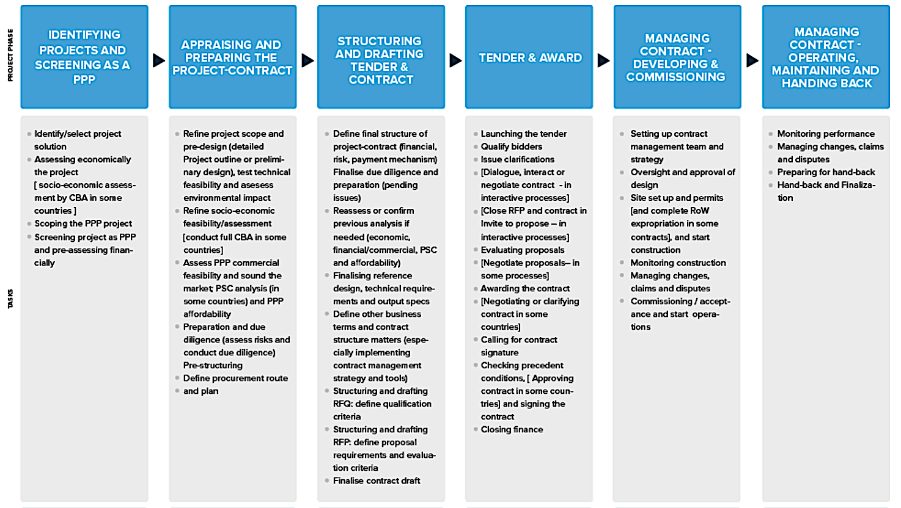
PPP PROJECTS LLIFE CYCLE (PROCESS)
FOCUS AREA OF MONITORING
INITIAL MONITORING
https://ppp-certification.com/ppp-certification-guide/10-overview-ppp-process-cycle-how-prepare-structure-and-manage-ppp-contract

Slide 8
PPP PROJECTS LLIFE CYCLE (PROCESS) - CONTINUED
INITIAL MONITORING
FOCUS AREA OF MONITORING
https://ppp-certification.com/ppp-certification-guide/10-overview-ppp-process-cycle-how-prepare-structure-and-manage-ppp-contract

Slide 9
LIFE-CYCLE MONITORING CHALLENGES FOR PPP PROJECTS
Government should have monitoring mechanisms in place to ensure that the private partner takes on responsibility and manages the risks actively – this includes the public sector as well
Monitoring requires commitment of resources by both parties
Monitoring should be done by line ministries or a national PPP unit if there is limited experience
Ultimately, signatories to a PPP contract are responsible for monitoring
The private partner should develop and undertake a clear monitoring, evaluation and reporting plan to ensure continuity of quality service and maintenance – this should be approved by the public sector to ensure that contract terms, milestones, and expected outcomes are monitored
A monitoring strategy is also required that should be institutionalized
Questions that should be asked include:
Are measure working as expected?
Have there been any other unexpected impacts (positive or negative) associated with the project implementation?
What follow-up actions are being undertaken
Who is responsible – accountable?
What efforts are being undertaken to ensure that projects remain resilient?
How adaptive is monitoring and evaluation actions?
What systems have been established to ensure O&M evaluation?
Are responsible parties competent?

Slide 10
LIFE-CYCLE MONITORING CHALLENGES FOR PPP PROJECTS
During construction monitoring is focused on ensuring that standards and quality materials are used as specified
During operations monitoring seeks to ensure that the asset is meeting service performance requirements (i.e. service standards or target levels of services)
During maintenance monitoring focuses on whether the specification around maintenance are being met so that the infrastructure maintains operational standards
Updating of key performance indictors (KPIs) throughout the life cycle of the project can ensure performance resilience
Internal and external stakeholders should be involved in monitoring at all times (this can include legal, technical, financial or independent entities
At times independent engineers and independent certifiers that provide independent technical assessments should be consulted – actions include review, inspection and monitoring of construction works, examining the designs and drawings for their conformity with the concession agreement and conducting tests and issuing completion certificates during the construction period. During the O&M phase, the Independent Engineer is expected to monitor compliance with the performance and maintenance standards (Global Center for Adaptation – Climate Resilient PPPs Handbook)

Slide 11
CONSTRUCTION MONITORING OF PPP PROJECTS
Construction monitoring tasks include –
Schedule Monitoring
Scope Monitoring
Performance and compliance monitoring with applicable laws and regulations;
Monitoring of quality control and materials
Monitoring relationships with the private part and stakeholders
Risk Management is critically important – this requires that aqccountabilty protocols and systems be established for both parties – requires the use of a risk matrix.
Performance monitoring may be defined as an assurance role played by the government (primarily through the contract management team although other affected agencies and departments may also be involved) where assurance is obtained that the private partner has:
Adequate systems, policies, procedures, and resources in place to perform the specific performance-related obligations set out in the PPP contract (the output specification)
functional quality assurance system in place to do self-monitoring and
Achieved the required outputs to meet the specification
Source: https://ppp-certification.com/ppp-certification-guide/71-understanding-monitoring-performance-and-risk-monitoring

Slide 12
CONSTRUCTION MONITORING OF PPP PROJECTS
Construction monitoring tasks include –
Schedule Monitoring
Scope Monitoring
Performance and compliance monitoring with applicable laws and regulations;
Monitoring of quality control and materials
Monitoring relationships with the private part and stakeholders
Risk Management is critically important – this requires that accountability protocols and systems be established for both parties – requires the use of a risk matrix.

Slide 13
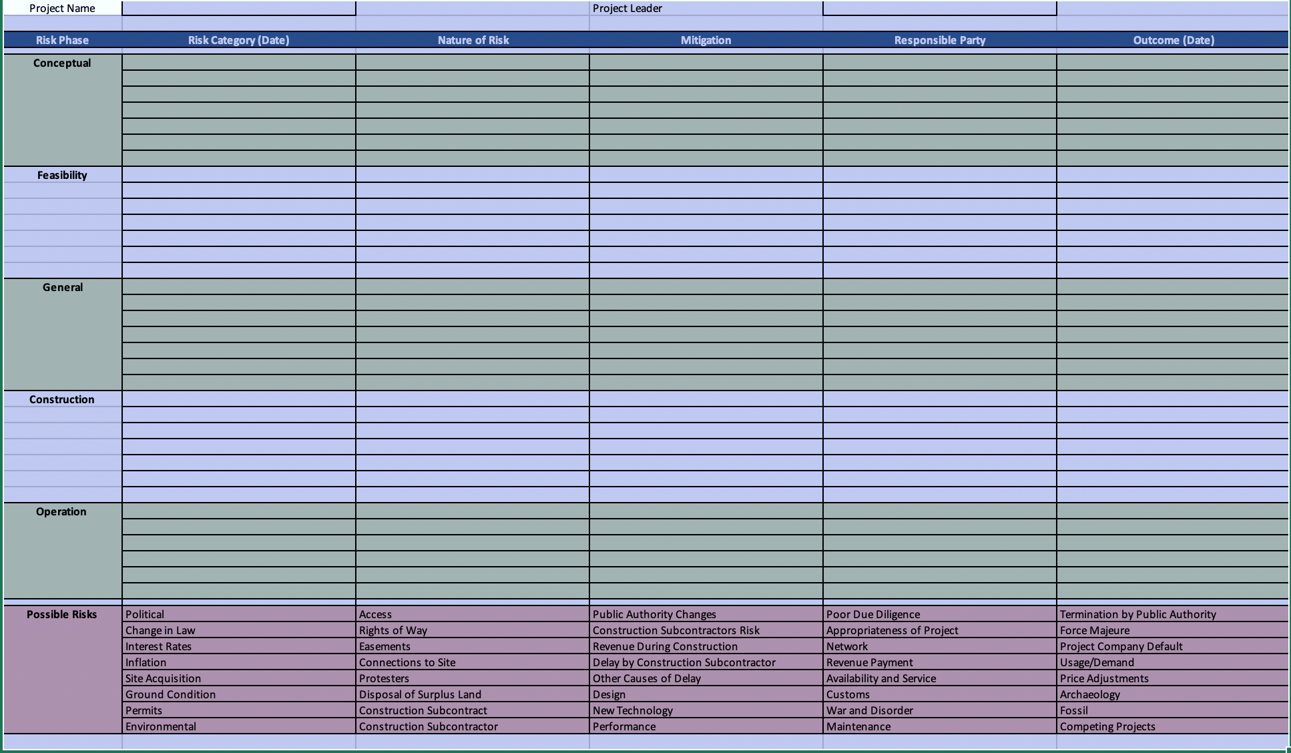

Slide 14
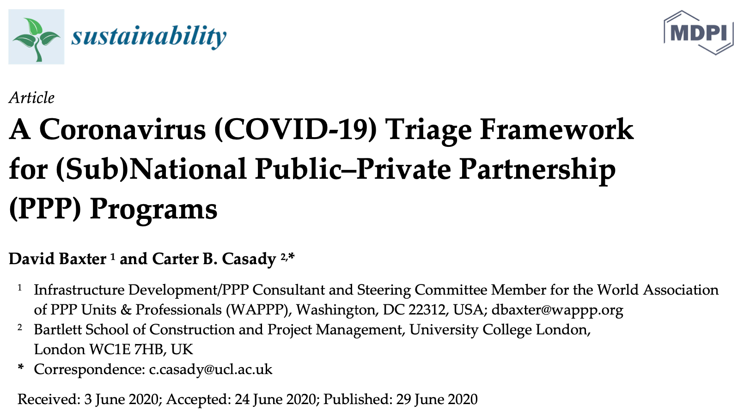
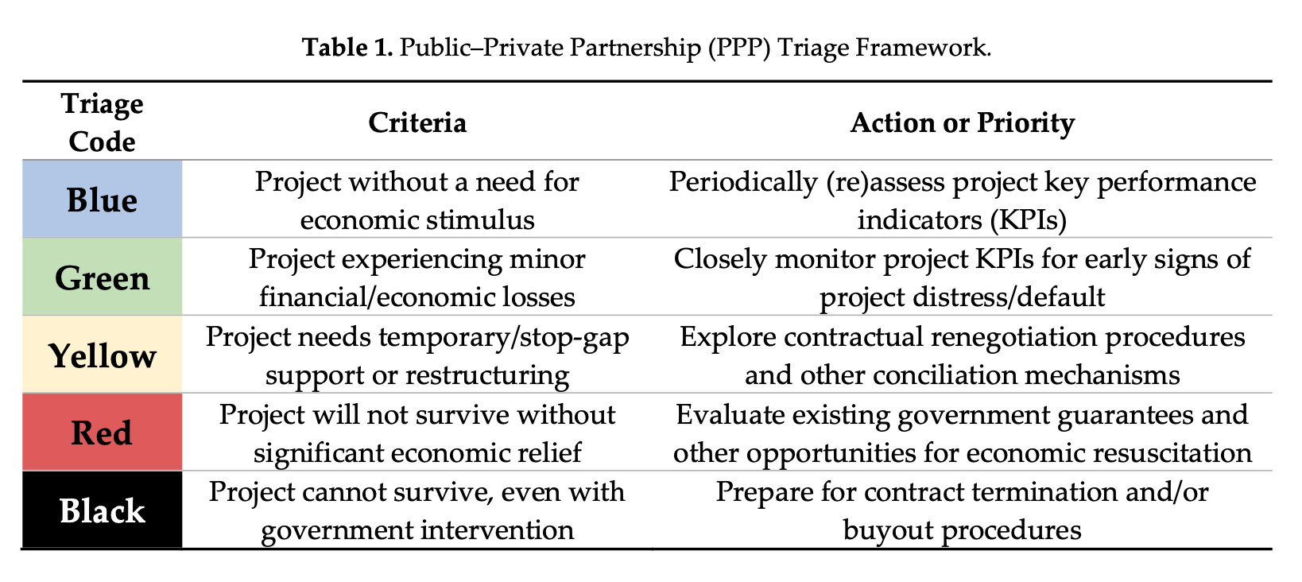
OPERATIONAL MONITORING OF PPP PROJECTS
During operational and maintenance monitoring focus is on project delivery and availability of the services in accordance with the output specification
O&M monitoring relies on the self-reporting of the private partner and the oversight and assurance systems applied by the government
This requires protocols (rules) and specified data collection
Performance monitoring is linked to the penalty regime but should also delivery and incentivization rewards
Monitoring and lessons learned should lead to feedback actions for mitigations for existing and future projects
It could / should lead to flexible decision regarding unexpected events (e.g. force majeure actions and decisions related to the pandemic) revealed during monitoring

Slide 15
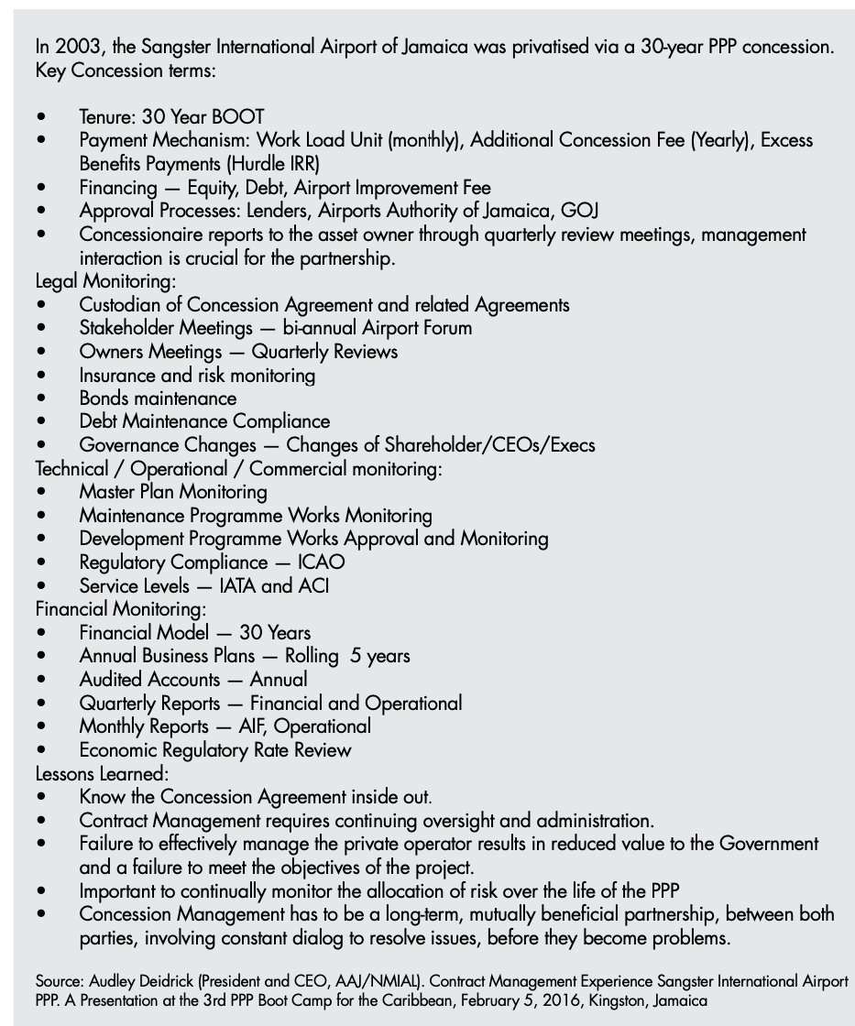
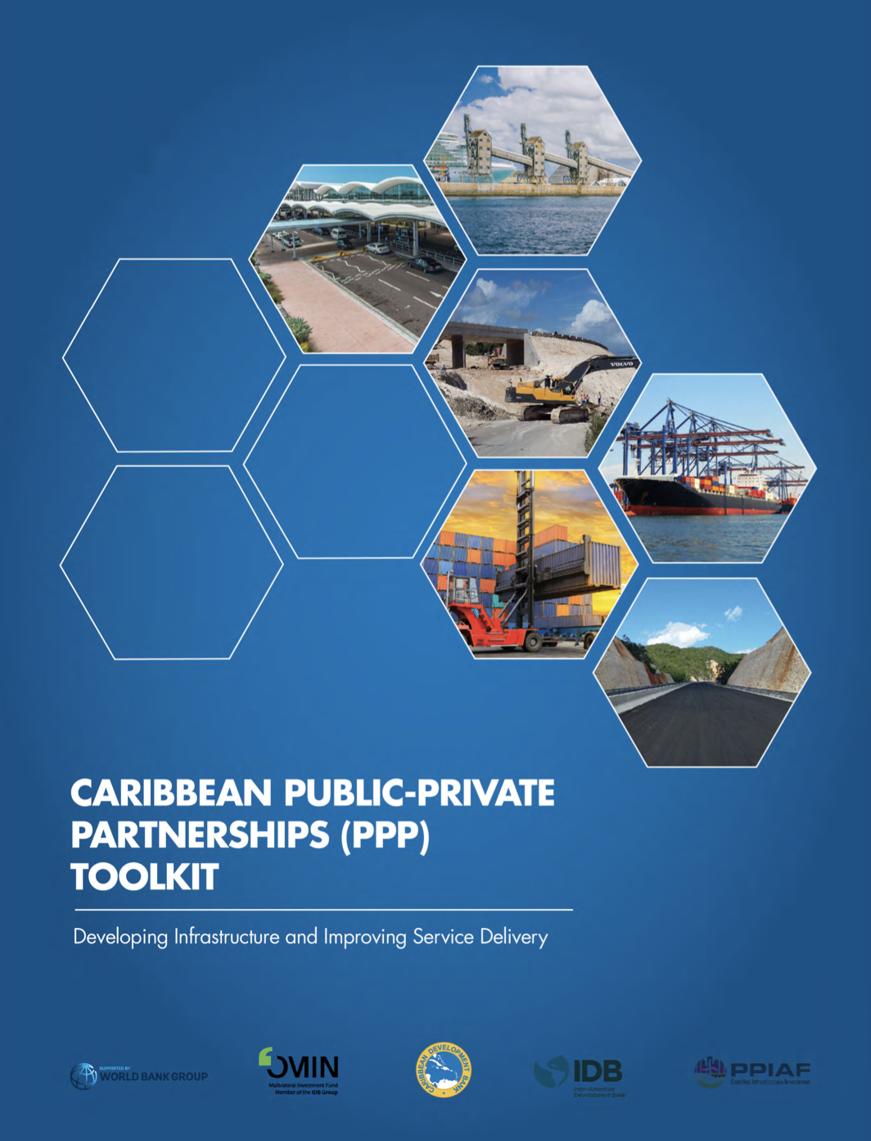
MONITORING OF PPP PROJECTS - CASE STUDY

Slide 16
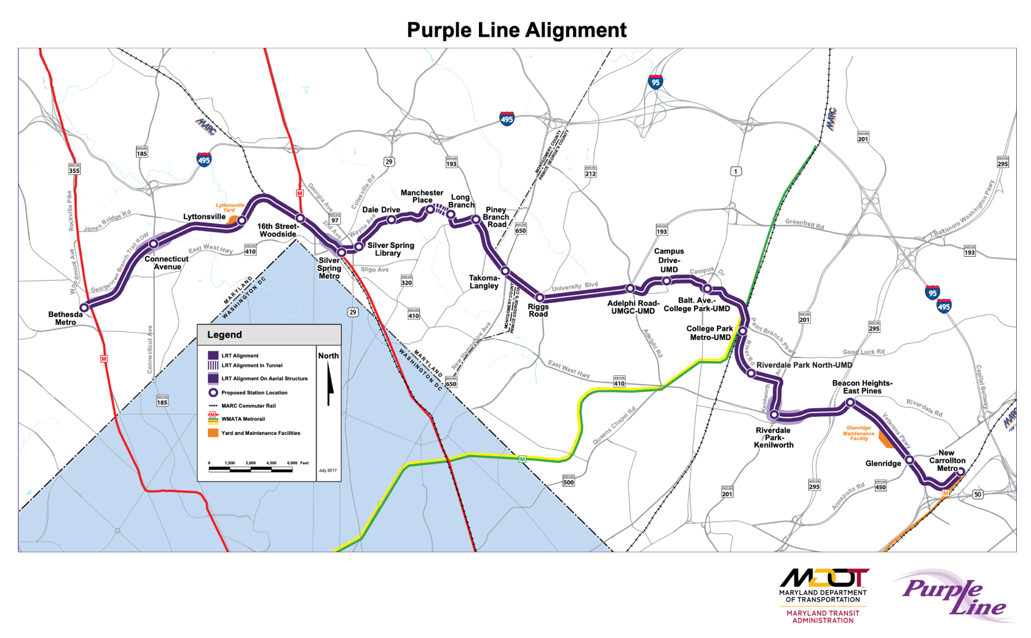
THE MDOT – MTA PURPLE LINE PPP PROJECT – A LOST OPPORTUNTITY
The Purple line is a 16.2-mile light rail project in Maryland - USA
Launched as a 36-year PPP by the Maryland Department of Transportation (MDOT) and the Maryland Transit Administration (MTA)
The completion date was set for 2022 for the eastern sector of the project.
21-station project was envisioned as a loop connector that would improve connectivity to users of the Metropolitan Metro System.
Seen as an economic contributor Montgomery and Prince George’s counties
Enjoyed political support
Environmental Benefits
The Purple Line is estimated to take 17,000 cars off of the road daily and saving 1 million gallons of gas (petrol) within 20 years.
Electric power of light rail system means no polluting air emissions into the immediate environment
Purple Line’s use of existing roadways (ROWs) minimizes effects on land and water resources

Slide 17
THE MDOT – MTA PURPLE LINE PPP PROJECT – A LOST OPPORTUNTITY
Due to the shortage of public funds a PPP procurement was decided on
It promised innovative delivery and time saving
There was some opposition from residents, and environmental and financial concerns
Two camps of stakeholders: those who strongly supported the project for its traffic alleviating values and those who strongly opposed it mainly for environmental concerns
The competitively bid contract was awarded to a construction consortium called the Purple Line Transit Constructors (PLTC) - a partnership of Flour, Lane Contraction, and Taylor Brothers
Under the PPP agreement, PLTC held the larger $5.6 billion Purple Line design-build, and operating contract with the PPP consortium partners PLTP (Purple Line Transit Partners includes Meridiam, Flour, and Star America Infrastructure Partner

Slide 18
THE MDOT – MTA PURPLE LINE PPP PROJECT – A LOST OPPORTUNTITY
Challenges:
Financial risk may have been disproportionately been assumed by the state
The acceptance of a low-bid construction contract selection - due to state pressure
Project delays, environmental challenges, construction costs overruns, and delays in resolving responsibility, led to poor communication of challenges and an adversarial approach to emerging challenges
In 2020 serious disagreements between PLTC and MDOT / MTA threatened the project’s completion and PLTC sought ways to exit the project
Legal actions were launched to mitigate the impacts of litigation and ongoing change order requests on project schedule delays and costs
Delays - inclusive of difficulties in receiving environmental approvals - caused a 2.5-year delay and added $519 million to the overall project costs

Slide 19
THE MDOT – MTA PURPLE LINE PPP PROJECT – A LOST OPPORTUNTITY
Things Fall Apart:
The project experienced 976 days in delays
The project company stated that it was unable to complete the project under current circumstance as it was unable to obtain the time and cost relief to which it felt it was entitled to
In April 2020 PLTC had notified MDOT / MTA that it needed an additional $187.7 millions and an extra-five months was needed to complete construction of the east phase
Negotiations broke down and PLTC then announced that it would vacate the projects construction sites after a 60 to 90 days orderly transition
The decision the PPP consortium partners PLPT in a difficult position as they had to scramble to find new construction firms to replace PLTC

Slide 20
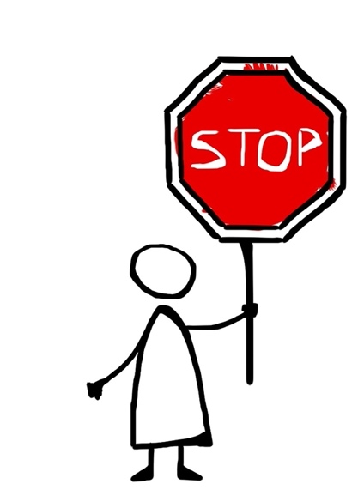
THE MDOT – MTA PURPLE LINE PPP PROJECT – A LOST OPPORTUNTITY
Stop Throwing Money at a Failing Project
What was the solution?
Scenarios were considered which included cancelling the project, the state taking over the project and becoming the de facto operator; finding a new private partner who could take over the project or reaching an agreement with PLTC
No matter the scenario the state would still have to throw extra unbudgeted money at the distressed project
The question whether it made sense to throw any more money at the project was being widely asked
Consequence
The state did not agree with the contractor’s assessment of $519 million in cost overruns
The contractor was now saying that the project would only be completed by mid-2025
The contractor stepped away
Project stalled and construction sites had to be secured at great cost

Slide 21
THE MDOT – MTA PURPLE LINE PPP PROJECT – A LOST OPPORTUNTITY
What could have been done better?
Reactive and responsive monitoring
Avoiding political procurement interference would not have resulted in a “low bid” being accepted
Environmental concerns should have been addressed before the project even started
Better stakeholder consultation would have helped alleviate tensions
Early solution seeking, partner trust building, better conflict resolution protocols, and acceptance of realities on the ground could have resulted in proactive actions
MDOT/MTA should have been more assertive in its project monitoring.
The consortia members should have formed a more cohesive team
Project risks should have been more astutely allocated

Slide 22
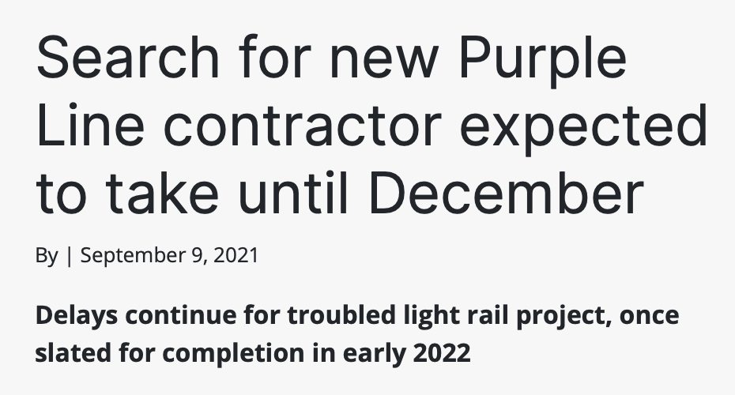
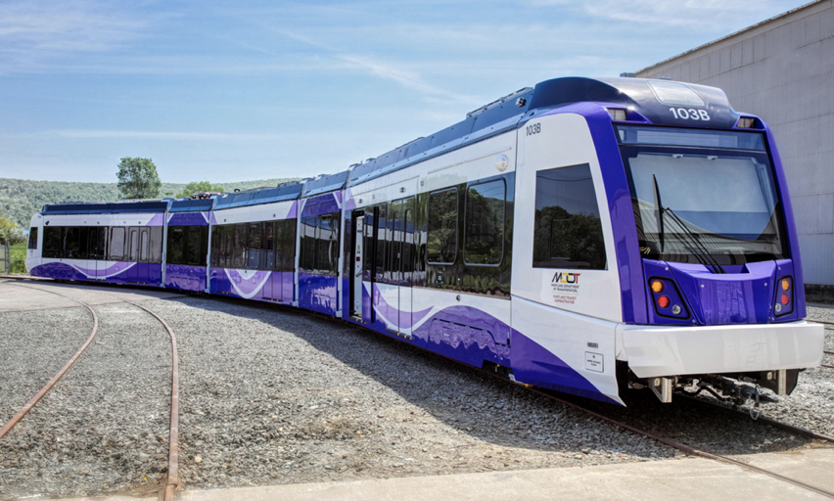
THE MDOT – MTA PURPLE LINE PPP PROJECT – A LOST OPPORTUNTITY
Post-Script
Selection of a new contractor for Maryland’s much-delayed Purple Line light rail project is likely to occur in December 2021, with a contract finalized by February 2022
A new timeline for the project is likely to be determined when the new contractor is selected
A new cost estimate for the light rail line will have to be selected
The project has been in limbo since September 2020
There are $700 million in unpaid cost overruns
The new schedule must be approved by the state Board of Public Works because it changes terms of a $250 million settlement with the builders while allowing two of the three primary contractors to remain

Slide 23
CONCLUSION
Many moving parts
All parties are responsible
PPPs require a long-term monitoring plan – strategy
Costs can be enormous for failed projects
All phases should be monitored
QUESTIONS?

Slide 24
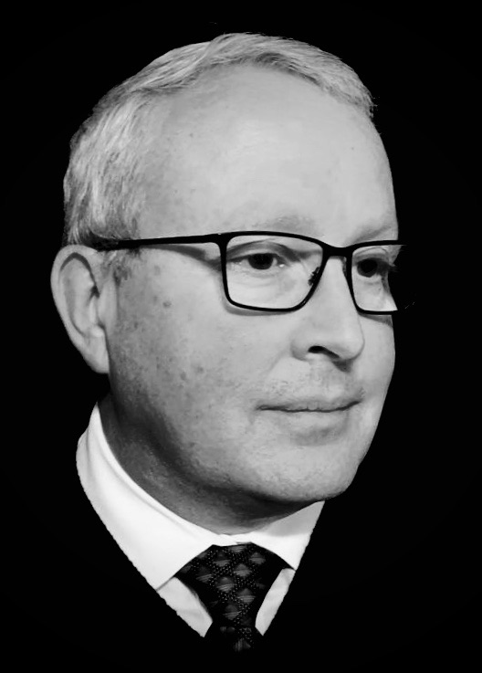
CONTACT INFORMATION
Senior Advisor to the International Sustainable Resilience Center (ISRC) for PPPs- https://isrc-ppp.org/
Steering Committee Member of the World Association of PPP Units and Professionals https://wappp.org/
Email – baxterintdev@gmaill.com
WhatsApp - +17034623661
Skype – david.baxter22209
Twitter – @BaxterDevelop

