Slide 1
Double Edged Sword risk management for PPP projects
Istanbul PPP Week
Darrin Grimsey
5/11/20

Slide 2
Historical analysis of the Australian / NZ Project Finance Transactions
Much like the GFC in 2008, the COVID19 poses funding issues that will eventually lead to an increase in cost of project financing in the foreseeable future
Historical Project Finance margin recovery post-GFC
No. of Projects, which reached financial close
bps
Maturity
Source: IJonline, Claytonutz, PV Magazine and Bakermckenzie
Notes:
https://www.nortonrosefulbright.com/en/knowledge/publications/2e8fe68a/covid-19-and-its-impact-on-project-finance-transactions
https://www.leadenhall.com.au/wp-content/uploads/2020/04/March-2020-MRP-Article.pdf
https://www.claytonutz.com/ArticleDocuments/178/Clayton-Utz-Emerging-from-the-Crisis-Infrastructure-Finance-Post-GFC-2010.pdf.aspx
https://www.claytonutz.com/knowledge/2011/may/ppps-the-australian-gfc-experience
https://www.pv-magazine-australia.com/2020/03/28/covid-19-to-wreck-economics-of-new-solar-and-wind-projects/
https://www.pv-magazine-australia.com/2020/04/16/covid-19-to-pause-gigawatts-of-wind-and-solar-project-in-australia/
https://www.energetics.com.au/insights/thought-leadership/australia-s-renewable-energy-market-covid-19-impacts-challenges-from-2019-and-the-value-in-ppas
https://www.bakermckenzie.com/en/insight/publications/2020/03/covid19-finance-energy-infrastructure-projects

Slide 3
Historical Credit Spreads
Market volatility and financial stress spiked to levels last seen in the GFC, causing concerns that the market impact is expected to be bad as the GFC
COVID -19
  Global Financial Crisis
  c.500bps
  Covid-19
  Currently c. 100bps
  Euro Sovereign Debt Crisis
  c. 100bps
  Commodity Price Collapse
  c. 100bps
Source: Bloomberg, Reuters
Notes:
https://www.reuters.com/article/us-health-coronavirus-vix/vix-futures-point-to-coronavirus-worries-for-months-to-come-idUSKCN21Q2ZS
https://www.avivainvestors.com/en-au/views/aiq-investment-thinking/2020/05/covid-19-impact-on-credit-markets/

Slide 4
COVID-19 Impact on the Equity and Debt Markets
The spread of the COVID-19 pandemic triggered a decline in the prices of risky assets. Extreme volatility and poor liquidity in financial markets have increased further due to the dysfunction in government bond markets
Equity Risk Premium (Oct 2019 – Oct 2020 YTD)
Debt Margins (Sep 2019 – Sep 2020)
Bps pa
Source: Bloomberg, RBA and Mondaq and Leadenhall
Notes:
https://www.rba.gov.au/publications/fsr/2020/apr/the-australian-and-global-financial-systems.html
https://www.mondaq.com/australia/financing/918838/the-impact-of-covid-19-on-valuations-of-businesses-shares-and-other-equity
https://www.leadenhall.com.au/wp-content/uploads/2020/04/March-2020-MRP-Article.pdf
http://thewire.fiig.com.au/article/commentary/trade%20opportunities/2020/04/01/credit-spreads-and-equity-performance-during-financial-disruptions
https://www.leadenhall.com.au/covid-19-understanding-the-valuation-implications/

Slide 5
Impact of COVID 19 on the PPP market
Europe has witnessed the largest number of PPP deals since the outbreak of the pandemic, while Transport and Social sectors projects are the leading recipients
120 PPP projects have reached financial close during the period
20
    deals in North America
    13 in the US
    7 in Canada
    11 in Transport sector
    7 in Social Infrastructure
49
    deals in Europe
    15 in France
    11 in Germany
    22 in Social Infrastructure
    18 in Transport sector
15
    deals in Asia
    6 in India
    2 in Japan
    7 in Transport sector
    3 in Social Infrastructure
36
deals in the rest of the world
Page 5
Source: Inframation

Slide 6
Impact of COVID 19 on the PPP market
Comparing the GFC with COVID-19 reveals the current impact is not as severe as the 2008 crisis, however, there are some crucial points to consider
Learnings from the 2008 crisis | Difference between COVID 19
Liquidity completely dried up | Liquidity still present
Extreme volatility (up to 300bps) followed by an extend period of stability | Not as much disruption to PPP and project finance markets
Miniperms emerged and took some time for tenors to return | Infra stimulus ramping up that should bolster market
Consequent impact on refi risk and T&Cs (market disruption clauses) | Need to be cautious and investment needs to be targeted
Margins increased during the crisis and did not return to pre GFC levels for a decade | Contractors risk averse
Capital markets took some time to recover and still not there in some places, eg Australia | Move beyond short-termism and address holistic implications
No availability PPP refinancing's during the GFC | Actively designing measures that account for the long-term implications of COVID-19 on PPP programs
There were a number of greenfield PPP transactions during the GFC (2008 – 2011) | Need to take a closer look at their current project pipelines and enabling policy, legal, and institutional environments.
But took some time to move to close | This way both portfolios and PPP frameworks are revisited will have an important signalling effect to the private sector and ultimately determine investors’ and financiers’ interest
Page 6

Slide 7
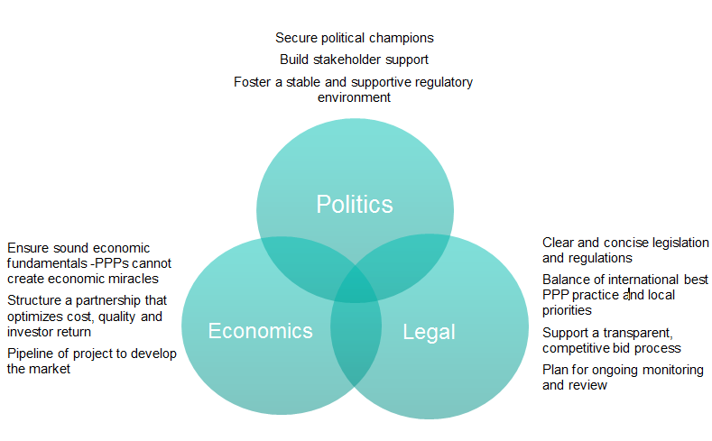
Fundamental factors for a successful PPP framework

Slide 8
Successfully delivering PPPs
Risk allocation

Slide 9
Successfully delivering PPPs
Risk allocation
Aim is to achieve Optimal Risk Transfer:
Optimal risk allocation seeks to minimise both project costs and the risks to the project by allocating risk to the party in the best position to control them in the most cost effective way.
That party has:
  the best ability to reduce the likelihood of the risk occurring
  the best ability to control the consequences if it does arise
  Excessive risk allocation results in lower VfM as private sector price risk at higher rates.
Optimal Point – VfM maximised
VFM
Risk Transfer

Slide 10
Successfully delivering PPPs
Risk allocation
Risks should be allocated to the party best able to understand and manage them
Public
Shared
Private
Retained Risk
Transferred Risk
    Land acquisition
    Demand risk (?)
    Changes in requirement
    Latent defects (existing)
    Environmental approvals
    Inflation
    Regulatory
    Taxation
    Force Majeure
    Design & construction
    Commissioning
    Operating & maintenance costs
    Operating performance
    Latent defects (new)
    Third party revenue

Slide 11



In practice you need 3 fundamentals in place to successfully transfer risk…
Successfully delivering PPPs
Risk allocation
Capability
Finance
Contract

Slide 12
Risk transfer and impact on the market
Government has a responsibility to structure projects appropriately and transfer risk that the market is able to manage. Where risk transfer has been imposed on the market it has resulted in poor project outcomes or pushback.
Size of traditional social PPP project risk allocation on company balance sheet
Size of mega transport PPP project risk allocation on company balance sheet
company balance sheet
company balance sheet
transferred Risk (private)
transferred Risk (private)
retained risk (Govt.)
Retained risk (Govt.)
Notes:
Source:
https://blogs.worldbank.org/ppps/making-ppp-legal-frameworks-fit-post-covid-19
https://www.ifc.org/wps/wcm/connect/b2364239-ebac-465c-8afc-71a83bdb8900/%28Consolidated%29_Infra+WS_ppt_201005.pdf?MOD=AJPERES&CVID=nk5.nPl

Slide 13
Risk transfer and impact on the market
Government has a responsibility to structure projects appropriately and transfer risk that the market is able to manage. Where risk transfer has been imposed on the market it has resulted in poor project outcomes or pushback.
Risk allocation environment:
  PPPs were about risk allocation and the principle of placing risk with the party best placed to manage the risk
  More recently aggressive risk transfer appears to have taken hold
  Accepting risk to win the deal becomes the new normal
  The market is now pushing back
  Risk allocation considerations:
  Governments have a role - transferring to a market under pressure is not the best policy
  Government has a responsibility to retain risks that are too great for the private sector
  Historical risk allocations (i.e. for past social infrastructure projects) need to be reconsidered
  More collaboration between Governments and the market to understand project risks
  Utilities and geotechnical risks are significant on mega transport projects
Notes:
Source:
https://blogs.worldbank.org/ppps/making-ppp-legal-frameworks-fit-post-covid-19
https://www.ifc.org/wps/wcm/connect/b2364239-ebac-465c-8afc-71a83bdb8900/%28Consolidated%29_Infra+WS_ppt_201005.pdf?MOD=AJPERES&CVID=nk5.nPl

Slide 14
Successfully delivering PPPs
Risk allocation
Optimal risk allocation
Consistent with market
Address deal specific issues
Reflected policy changes
Government
aims
Government risk allocation is more challenging than private sector’s
Transfer of risk is seen as good for its own sake
Has Government resolved its internal position?
Have Government’s legal advisors been properly tested?
Does the Government want ‘insurance’ or to allocate risk where it can best be managed?
Can tenderers participate?
Diversion of resources
Address via the ‘back door’
Price contingencies at 100%
Risk
Allocation
Private
sector
view
Outcomes

Slide 15
Outer Suburban Arterial Roads (OSARs) Program
Western Package – Case Study
19 April 2018

Slide 16
Strategic Rationale:
Key objectives - improving performance and driving value for money
Increased economic development
Value for money solution
Reduced congestion
Improved reliance and performance
Create a safe and accessible road network

Slide 17
Western Roads Upgrade Project:
Key project figures
$1.133B
Final Proposal (NPC)
8
Arterial road upgrade projects and expenditure for rehabilitation works across the network during construction
~30
Kilometres of road duplications
2021
Arterial road projects, upgrades and rehab complete
~260
Kilometres of arterial road maintenance
20
Years of maintenance
1,200+
Job opportunities created over the life of the Project
$

Slide 18
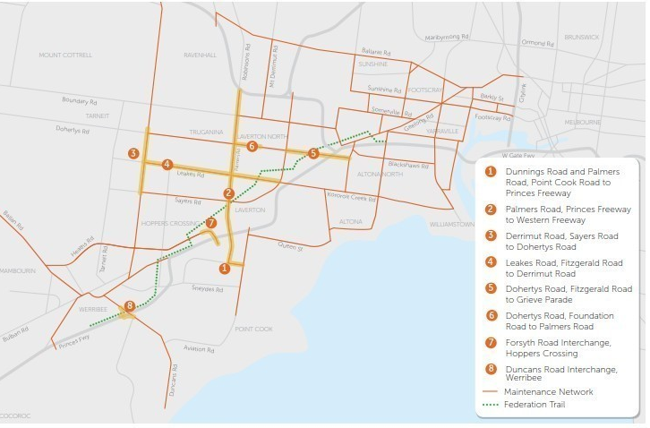
Western Roads Upgrade Project:
Capital works and maintenance services

Slide 19
Western Roads Upgrade Project:
Obligation over time
Financial close
Commercial Acceptance
Development phase (D&C)
Initial Maintenance Phase
Full Maintenance Phase
VR (M)*
Input von TAS
3-4 years
20 years
Development Phase:
*VR (M) – 3 to 6 months mobilisation period
Design and construction activities related to the identified arterial road capital projects
Rehabilitation works across the broader maintenance area (pavement and structures)
Initial Maintenance Phase:
Routine and periodic maintenance services for roads, structures, road-side assets and drainage assets
Full Maintenance Phase:
Routine and periodic maintenance of arterial road pavement, structures, road-side assets and drainage assets
Rehabilitation of roads, road side assets, structures and drainage assets
Project Co to meet hand-back requirements at completion of the concession term

Slide 20
EY | Assurance | Tax | Transactions | Advisory
About EY
EY is a global leader in assurance, tax, transaction and advisory services. The insights and quality services we deliver help build trust and confidence in the capital markets and in economies the world over. We develop outstanding leaders who team to deliver on our promises to all of our stakeholders. In so doing, we play a critical role in building a better working world for our people, for our clients and for our communities.
EY refers to the global organization, and may refer to one or more, of the member firms of Ernst & Young Global Limited, each of which is a separate legal entity. Ernst & Young Global Limited, a UK company limited by guarantee, does not provide services to clients. Information about how EY collects and uses personal data and a description of the rights individuals have under data protection legislation is available via ey.com/privacy. For more information about our organization, please visit ey.com.
© 2020 Ernst & Young, Australia.
All Rights Reserved.
Liability limited by a scheme approved under Professional Standards Legislation.
This communication provides general information which is current at the time of production. The information contained in this communication does not constitute advice and should not be relied on as such. Professional advice should be sought prior to any action being taken in reliance on any of the information.
Ernst & Young disclaims all responsibility and liability (including, without limitation, for any direct or indirect or consequential costs, loss or damage or loss of profits) arising from anything done or omitted to be done by any party in reliance, whether wholly or partially, on any of the information. Any party that relies on the information does so at its own risk.
ey.com

