Slide 1

Private Participation in Infrastructure
Lessons Learned from the Latin-American and Caribbean Experience
Daniel Benitez
November 4, 2016
Istanbul

Slide 2
Outline
Why is the Latin-American and Caribbean (LAC) experience relevant?
  LAC in figures
  Investment needs and sector performance
  Renegotiation
What are the lessons learned?
  Reforms to improve the PPP framework
A few selected country cases:
  Chile, Peru, Uruguay and Paraguay, and Argentina

Slide 3
Latin-American and Caribbean (LAC) in figures, Investment Commitments
Source: PPIAF – ppi.worldbank.org

Slide 4
Investment Commitment by Sector, LAC only, 1991-2015
Source: PPIAF

Slide 5
Top ten countries in LAC 2010-2015 US$ million
Investment commitments
Excluding Brazil
Source: PPIAF

Slide 6
And in social infrastructure: investments in the pipeline, LAC (2016)

Slide 7
Percentage of projects awarded direct negotiation or competitive (2010-2015)
Source: Infrastructure Finance in Latin America and the Caribbean:
Challenges and Opportunities, World Bank 2016

Slide 8
Revenue source in LAC 2010-2015
Source: Infrastructure Finance in Latin America and the Caribbean:
Challenges and Opportunities, World Bank 2016

Slide 9
Type of Government Support, 2010-2015, by Sector
Source: Infrastructure Finance in Latin America and the Caribbean:
Challenges and Opportunities, World Bank 2016

Slide 10
Revenue sharing: payments to the government
Source: PPIAF

Slide 11
Number of projects and type of MDB support, 2010-2015, LAC Only
Source: Infrastructure Finance in Latin America and the Caribbean:
Challenges and Opportunities, World Bank 2016

Slide 12
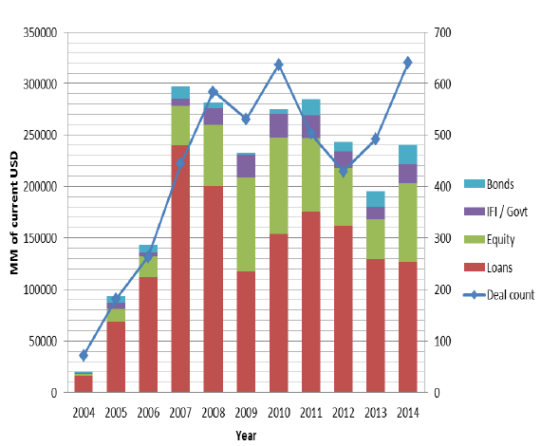
Financing sources: increase in equity contribution since 2008
Source: Infrastructure Journal Database

Slide 13
LAC’s sponsors investing in other countries
Number of projects with sponsors investing
in other countries
Source: PPIAF

Slide 14
Unsolicited proposal – all regions
Regional distribution of Unsolicited Proposals
Source: World Bank 2016

Slide 15
Investments and fiscal space
PPP Investments / Total Investments (2011) OECD
Australia
10-15%
Luxembourg
5-10%
Canada
1- 3%
Mexico
15%
Czech Rep
0-3%
New Zealand
1-3%
Finland
10-15%
Norway
3-5%
Germany
3-5%
South Africa
3-5%
Italy
1-3%
Spain
3-5%
Korea
5-10%
UK
15%
Peru – Public and Private Investments in Transport Infrastructure
Percentage of GDP – source IPE
Average
Max
Min

Slide 16
Sector performance perception (WEF)

Slide 17
Contract renegotiations: some (old) numbers
A poor enabling framework and lack of a good preparation was the source of a large number of contract renegotiations in developing countries

Slide 18
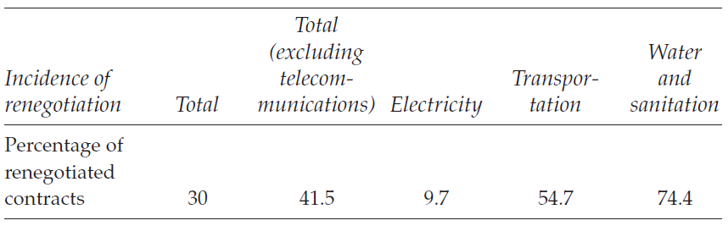
Contract Renegotiations in LAC:
Incidence (%) of Contract Renegotiation (1985-2004, 1000 contracts)*
Weak experience with contract regulation
But probably projects poorly prepared
*Guasch (2004)
Notes:
Two sectors: transport and W&S
In transport, most of the contract renegotiations modified committed investments, reduce payment to the government, or increased tariff
Poor feasibility studies

Slide 19
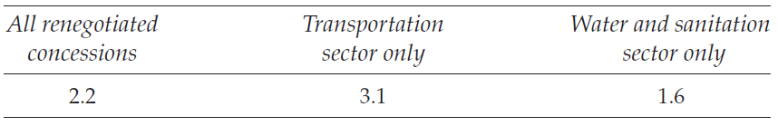
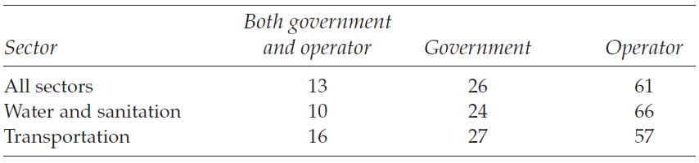
Contract renegotiation since award
Average time (years) to Renegotiate since awards
Who initiated the renegotiation? percentage of total requests
Notes:
Very early and largely initiated by the operator

Slide 20
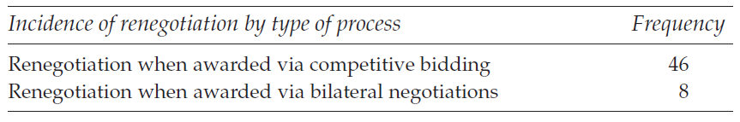
Renegotiation and award criteria: a counterintuitive result
Notes:
Around than 78% of the contracts allocated through competitive bidding
More renegotiations when competitive bidding
More flexible contract negotiation when bilateral – government less informed.

Slide 21
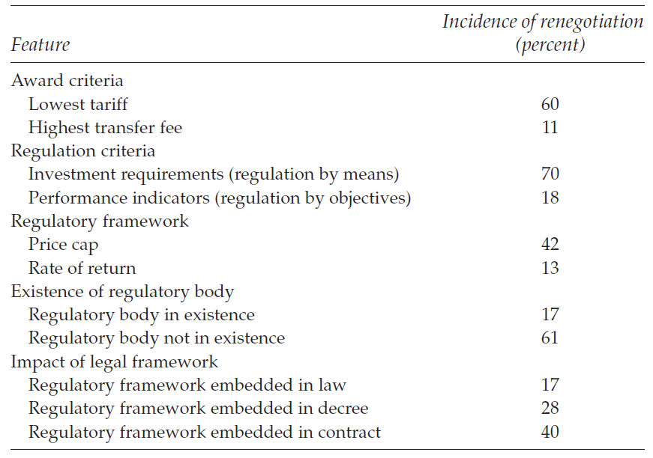
Contract renegotiation and regulatory framework
Some evidence on sector performance and the quality of the regulatory framework (Andrés, 2012)
Regulatory framework defined by some principles
  Autonomy (budget and decision), transparency, and accountability
Notes:
The existence on an explicit regulatory matters to avoid renegotiation
More difficult to renegotiate when the regulatory framework when embedded in the law.

Slide 22
Lessons learned

Slide 23
Where the effort is now being focused?
Public and Private: capacity; commitment, and social acceptance
7
Objectives
1
Financing markets: lending, bonds, etc.
6
Institutional and legal framework
2
5
3
4
Planning, prioritization and analysis; pipeline
Project (and sector) funding
Project preparation (technical and financial) risk analysis and strategy

Slide 24
Objectives: how PPPs may help to deliver infrastructure

Slide 25
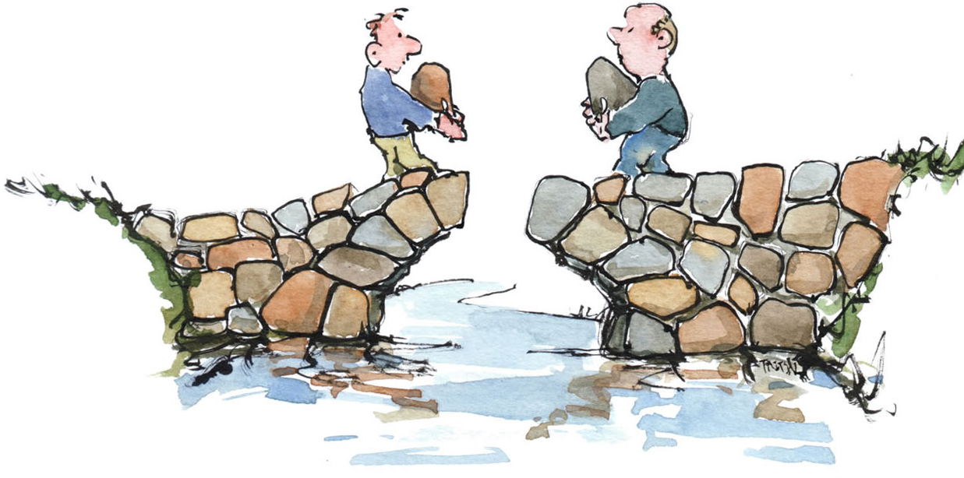
PPP Value Drivers:
No, You first
You first
Are the ways to improve value for money in infrastructure provision:
  Whole-of-life costing and upfront commitment
  Risk transfer
  Focus on service delivery
  Innovation
  Asset innovation
  Mobilization of additional funding
  Accountability
PPP: it’s all about risk
Notes:
Whole-of-life costing full integration, under the responsibility of one party, of up-front design and construction with ongoing service delivery, operation, maintenance and refurbishment, can reduce total project costs. Full integration incentivizes the single party to complete each project function (design, build, operate, maintain) in a way that minimizes total costs
Risk transfer—risk retained by the Government in owning and operating infrastructure typically carries substantial, and often, unvalued cost. Allocating some of the risk to a private party which can better manage it, can reduce the project’s overall cost to government
Upfront commitment to adequate maintenance, and predictability and transparency of whole-of-life costs—a PPP requires an upfront commitment to the whole-of-life cost of providing
the asset over its lifetime, building in appropriate maintenance. This both provides budgetary predictability over the life of the infrastructure, and reduces the risks of funds not being made
available for maintenance after the project is constructed
Focus on service delivery—allows a sponsoring department or agency to enter into a long term contract for services to be delivered when and as required. Management in the PPP firm is then focused on the service to be delivered without having to consider other objectives or
constraints typical in the public sector
Innovation—specifying outputs in a contract, rather than prescribing inputs, provides wider opportunity for innovation. Competitive procurement of these contracts incentivizes bidders to develop innovative solutions for meeting these specifications
• Asset utilization—private parties are motivated to use a single facility to support multiple revenue streams, reducing the cost of any particular service from the facility
• Mobilization of additional funding—charging users for services can bring in more revenue, and can sometime be done better or more easily with private operation than in the public sector. Additionally, PPPs can provide alternative sources of financing for infrastructure, where governments face financing constraints
• Accountability—government payments are conditional on the private party providing the specified outputs at the agreed quality, quantity, and timeframe. If performance requirements
are not met, service payments to the private sector party may be abated.

Slide 26
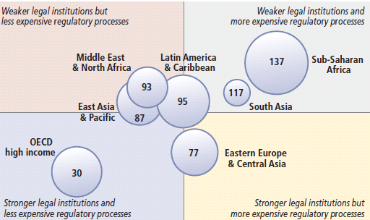
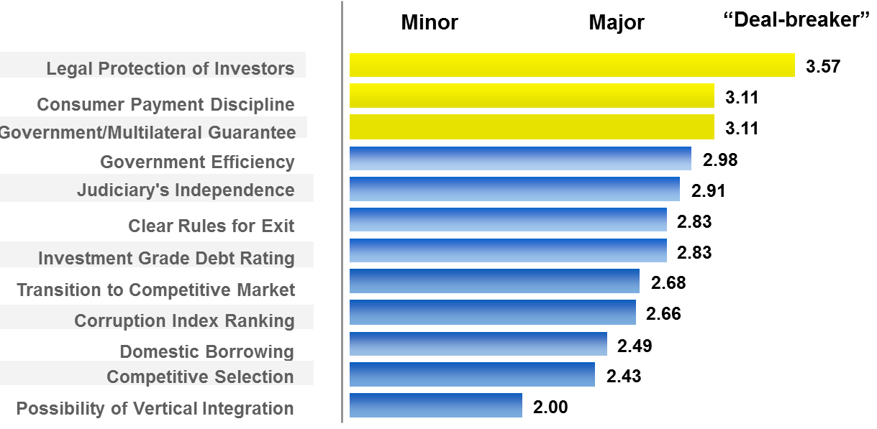
Conductive enabling framework
Institutional framework
Legal framework
Capacity
World Bank surveys of investors have repeatedly shown that the issue of 'protection of legal rights' is the primary concern in making decisions as to where to undertake major infrastructure projects
Institution and regulatory processes (Doing Business)
Notes:
Note: Strength of legal institutions refers to the average ranking in getting credit, protecting investors, enforcing contracts and
resolving insolvency. Complexity and cost of regulatory processes refers to the average ranking in starting a business, dealing with
construction permits, getting electricity, registering property, paying taxes and trading across borders.
The size of the bubble reflects the number of economies in each region and the number is the average ranking on the ease of doing business for the region.

Slide 27
Project Cycle
Some key elements:
  Processes
  Roles
  Check and balance
  Predictability

Slide 28
Planning: strategic and project delivery
Planning (and budgeting) is challenging in the context of rapid and volatile growth
Growth and rapid urbanization emphasizes the need for better planning
  The rural -> urban migration continues
Rapid expansion of mid size cities
  More cities implies need for better planning (avoid urban sprawl)
  Intercity competition and Fiscal federalism
The demand of transport is particularly challenging:
  Connectivity;
  Urban mobility and increase in motorization
But growth is happening with insufficient planning capacity because…
Insufficient articulation of planning between national and subnational level
Not all sectors are the same at planning:
  Inadequate understanding of levels of infrastructure needs
Adaptation and mitigation for climate change needs to be integrated into infrastructure planning

Slide 29
Planning: strategic and project delivery
Planning (and budgeting) is challenging in the context of rapid and volatile growth
But growth is happening with insufficient planning capacity because…
Growth and rapid urbanization emphasizes the need for better planning
  The rural -> urban migration continues
Rapid expansion of mid size cities
  More cities implies need for better planning (avoid urban sprawl)
  Intercity competition and Fiscal federalism
The demand of transport is particularly challenging:
  Connectivity;
  Urban mobility and increase in motorization
Insufficient articulation of planning between national and subnational level
Not all sectors are the same at planning:
  Inadequate understanding of levels of infrastructure needs
Adaptation and mitigation for climate change needs to be integrated into infrastructure planning

Slide 30
The political economy of large scale projects: commitment and beyond…
Getting the right solution: e.g. metro/BRT/elevated train
Political cycle: I want it, and I want it now!
  governance, checks and balance
Citizen engagement: it works better when all voices are represented
Managing expectation: FDI, private investments; market test
Maximizing the benefits:
  e.g. feeders, tariff integration, land use
  hard vs. soft infrastructure
Crossing borders:
  metropolitan authority
  last mile connectivity (road/rail/port)
  cross-border projects (tunnel, power lines, etc.)

Slide 31
Project preparation and procurement
Poor project preparation
  Contractual closure and financial closure
  Election cycle
Implementation Capacity
Lack of (clear) procedures and gateways
  Environmental legislation (DFBOT) and land acquisition
Risk analysis:
Checklist (project readiness)
Reform or creation of new PPP units
  Colombia, Chile and Peru
  Uruguay, Paraguay and Argentina
Procurement
  Processes and timetable, transparency
  Attracting the right expertise
Value for money
  In project preparation rather than in a quantitative PSC
Identification
Measurement
Mitigation
Allocation

Slide 32
Cost and time overruns in PPP vs. Traditional procurement
Source: PPP Reference Guide V2.0 for the UK and Australia and WB for Peru

Slide 33
PPP Benchmarking
Source PPP Procurement Benchmark WB

Slide 34
Contract Management
Establishing contract management institutions:
  Defining and establishing the responsibilities and communication mechanisms that will enable an effective relationship between the public and private partners to the contract
Monitoring PPP delivery and risk:
  Monitoring and enforcing contract compliance and service performance by the private party, ensuring the government delivers on its responsibilities under the contract efficiently, and monitoring and mitigating risk
Dealing with change:
  Putting into practice the mechanisms to deal with contract adjustments, dispute resolution, and contract termination, as well as deciding whether, when and how to re-negotiate
Managing contract expiry and asset handover:
  Managing the transition of assets and operations at the end of the contract term.

Slide 35
Selected case studies

Slide 36
Chile: achievements of the concession program
Statistics speak louder than words
  Program started in 1993
  +14 billion USD
  +3 billion under constructions
  79 contracts (45 in operation)
  $335.4 billion GPD
  Population: +17 millions
Public building (and others): hospitals; prisons; museum; Transantiago Infrastructure; Stadium(s)

Slide 37
Chile Annual Investment in Concession (MoPW)

Slide 38
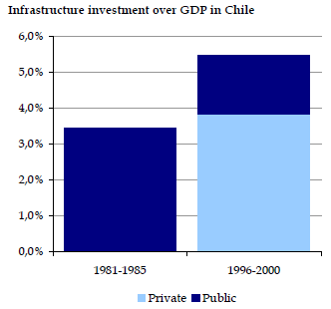
Chile: other achievements (and some weakness)
Innovations:
  Infrastructure bonds
  Variable term contract with LPV
  MRG
Development of capital market & long term financing
A way paved of many contract renegotiations – mainly to increase investments rather than for bankability issues (but opportunistic)
  By 2010 a modification of concession law limits the incentives for renegotiations and introduces competing bidding when there are new investments
Source: BBVA , as presented in Bond Markets and Infrastructure Financing, An Introduction, World Bank, Loladze Tamuna, February 2013

Slide 39
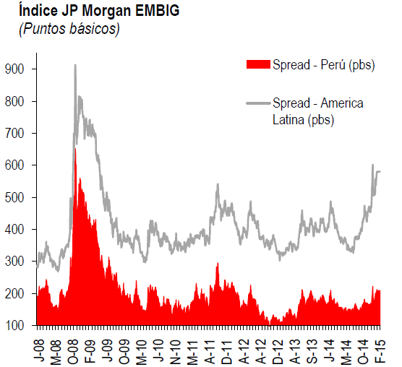
Peru: some achievements
92 PPP transactions (1993-2016)
USD 29 billion investment commitments
Innovation in PPP financing instruments (from CRPAO to RPICAO) mobilized important investments, including pension fund participation
JP Morgan EMBIG
(Basic Points)
Source: Central Bank Peru

Slide 40
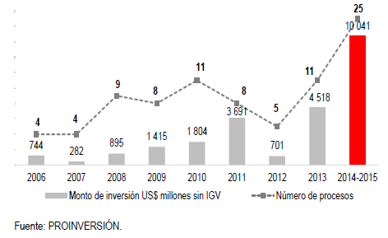
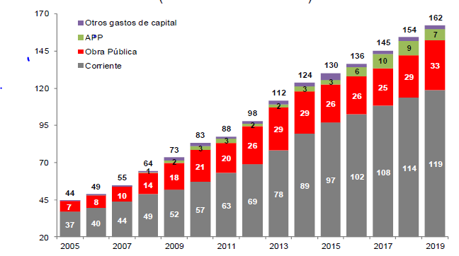
Peru: more and bigger PPP transactions will increase PPP expenses in the coming years
Source: Proinversion
Source: Ministry of Finance

Slide 41
Peru: PPPs reforms to meet OECD standards
2015: New PPP law and regulations met OECD governance principals.
2016:
  PPP instruments to manage project appraisal, risk allocation and standard PPP contracts, based in more Value for money.
  New law to strengthen the PPP agency (Proinversion) with more independency, capacity, decentralization and leadership.
2017: Implementation of upgraded PPP regulatory framework.

Slide 42
Other programs
Uruguay
Paraguay
Argentina…

