Slide 1
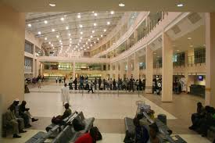
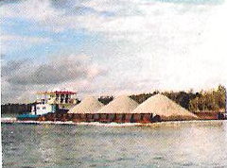
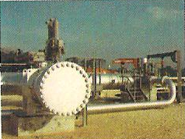
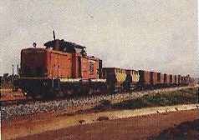
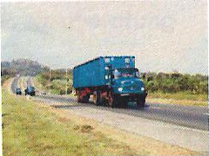
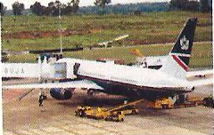
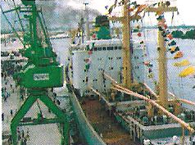
Aminu Diko DIRECTOR GENERAL INFRASTRUCTURE CONCESSION REGULATORY COMMISSION November 2, 2015
2015 ISTANBUL PPP WEEK
Nigeria’s Country Presentation
PRESENTATION BY THE INFRASTRUCTURE CONCESSION REGULATORY COMMISSION AT THE 1ST ISTANBUL PPP WEEK, 2015. ISTANBUL, TURKEY

Slide 2
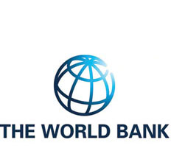
Thank You All For This Summit

Slide 3
Outline
Introducing Nigeria
Nigerian Investment Needs & Opportunities
The Nigerian PPP Framework: Overview
Completed PPP Projects in Nigeria
Current/Ongoing PPP Projects in Nigeria
Future Infrastructure Projects in Nigeria

Slide 4
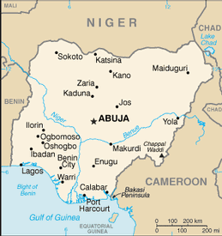
Introducing Nigeria
Size: 923,764 Sq.KM
Population: 170,000,000
Following 2014 rebasing, Nigeria emerged Africa’s largest economy with GDP at US$502 billion
Economy continued to grow at 6-8% per annum and projected to grow at 7.4 in 2016. IMF

Slide 5
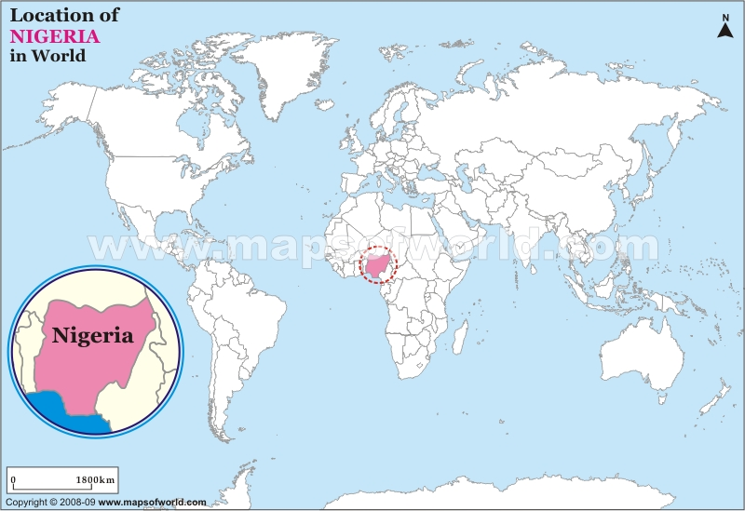
Introducing Nigeria
SWF with over $1billion under management
$1 billion of Pension funds available for investment in infrastructure.
Population = 170million
Civilian Rule since 1999
Rebased Economy Diversifying though Oil provides 95% of foreign exchange earning

Slide 6
Introducing Nigeria
Goldman Sachs project that if growth the trajectory is maintained, Nigeria could become:
the 20th largest economy by 2025 on the basis of GDP
21st on per Capita Income (2025).
12th largest economy to 2050 based on GDP.

Slide 7
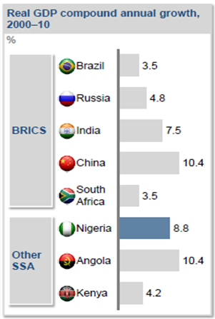
Investment Needs & Opportunities
Sources: World Bank/IMF

Slide 8
Investment Needs & Opportunities
International Benchmark for core infrastructure – 70% of GDP
Nigeria is at between 35% - 40% of GDP
Despite strong fundamentals, oil and mineral rich Nigeria has been humbled by inadequate power supply, huge infrastructure deficit and insecurity concerns

Slide 9
Investment Needs & Opportunities
Based on a 30-year National Integrated Infrastructure Masterplan (NIIMP) :
Nigeria requires an expenditure of US$ 3.10 trillion in 30 years.
48% of planned investment is expected to be from the private sector through PPP transactions.
The expenditure requirement for the first five years of the plan comprises Energy (US$13bn), Transport (US$11bn), Agric. (US$3.2bn) and ICT (US$3.7bn). Others are Housing (US$1.4bn), Social Information (US$2.1bn) and Vital Registration & Security (US$ 0.6bn).
Source: NPC

Slide 10
The Nigerian PPP Framework
FOR SUCCESSFUL INVESTMENT
Coherent Planning Framework
Policy; Roadmap
Legal and Regulatory Framework
Infrastructure Financing Framework
Institutional Framework
Human Capital Development
LEADERSHIP

Slide 11
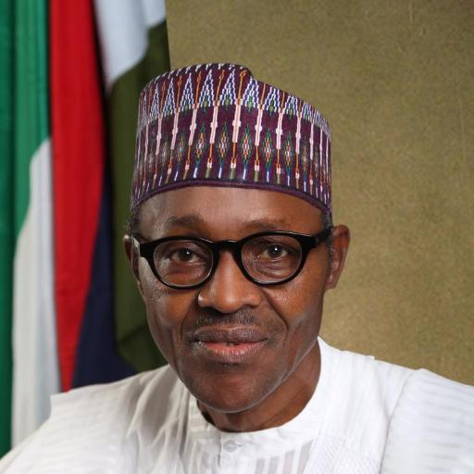
Political Commitment
EXCERPTS OF SPEECH OF PRESIDENT
MUHAMMADU BUHARI
AT THE
THE 55TH GENERAL CONFERENCE OF THE NIGERIAN BAR ASSOCIATION
AUGUST 23, 2015
“It becomes even more important that our legal system is made to function smoothly speedily and effectively. Nigeria is now in a situation where it obviously has to diversify its economy. We also have a huge infrastructure deficit for which we require foreign capital and expertise to supplement whatever resources we can marshal at home. In essence, we seek public private partnerships in our quest for enhanced capital and expertise.”

Slide 12
Independent Regulator
The Infrastructure Concession Regulatory Commission (ICRC)
was established in 2008 to:`
Regulate Public Private Partnership (PPP) procurement by:
Guiding Federal government agencies in structuring PPP transactions for both green field and brown field infrastructure – Pre Contract regulation
Ensuring compliance with the terms and conditions of such contracts -Post Contract Regulation
Issue regulations and guidelines over PPP
Operates under law of 2005, National Policy on PPP 2009 and reporting to the President.

Slide 13
Completed PPP Projects
S/No | Sectors/Projects | Number of Projects | % Composition of PPPs by Sector
1. | Sea Ports and Marine Services | 25 | 54.35
2. | Power Sector Projects | 2 | 4.35
3. | Aviation Concessions | 3 | 6.52
4. | Urban and District Engineering Infrastructure | 1 | 2.17
5. | Social Infrastructure (Complexes) | 2 | 4.35
6. | Information Technology | 2 | 4.35
7. | Telecommunication Infrastructure | 2 | 4.35
8. | Inland Container Depot (ICDs) | 6 | 13.04
9. | Health Care Delivery Service | 1 | 2.17
10. | Marine Security concession project | 1 | 2.17
11. | Housing Development Project | 1 | 2.17
 | TOTAL | 46 | 100

Slide 14
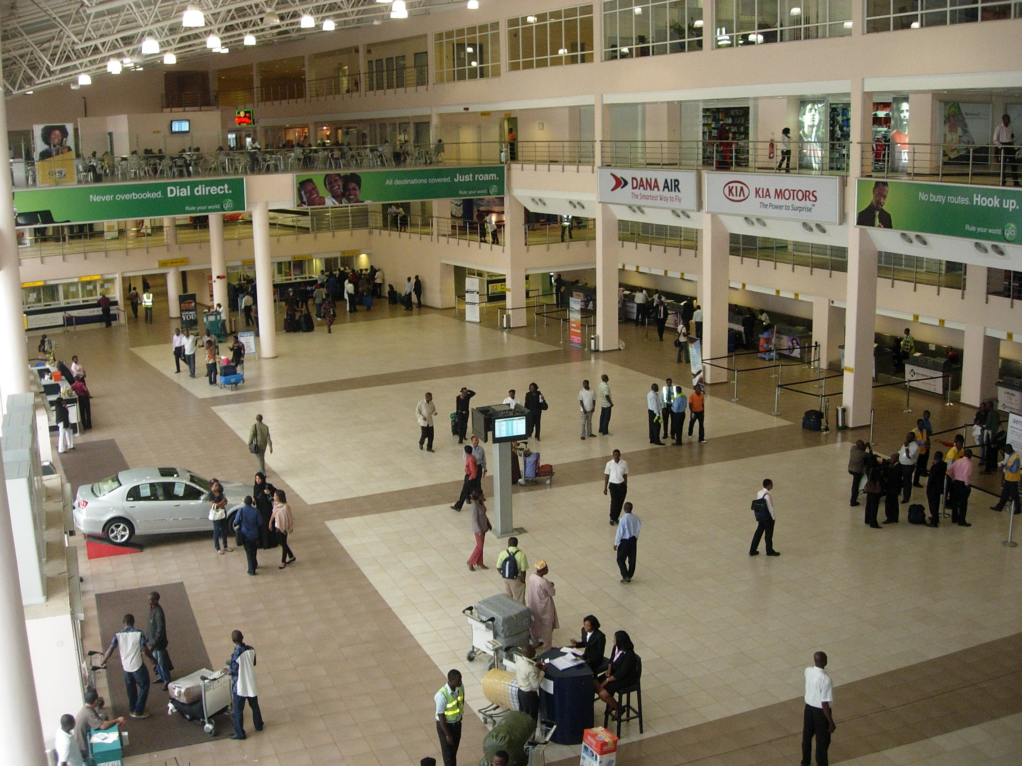
Completed PPP Projects - Airports
MMA2 Departure Hall

Slide 15
Current & Ongoing Projects
Sector | Project
Energy | 7
Agriculture/Irrigation/Dam | 9
Urban Infrastructure | 8
Roads/Bridges | 12
Seaports & Inland Container Depot | 2
Railway (Green Fields – 615km) | 1
Social Infrastructure (Stadia) | 2
Health | 1
Media | 6
TOTAL | 48

Slide 16
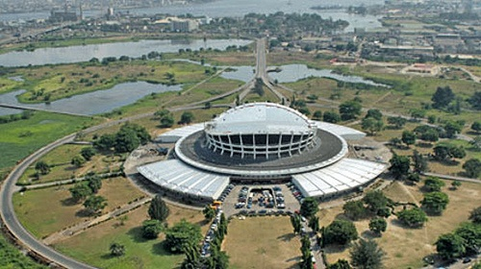
Re-development of National Arts Theatre, Lagos
Current & Ongoing Projects
Development of 65 hectares fallow land around the 134 hectares theatre complex. Completed in 1976 for FESTAC in 1977.

Slide 17
Current & Ongoing Projects
Re-development of National Arts Theatre, Lagos

Slide 18
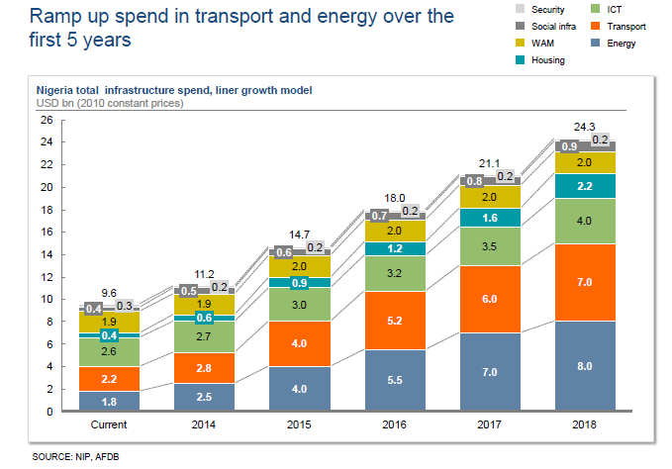
Future Infrastructure Projects

Slide 19
Future Infrastructure Projects
NNPC $5bn Calabar - Kano Gas Pipeline. Subset of Trans-Saharan Gas Pipeline project.
Rehabilitation and upgrade of 368 Km Shagamu-Benin-Asaba Expressways through PPP.
Inland Ports Concession at Onitsha, Baro, Lokoja & Oguta.

Slide 20
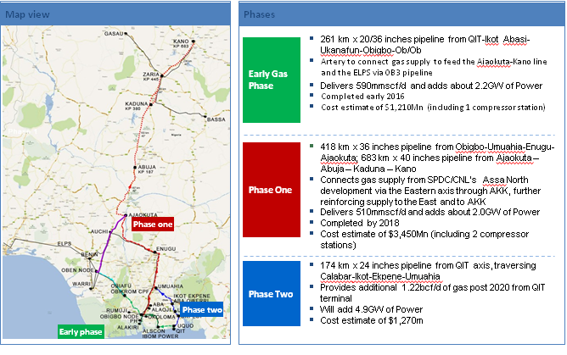
Future Infrastructure Projects - Gas
Calabar – Kano Gas Pipeline Project
Source: NNPC

Slide 21
Future Infrastructure Projects - Roads
ROAD NETWORK - 2020
Future Infrastructure Project-Roads

Slide 22
Future Infrastructure Projects - Prisons
Kirikiri Port Lighter Terminal I & II, Lagos.
Ibom Deep Sea Port ($2.64 billion estimated cost - private sector funding)
Nigerian Prisons Redevelopment
6 Integrated Prisons Facility, with value chain linkages to be located in 6 geopolitical zones. Some will be structured under a Land Swap Arrangement.

Slide 23
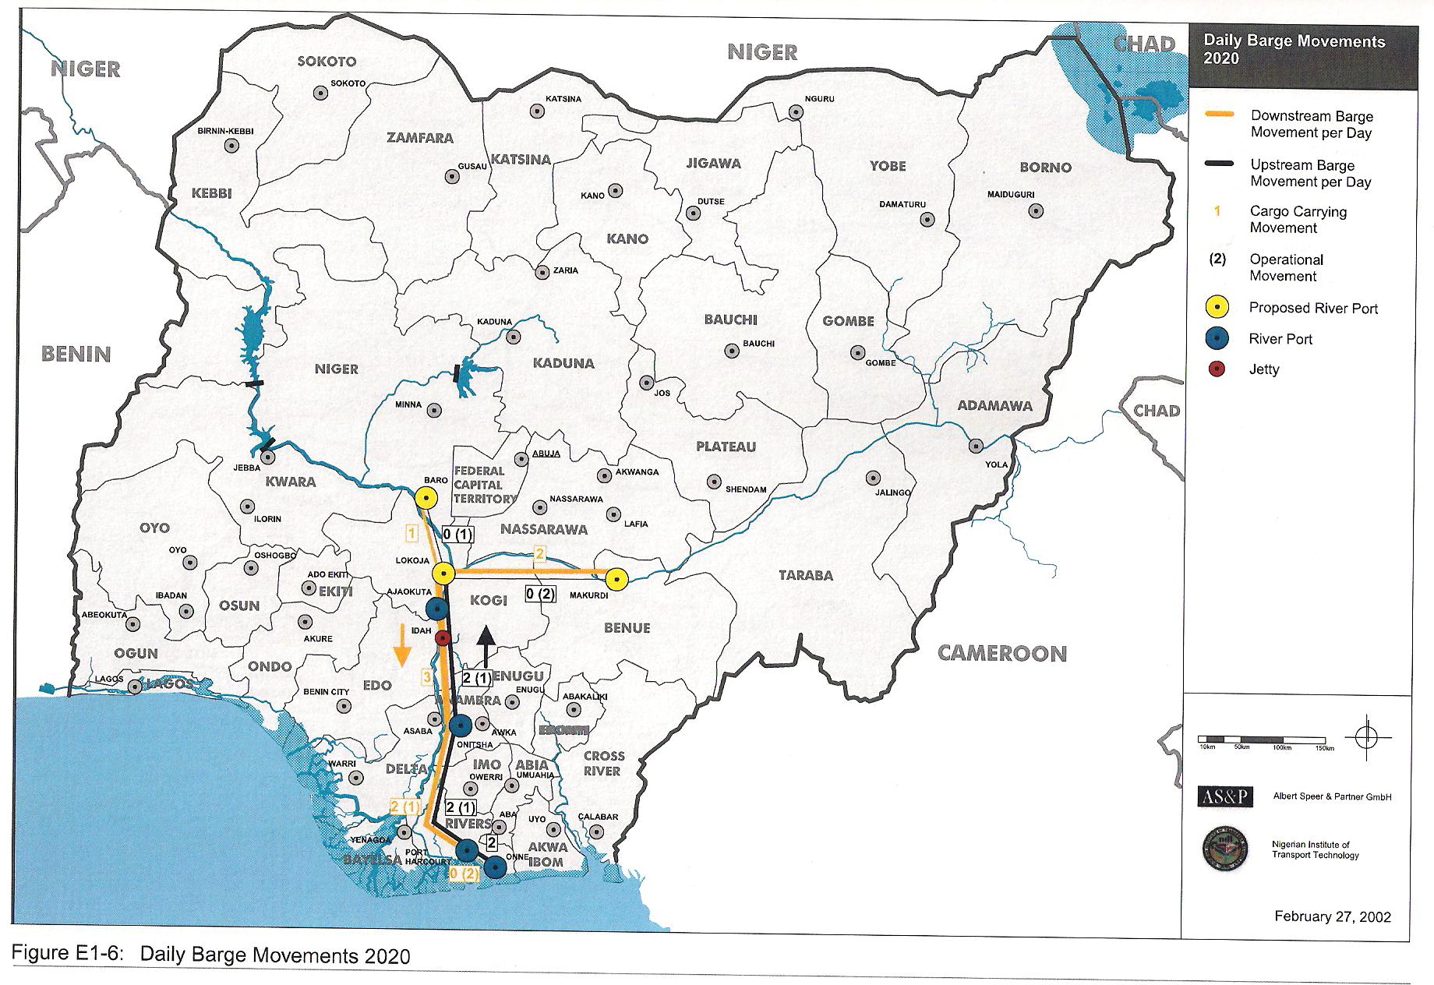
Future Infrastructure Projects - Ports
Lekki Deep Seaport
Akwa Ibom Deep seaport

Slide 24
Future Infrastructure Projects - Dams
Ten Small Dams in 3 Lots
LOTS | DAMS
Lot 1 | 10MW Oyan Dam Ogun State, 6MW Ikere Gorge Dam Oyo State 450KW Owena Dam Ondo State.
Lot 2 | 3MW Bakolori Dam, Zamfara State 500KW Kampe, Dam Kogi State 1MW Doma, Dam Nasarawa State.
Lot 3 | 4MW Jibia Dam, Katsina State 300KW Zobe, Dam Katina state 10MW Toga Dam, Kano state 10MW Challawa Dam, Kano State

Slide 25
Future Infrastructure Projects - Rail
The Nigerian seeks to grant concessions of under mentioned railway corridors in the country:-
Narrow Gauge Railway Concessions (Brown Field: Lagos-Kano -1,126km; PH- Maiduguri 1,622 km)
Lagos -Ibadan – Oshogbo –Baro - Abuja - 615KM (High-speed)
Lagos - Shagamu- Ijebu Ode- Ore- Benin City (300km) (standard gauge)
Benin - Agbor-OgwashiUku- Asaba- Onitsha - Nnewi - Owerri-Aba with additional line from Onitsha-Enugu – Abakaliki -500km. (standard gauge)
Ajaokuta(Eganyi)-Obajana-Jakura-Baro-Abuja with additional line from Ajaokuta- Otukpo -533km (standard gauge)
Zaria - Funtua - Tsafe - Gusau - Kaura - Namoda-Sokoto-Illela- 520Km (standard gauge)

Slide 26
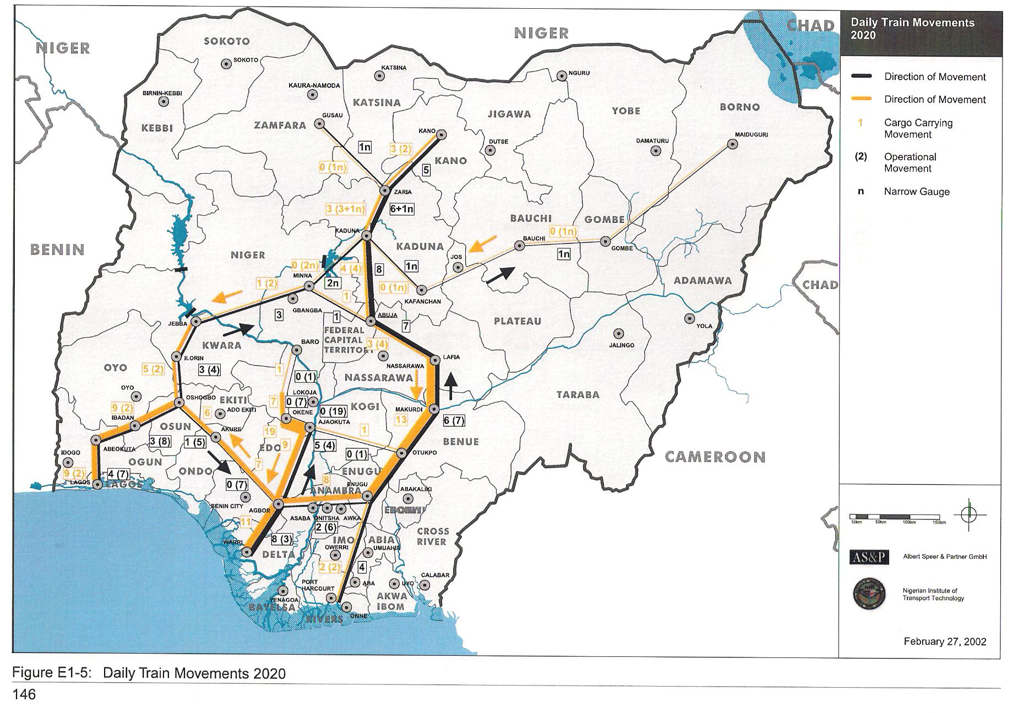
Future Infrastructure Projects - Rail
28

Slide 27
INFRASTRUCTURE CONCESSION REGULATORY COMMISSION
Plot 1270 Ayangba Street, Near FCDA Headquarters,
Area 11, Garki, Abuja – Federal Capital City.
Phone: +234 9-4604900, E-mail: info@icrc.gov.ng
Website: www.icrc.gov.ng

