Slide 1


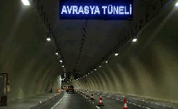
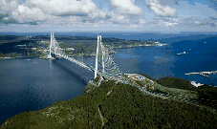
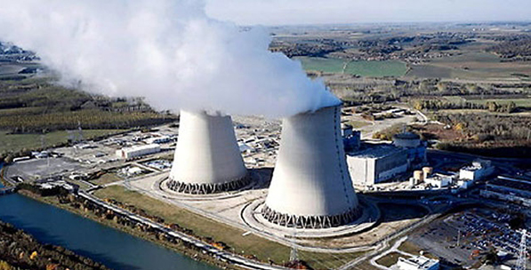

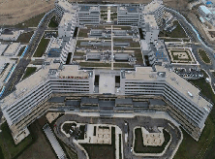
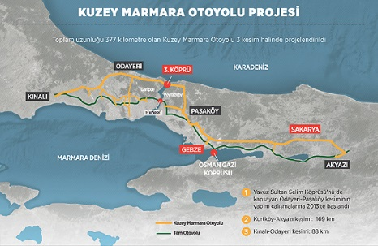
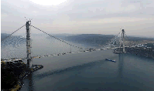
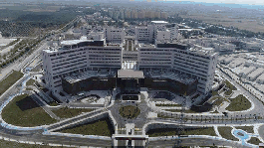

PPP Week 2020
‘ICBC Investments in PPP Market & Turkish Cases’
Ahmet Can Yakar
ICBC Turkey Investment Banking Project Finance Department
5st Nov 2020
1

Slide 2
About Me
Ahmet Can Yakar has started his banking career at Denizbank Corporate Banking Division, and then developed his expertise in the field of project finance at Denizbank. After he worked for UniCredit and Ciner Group, currently he works at ICBC Turkey Investment Banking Project Finance Department as Department Head being mainly responsible for infrastructure, energy, M&A financing and refinancing projects, with a concentration on financing healthcare PPP’s, BOT type, renewable energy investments as well as CCGT’s and CFPP’s.
As educational background; after graduating from Bilkent University Department of Business Administration, Mr. Ahmet Can Yakar successfully completed his masters degree on MSc Business Studies specialization on Entrepreneurship at University of Amsterdam.
The projects which Ahmet Can Yakar has participate in are as below;
İzmir Adnan Menderes Airport Financing
Istanbul Grand Airport Financing
Ilısu DAM Financing
Bodrum Airport Financing
Graniser M&A Transition Long Term Financing
Etlik Integrated Hospital PPP Financing
Mersin Integrated Hospital PPP Financing
Çanakkale Bridge and Malkara Motorway Financing
Bursa Integrated Hospital PPP Financing
Elazığ Integrated Hospital PPP Financing
İzmir Integrated Hospital PPP Financing
Kocaeli Integrated Hospital PPP Financing
3rd Bridge Project Refinancing
Northern Marmara Motorway Project Financing
Güriş Integrated Hospital PPP Financing
TKD Hydroelectrical Power Plants Financing
Eczacıbaşı Long Term Investment Loan Financing
ICBC Turkey Investment Banking Project Finance Department
1

Slide 3
Outline
PPP Framework
Public - Private Partnership Model
Definition of PPP
Why Public - Private Partnership Model?
PPP Contract Types
Turkish PPP Healthcare PPPs
PPP Models in Turkey
Turkish PPP Healthcare PPPs
PPPs in TURKEY-Stakeholders
Successfully Delivering PPPs – Best Practise
Hospital-Health Campus PPP Projects in Turkey
Incentives for PPP projects in Turkey for Banks
Hospital-Health Campus PPP Projects in Turkey and ICBC Participation
ICBC Investments in PPP Market
Best Practice in Turkey – Elazığ Fethi Sekin City Hospital
Covid-19 Pandemic and Its Effects on PPP Projects
Conclusion
ICBC Turkey Investment Banking Project Finance Department
1

Slide 4
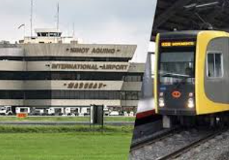
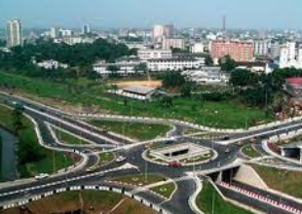
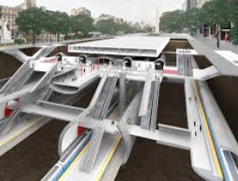
PPP Framework (1)
A PPP framework is best understood as the established procedures, rules and institutional responsibilities that determine how the government selects, implements and manages PPP projects.
By defining institutional responsibilities, a PPP framework makes institutions accountable for their role in procedures and rules, good PPP practice can be established within the government.
A good PPP framework lets the market know how PPP projects will be developed, and how bids will be assessed. This can lead to more competitive procurement and better value for the public.
ICBC Turkey Investment Banking Project Finance Department
1
1

Slide 5


PPP Framework (2)
The PPP framework will need to be developed taking into account the legislative and administrative contexts. The PPP framework will often be embodied in PPP specific policy documents or legislation. PPP frameworks typically define;
Procedures: What things need to be done, by whom, in what order, to allow the right decision to be made and the right actions to be taken? For example, the Appraisal Phase could set out how a specified agency in government will gather and process information to assess whether the project would be best done as a PPP.
Decision criteria: How will decisions be made at each step? Again, at the Appraisal Phase, one criterion should be “whether the public interest will be better served by doing this as a PPP or as a conventional public sector project”.
Institutional responsibilities: Which entities are responsible for which tasks and objectives? For example, a specialist PPP unit may be responsible for assessing whether a project is best done as a PPP or not; the cabinet may be responsible for making a decision at to whether a project should proceed as a PPP; the ministry of finance may have a responsibility to advise on fiscal commitments made to a PPP project.
ICBC Turkey Investment Banking Project Finance Department
2
1

Slide 6
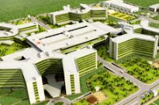
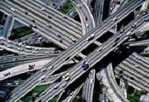
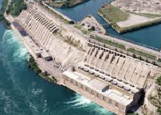
Public - Private Partnership Model
PPPs as a Definition:
A long-term contract between a private party and a government entity, for providing a public asset or service, in which the private party bears significant risk and management responsibility and remuneration is linked to performance. PPP is regarded as a method for procuring and delivering both public assets.
PPP is an alternative procurement method being adopted for public infrastructure development worldwide. In PPP method, public sector invites private agencies to bring their capital and technical assets for executing public projects. PPP is being popularized worldwide for its potential benefits.
Public-private partnership (PPP) means that the government and the private sector enter into long-term collaboration on government building and infrastructure projects. The goal of these partnerships is to produce better-quality end products at lower cost. Tasks and risks are shared, and each party is responsible for the tasks it is best equipped to perform, as well as for the associated risks.
Public
Private
Direct Agreements
PPP
Various recourse mechanisms
Lenders
ICBC Turkey Investment Banking Project Finance Department
3
9

Slide 7
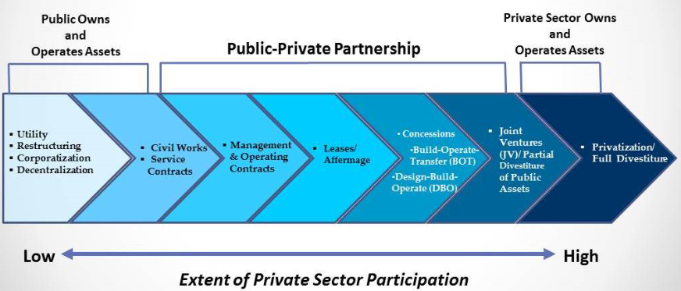
Definition of PPP (1)
A long-term contract between a private party and a government entity, for providing a public asset or service, in which the private party bears significant risk and management responsibility and remuneration is linked to performance.
Public-private partnership (PPP) means that the government and the private sector enter into long-term collaboration on government building and infrastructure projects. The goal of these partnerships is to produce better-quality end products at lower cost. Tasks and risks are shared, and each party is responsible for the tasks it is best equipped to perform, as well as for the associated risks.
ICBC Turkey Investment Banking Project Finance Department
4
1

Slide 8
Definition of PPP (2)
Most PPP projects present a contractual term between 20 and 30 years; others have shorter terms; and a few last longer than 30 years. The term should always be long enough for the private party to have an incentive to integrate service delivery costs considerations into the design phase of the project.
This includes maintenance considerations as well, in order for the trade-offs between initial investment cost and future maintenance and operation costs to be optimized. The “whole-life” approach, considering whole-life costs and whole-life benefits, maximizes the efficiency of service delivery. It is at the core of the rationale for using PPPs for the delivery of public services.
The precise length of the contract depends on the type of project and policy considerations. Policy makers need to satisfy themselves that the demand for the services delivered by the project will be sustained over the whole life of the contract; the private party should be able to accept responsibility for service delivery over its term; and the procuring authority should be able to commit to the project for its term.
The availability of finance, and its conditions, may also influence the term of the PPP contract.
ICBC Turkey Investment Banking Project Finance Department
5
1

Slide 9
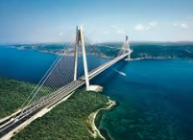
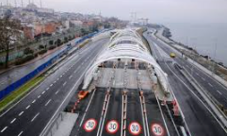
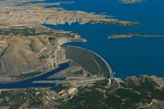
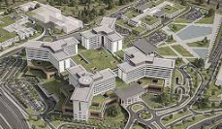
Why Public - Private Partnership Model?
When governments need to develop their physical and social infrastructure to provide necessary services to their citizens, they must decide how they will structure and finance it. They can do any of the following:
Finance, manage and oversee the construction, operation and maintenance (O&M) of the project themselves while contracting out discrete aspects of the project to different private sector parties.
Sell the project outright to a private sector party.
Enter into a public private partnership (PPP) agreement with a private sector party to perform all or material portions of the project.
Many governments do not want (or cannot afford) to assume full financial responsibility for their infrastructure projects. They may also lack the personnel and expertise necessary to develop and manage these projects. However, the privatization of the project may not be desired or appropriate (for example, for roads, highways and bridges or for assets that may have national security implications). As a result, governments are pursuing the third option and are increasingly using PPPs to develop their infrastructure.
Fundamentally, a PPP is a long-term contract between a government (the local or national government) or government-owned entity (hereinafter referred to as a public agency) and a private sector party.
ICBC Turkey Investment Banking Project Finance Department
6
1

Slide 10
PPP Contract Types
The functions for which the private party is responsible vary and depend on the type of asset and service involved. Typical functions include:
Design (also called engineering work): involves developing the project from initial concept and output requirements to construction-ready design specifications,
Build, or Rehabilitate: when PPPs are used for new infrastructure assets, they typically require the private party to construct the asset and install all equipment. Where PPPs involve existing assets, the private party may be responsible for rehabilitating or extending the asset,
Finance: when a PPP includes building or rehabilitating the asset, the private party is typically also required to finance all or part of the necessary capital expenditure, as described further in How PPPs Are Financed,
Maintain: PPPs assign responsibility to the private party for maintaining an infrastructure asset to a specified standard over the life of the contract. This is a fundamental feature of PPP contracts,
Operate: the operating responsibilities of the private party to a PPP can vary widely, depending on the nature of the underlying asset and associated service. For example, the private party could be responsible for,
Technical operation of an asset and providing a bulk service to a government off-taker—for example, a bulk water treatment plant,
Technical operation of an asset and providing services directly to users—for example, a PPP for a water distribution system,
Providing support services with the government agency remaining responsible for delivering the public service to users—for example, a PPP for a school building that includes janitorial service.
1
7
ICBC Turkey Investment Banking Project Finance Department

Slide 11
PPP Models in Turkey
1. TOR - Concession method: The TOR model in general refers to an administration transferring the operation of its assets for a designated period to the private sector in consideration for a payment. Ownership of the asset remains with the administration.
2.1 BOT – Concession method: Today, the BOT model and concession method are used concurrently for many PPP projects. The concession route is used mainly for the transfer of operating rights to existing publicly-owned infrastructure, such as ports, roads, and electricity distribution facilities. This method was used to transfer the operation rights to sizeable ports, as well as a portion of the entirety of the country’s vehicle safety inspection stations, to the private sector.
2.2 Build-Operate-Transfer (BOT): Under this model, the private party finances, builds, and operates the project during the term of the agreement. At the designated expiry date, the private sector partner returns the property to the administration.
3. Build-Operate (BO): Under the BO model, the private party finances, builds, and operates the project. However, the ownership of the property remains with the private party even after the expiry of the agreement.
4. Build-Lease-Transfer (BLT): The BLT model is predicated on the administration providing a private party with servitude rights over certain real property, and the private party financing, designing, and building the facilities. The private party then leases the facilities back to the administration for a designated time period and also provides certain operational services. The servitude right and thus the facilities are handed back to the administration free of charge and without encumbrances at the end of the contract period.
5. Build-Lease (BL): In the BL model, the private sector builds and then leases the facilities to the relevant administration. The administration operates the facilities for a maximum lease period of forty-nine years in consideration for rental fees, and the facilities are handed back to the administration free of charge and without encumbrances at the end of the contract period. The basic features of the above mentioned PPP models (other than the BL model, which only applies to the education sector) can be found in the table of “Legislative Comparison in Turkish PPPs”
ICBC Turkey Investment Banking Project Finance Department
8

Slide 12
Turkish PPP Healthcare PPPs
Overview of the Turkish PPP Healthcare Programme;
As a result of rapid increasing demand for healthcare services, Turkey’s Health Transformation Programme(HTTP) was introduced by the government in 2003 to enhance the accessibility, efficiency, and quality of healthcare facilities. Due to the limited availability of public resources to fund these new investments in healthcare, the government has decided to procure them by using a build-lease-transfer model via public-private partnership (PPP);
All public facilities were merged under MoH responsibility in 2005.
The financing of health care services underwent a major restructuring – 5 social security funds were merged in a newly created Social Security Institution “SSI”.
A pilot family practitioner was introduced and extended to cover the whole population by end 2010.
The HTP aimed at increasing the administrative and financial autonomy of hospitals.
Facing constraints on public resources and fiscal space, while recognizing the importance of investment in infrastructure to help their economies grow, governments are increasingly turning to the private sector as an alternative additional source of funding to meet the funding gap.
Sponsors
MoH
Direct Agreement
Project Agreement
Shareholders’ Agreement
Loan / Facility
Project Company SPV
Agreement
Lenders
EPC Contract
O&M Contract
Direct Agreement
EPC Contractor
O&M Contractor
9
Direct Agreement

Slide 13
Turkish PPP Healthcare PPPs
Key Attractions of Turkish PPP Program
Adjustment against Inflation and FX
No Double Counting for Deductions and Penalties
Capped Variation Orders (1% and up to 20%)
Capped Deductions (20% of Service and 10% of Lease)
VAT Exemption for CAPEX
Compensation at Termination for Loan & Equity
Market Testing for Services (every 5 years)
Insurance Risk taken by MoH
Protection against Change in Law
ICC International Arbitration for Dispute Resolution
Lenders sign Direct Agreements with the MoH
ICBC Turkey Investment Banking Project Finance Department
10

Slide 14
Turkish PPP Healthcare PPPs
Average Concession Period: 28 Years
3 Years
25 Years
Investment Period
Operation Period
Highlights of the Project Agreement
SPV signs Project Agreement with MoH
The SPV is required to provide at least 20% Equity
Investment period starts with Site Delivery
SPV is not responsible of consumables & medicine used in medical treatment
SPV provides consumables used in support services
Market testing protects SPV to level service prices with market conditions
All payments are made in 7 days from dates due,
Aim of Turkish PPP Program
Creating a new modern and efficient public health infrastructure
Increasing number of beds
Upgrading current beds to qualified beds
Bringing together small hospitals under one campus to consolidate and save on operation expenses
Increased service quality and efficiency
Expansion and improvement of medical education and training.
ICBC Turkey Investment Banking Project Finance Department
11

Slide 15
Turkish PPP Healthcare PPPs
Steady Revenue Stream: The key cash flows and sources of revenue for the Project Company
Availability Payments
Debt
TRY
(Quarterly)
€ or US$
Service Payments
Non Volume Service Payments
TRY(monthly)
TRY
Operation and Maintenance Costs
MoH
Project Company
Volume Clinical Support Payments
€ or US$
Volume Service
Payments
TRY(monthly)
Volume Support Services Payments
TRY(monthly)
TRY
Debt Service
EPC Costs
CommerciallActivities
No Indexation
Inflation indexation only
Inflation and FX Indexation
ICBC Turkey Investment Banking Project Finance Department
12

Slide 16
Turkish PPP Healthcare PPPs
Two payments; Availability Payments and Service Payments are made to the SPV by the Turkish Government Ministry of Health in Turkish Lira (TRY).
Availability Payments
Non-volume Services
Revenues
Service
Payments
Support
Volume Based Services
Commercial Revenues
Medical Support
1. Availability Payments:
Composed of 90% of EBITDA; Collected independent of hospital occupancy rates (Fixed Income),
Guaranteed by MoH,
Payable quarterly in advance and denominated in TRY,
Adjusted quarterly by inflation and devaluation (Protection),
The correction factor (CF) provides mitigation should currency devaluation be more than inflation such that the EUR value of the AP cannot be lower in any period than the preceding period.
ICBC Turkey Investment Banking Project Finance Department
13

Slide 17
Turkish PPP Healthcare PPPs
2. Service Payments:
19 support services (P1+P2) will be provided by the SPV; 12 non-volume services and 7 volume services
Payments will be paid by monthly by the MoH to the SPV in TRY,
Guaranteed by MoH for certain volumes for volume based services (MoH will pay a discounted unitary price for amounts exceeding the guaranteed volume),
Until now, MoH guarantees a minimum 70% of the potential volume based services and the base case financial model only assumes this 70% payment, thus excluding any payments which are subject to volume risk
Payments will be adjusted by inflation annually; each period at the average of Turkish CPI and Turkish PPI (except medical support services),
Medical support services (which are all volume based) are not inflated in this way. Instead the unit price of these services are increased periodically in line with nationally agreed unit prices for medical services by MoH.
Market Test will be conducted for each service every 5 years in order to ensure and maintain the competitiveness of the price,
If market test is lost, MoH guarantees mark-up for overhead costs of SPV,
Capital intensive and specialized services such as imaging, lab, etc. will be outsourced (via sub service agreement)
Services | Category | Market Testing
P1 - MANDATORY SERVICES
Estate | non-volume | ✓
Extraordinary Maintenance | non-volume | ×
Utilities | non-volume | ✓
Other Medical Equipment Support | non-volume | ✓
Furniture | non-volume | ✓
Grounds & Garden (Landscaping) | non-volume | ✓
P2 - OPTIONAL SUPPORT SERVICES
Pest Control | non-volume | ✓
Car Parking | non-volume | ✓
Cleaning | non-volume | ✓
HIMS (IT) | non-volume | ✓
Security | non-volume | ✓
Patient Guiding/Portering/Reception/HelpDesk | non-volume | ✓
Linen (Laundry) | volume - support | ✓
Catering | volume - support | ✓
Waste Management | volume - support | ✓
Laboratories | volume - medical support | ✓
Imaging | volume - medical support | ✓
Sterilization and Disinfection | volume - medical support | ✓
Rehabilitation | volume - medical support | ✓
14

Slide 18
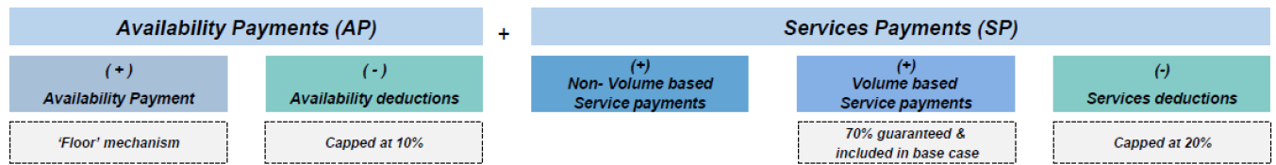
Turkish PPP Healthcare PPPs
About Financial Modelling of Turkish PPP Healthcare PPPs;
The Project revenues that are denominated in Turkish lira (“TRY”) will comprise Availability Payments, Service Payments and Commercial Revenues like the othet healthcare PPP projectsGuaranteed by MoH for certain volumes for volume based services (MoH will pay a discounted unitary price for amounts exceeding the guaranteed volume),
Availability Payments Payable in advance by the Administration to the Project Company at the beginning of each quarter in consideration of usage of the health facilities during the relevant period. The Availability Payments will be indexed for inflation and partially adjusted for foreign exchange fluctuations.
Service payments: are the maximum net amount payable by the Administration to the Project Company in consideration of the provision of the services by the Project Company excluding VAT and any other taxes and duties that are payable. Service payments shall be made by the Administration to the Project Company on a monthly basis. The Services are divided into two categories in terms of pricing and payment:
a) Non-Volume Services: Services with a constant volume which does not change in terms of the occupancy rate of the hospital, requirements, consumption and/or utilization. Non-volume services payments will be made by the Administration independently.
b) Volume Services: Services with a variable volume that change in terms of the occupancy rate of the hospital and/or consumption. Volume Services are further categorized into:
Medical support services and Service support services.
Administration underwrites a 70% occupancy rate for Volume Services during the Operating Period.
Commercial Revenues: Revenues related to commercial areas in the project.
ICBC Turkey Investment Banking Project Finance Department
15

Slide 19
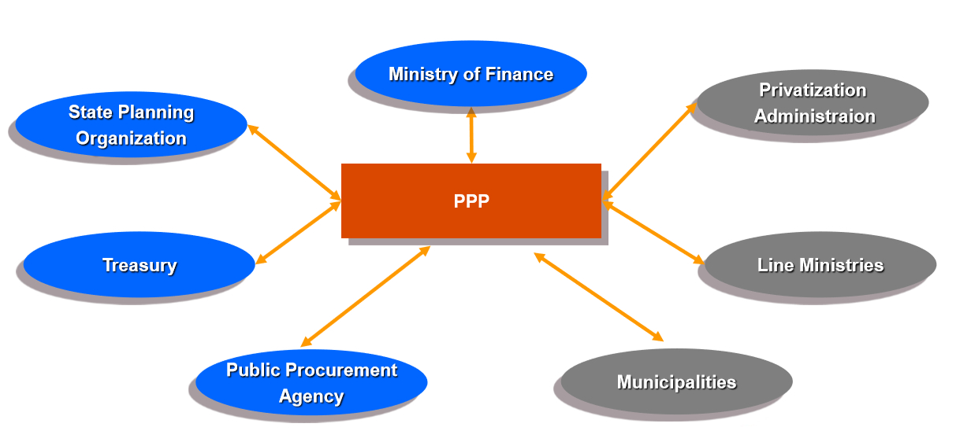
PPPs in TURKEY-Stakeholders
ICBC Turkey Investment Banking Project Finance Department
16

Slide 20
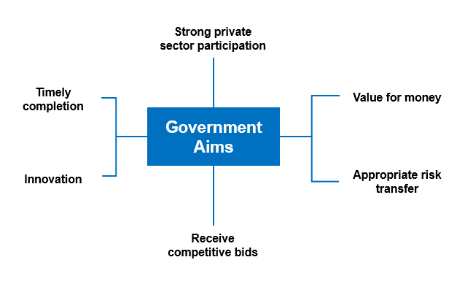
Successfully Delivering PPPs – Best Practise
ICBC Turkey Investment Banking Project Finance Department
17
1

Slide 21
Hospital-Health Campus PPP Projects in Turkey
Healthcare Sector in Turkey;
Several new governmental strategic plans and targets are being put in place in order to further improve the Turkish healthcare system.
Lack of Intensive Care Units & Quality Heathcare Services.
The growing population and ageing demographics contribute to the need to upgrade healthcare infrastructure; the percentage of the population over the age of 65 in Turkey is on a rise as it is expected to reach 10% of the total population in 2023 and 28% in 2075. In addition, there is a positive correlation between age and the increase in chronic diseases.
The estimates show that future changes in disease profiles are expected to put pressure on the healthcare system whch would require further investments in infrastructure and the diversification of healthcare services and as a result, spending per capita in healthcare in Turkey has been targeted to triple by 2023 (reaching USD 2,000). This fact can be supported also from expected increasing number in deaths from Cardiovascular Disease (CAGR of 28% by 2030) and Cancer, thus requiring lifelong medical attention and costly treatments.
Given physical space constraints and poor quality conditions, existing public hospitals are unable to meet patients‘ needs and to provide quality service.
Occupancy rates have substantially risen in 2013 and given increasing population and the requirements for higher services quality, new healthcare facilities are needed. High occupancy rates lead to a decrease in the quality of the services provided due to understaffing and increased waiting times.
OECD Statistics show that the supply of health workers in Turkey has increased over the past decade, but still remains low by OECD Standards. The number of doctors per capita in Turkey has risen considerably since 2000, going up from 1.0 doctor per 1000 population in 2000 to 1.8 in 2012, but this is still the lowest rate among other OECD countries and well below the OECD average of 3.2.
Social Security Coverage expansion;
The social security system in Turkey underwent major transformation, resulting more efficient. The social security system now covers approximately 99% of the total population, which is an increase of 29% from 2002.
The increasing number of persons benefiting from the social security system cause the increase in rate of utilization of healthcare facilities and services, confirming the fact that healthcare spending is showing an upward trend for the future.
ICBC Turkey Investment Banking Project Finance Department
18

Slide 22
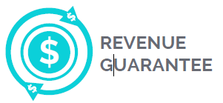
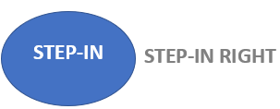

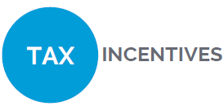

Incentives for PPP projects in Turkey for Banks
Certain PPP projects provide minimum revenue guarantees.
Lenders’ step-in rights allow the lenders to select, with the consent of the procuring authority, a new concessionaire to perform an ongoing PPP project in cases when the initial private partner is at risk of default.
The government may assume project companies’ foreign debt in BOT and BLT projects either partially or in full. In order qualify for debt assumption, the minimum investment must be ₺1 billion in BOT projects and ₺500 million in BLT projects.
Exemptions from certain fees and taxes (VAT and Stamp Duty). In addition, where applicable, PPP investors may benefit from corporate tax deductions and other financial incentives.
PPP projects in Turkey allow free use of government-owned land and expropriation.
ICBC Turkey Investment Banking Project Finance Department
19
1

Slide 23
Hospital-Health Campus PPP Projects in Turkey and ICBC Participation
PPP Projects of Turkey
 | Project Name | Bed Capacity | Status/Opening | ICBC Participation
1 | Adana PPP City Hospital Project | 1550 | Operative | -
2 | Mersin PPP City Hospital Project | 1294 | Operative | -
3 | Isparta PPP City Hospital Project | 755 | Operative | -
4 | Yozgat PPP City Hospital Project | 475 | Operative | -
5 | Kayseri PPP City Hospital Project | 1607 | Operative | -
6 | Manisa PPP City Hospital Project | 558 | Operative | -
7 | Elazığ PPP City Hospital Project | 1038 | Operative | Yes
8 | Ankara Bilkent PPP City Hospital Project | 3711 | Operative | -
9 | Eskişehir PPP City Hospital Project | 1081 | Operative | -
10 | Bursa PPP City Hospital Project | 1355 | Operative | Yes
11 | İstanbul PPP City Hospital Project | 2682 | Operative | -
12 | Konya Karatay PPP City Hospital Project | 1250 | Operative | -
13 | Tekirdağ PPP City Hospital Project | 480 | 2020 | -
14 | Kocaeli PPP City Hospital Project | 1210 | 2021 | Yes
15 | Kütahya PPP City Hospital Project | 610 | 2021 | Yes
16 | Ankara Etlik PPP City Hospital Project | 3624 | 2021 | -
17 | Gaziantep PPP City Hospital Project | 1875 | 2021 | -
18 | İzmir Bayraklı PPP City Hospital Project | 2060 | 2021 | Yes
Source: Ministry of Health
ICBC Turkey Investment Banking Project Finance Department
20
1

Slide 24
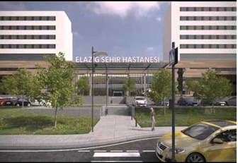
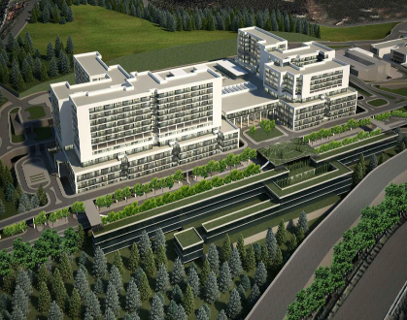
ICBC Investments in PPP Market
Elazığ Hospital PPP (ICBC Participated with EUR 35 mio)
Bursa Hospital PPP (ICBC Participated with EUR 10 mio)
1,038 beds integrated healthcare campus located in Elazığ. Project is under revenue and termination compensation guarantee by Ministry of Health. Project cost is EUR 360 mio
Elazığ Integrated Health Campus is operational as of 1 August 2018.
1,355 beds integrated healthcare campus located in Bursa. Project is under revenue and termination compensation guarantee by Ministry of Health. Project cost is EUR 487 mio.
Elazığ Integrated Health Campus is operational as of 16 July 2019.
İzmir Hospital PPP (ICBC Participated with EUR 80 mio)
Kocaeli Hospital PPP (ICBC Participated with EUR 10 mio)
2,060 beds integrated healthcare campus located in İzmir, Bayraklı District. Project is under revenue and termination compensation guarantee by Ministry of Health. Project cost is EUR 766 mio.
The project is under contruction and projected be operative in February 2022.
1,180 beds integrated healthcare campus located in Kocaeli, İzmit District. Project is under revenue and termination compensation guarantee by Ministry of Health. Project cost is EUR 409 mio
The project is under contruction and projected be operative in November 2021.
Kütahya Hospital PPP (ICBC Participated with EUR 30 mio)
600 beds integrated healthcare campus located in Kütahya. Project is under revenue and termination compensation guarantee by Ministry of Health. Project cost is EUR 220 mio
The project is under contruction and projeted to be operative in December 2021.
21

Slide 25
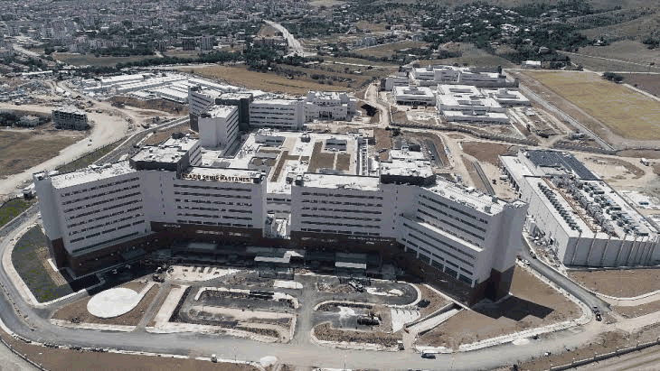
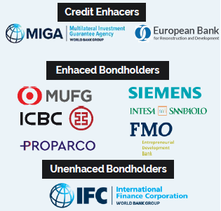

Best Practice in Turkey – Elazığ Fethi Sekin City Hospital
The Elazığ Fethi Sekin City Hospital provides healthcare services to the communities in Elazığ and neighbouring provinces, with a combined population of 1.6 million people.
Project Cost: €360 million= €288 million senior debt+ €72 million equity.
Bed capacity:1,038; Employment: 3,650
First project benefitting from risk mitigation provided jointly by MIGA’s political risk insurance coverage and EBRD’s unfunded liquidity facilities
First project bond financing for a greenfield infrastructure project in Turkey
A1 Bonds were rated Baa2
Vigeo Eiris certified the Elazig project bond as a ‘green and social’ bond –the first such certification for an infrastructure project in Turkey
With a 20 year maturity, the bond had the longest maturity for the Turkish Integrated Health Campuses PPP Programme
Source:Rönesans, GIH
22
1
ICBC Turkey Investment Banking Project Finance Department

Slide 26
Covid-19 Pandemic and Its Effects on PPP Projects in Turkey
Covid-19 disease is an ongoing worldwide pandemic, and the first Covid-19 positive diagnosis of Turkey was confirmed on March 11th, 2020. As a response to the outbreak, the Turkish government had imposed a set of strict social distancing measures.
With the spread of COVID-19, the business continuity of the Projects may be under increasing pressure over the next six to 12 months. Currently, the Projects (and all the stakeholders in this Projects) shall have a laser focus on mitigating the current challenges. The priority is naturally on the short-term recovery strategies.
It is also paramount at this stage, however, to also incorporate the medium to long term strategies for future forward-looking in a post COVID world. COVID-19 is expected to have an impact on the full spectrum of the Project lifecycle in the short-, medium-, and long-term. This includes the remainder of planning/design; build/construction; and commissioning; and operations and maintenance.
As one of the other the effect of Covid-19 pandemic is the possible decrease on occupancy levels and number of outpatient entries in PPP Hospitals. Due to pandemic, the MoH reduced the amount of appointments for noncritical patients which has decreased the number of patients admitted to the Hospital. Therefore, a decrease of volume on volume-based services are determined.
In addition there may be decreases in the number of medical tests, site inspections, drills and trainings. Due to current situation with Covid-19 around the world, Building and Land Services may also create encounter problems on access to material and specialized personnel to the facilities.
23
ICBC Turkey Investment Banking Project Finance Department

Slide 27
Conclusion
In PPP method, public sector invites private agencies to bring their capital and technical assets for executing public projects. PPP is being popularized worldwide for its potential benefits. In Public-private partnership model, the government and the private sector enter into long-term collaboration on government building and infrastructure projects.
PPP is an alternative procurement method being adopted for public infrastructure development worldwide. In PPP method, public sector invites private agencies to bring their capital and technical assets for executing public projects. PPP is being popularized worldwide for its potential benefits. In Public-private partnership model, the government and the private sector enter into long-term collaboration on government building and infrastructure projects.
Turkey is implementing the Public-Private-Partnership model since 2003 with the internationals financiers in addition to local financiers. Moreover, there is strong pipeline of Turkey which will give the private sector a much larger role in providing services with Public-Private-Partnership model.
Until today, ICBC Turkey Investment Banking Project Finance Department has been participated arrangement & financing of significant 5 Hospital PPP Projects of which 2 of them are already operative in addition to other landmark infrastructure projects. It is also important to mention that Elazig Hospital PPP deal is the first green-bond project financing of Turkey where the Project Company has investment grade.
ICBC Turkey Investment Banking Project Finance Department aims to participate in landmark projects which have strategic importance on Turkey’s development such as PPP Hospital and other Infrastructure Deals.
23
ICBC Turkey Investment Banking Project Finance Department

