Slide 1
AGIL AZIZOV
DEPUTY HEAD/UNEC
AZERBAIJAN

Slide 2
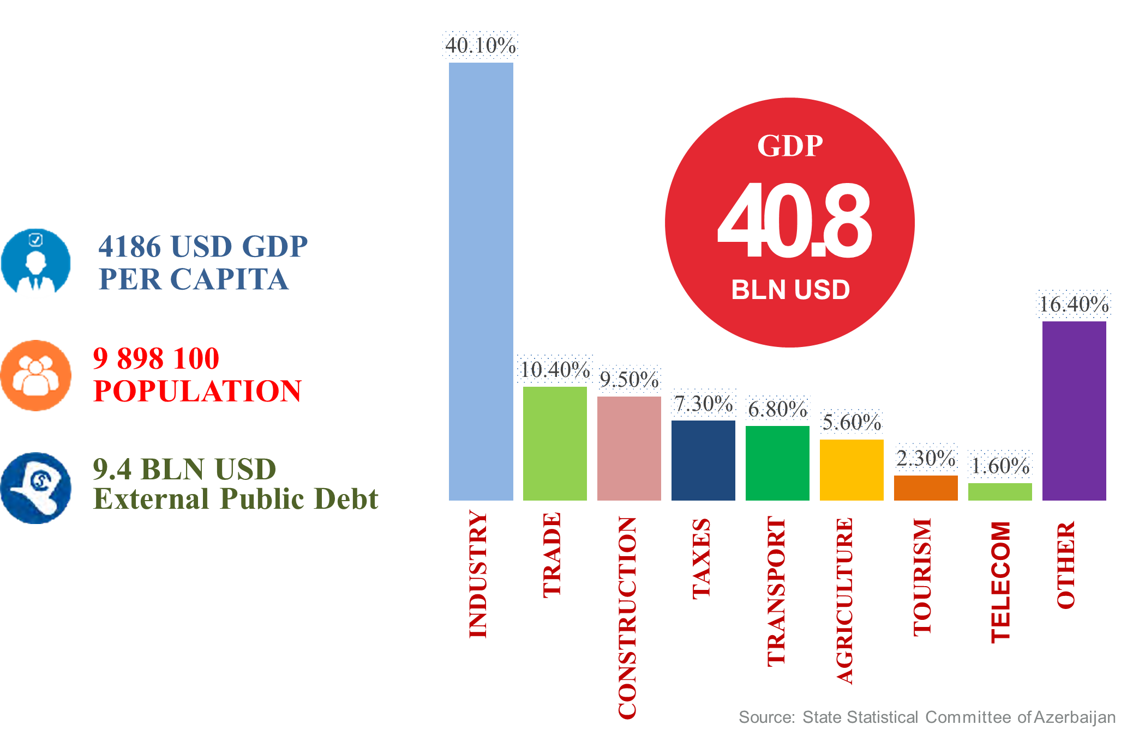
STATE OF ECONOMY

Slide 3
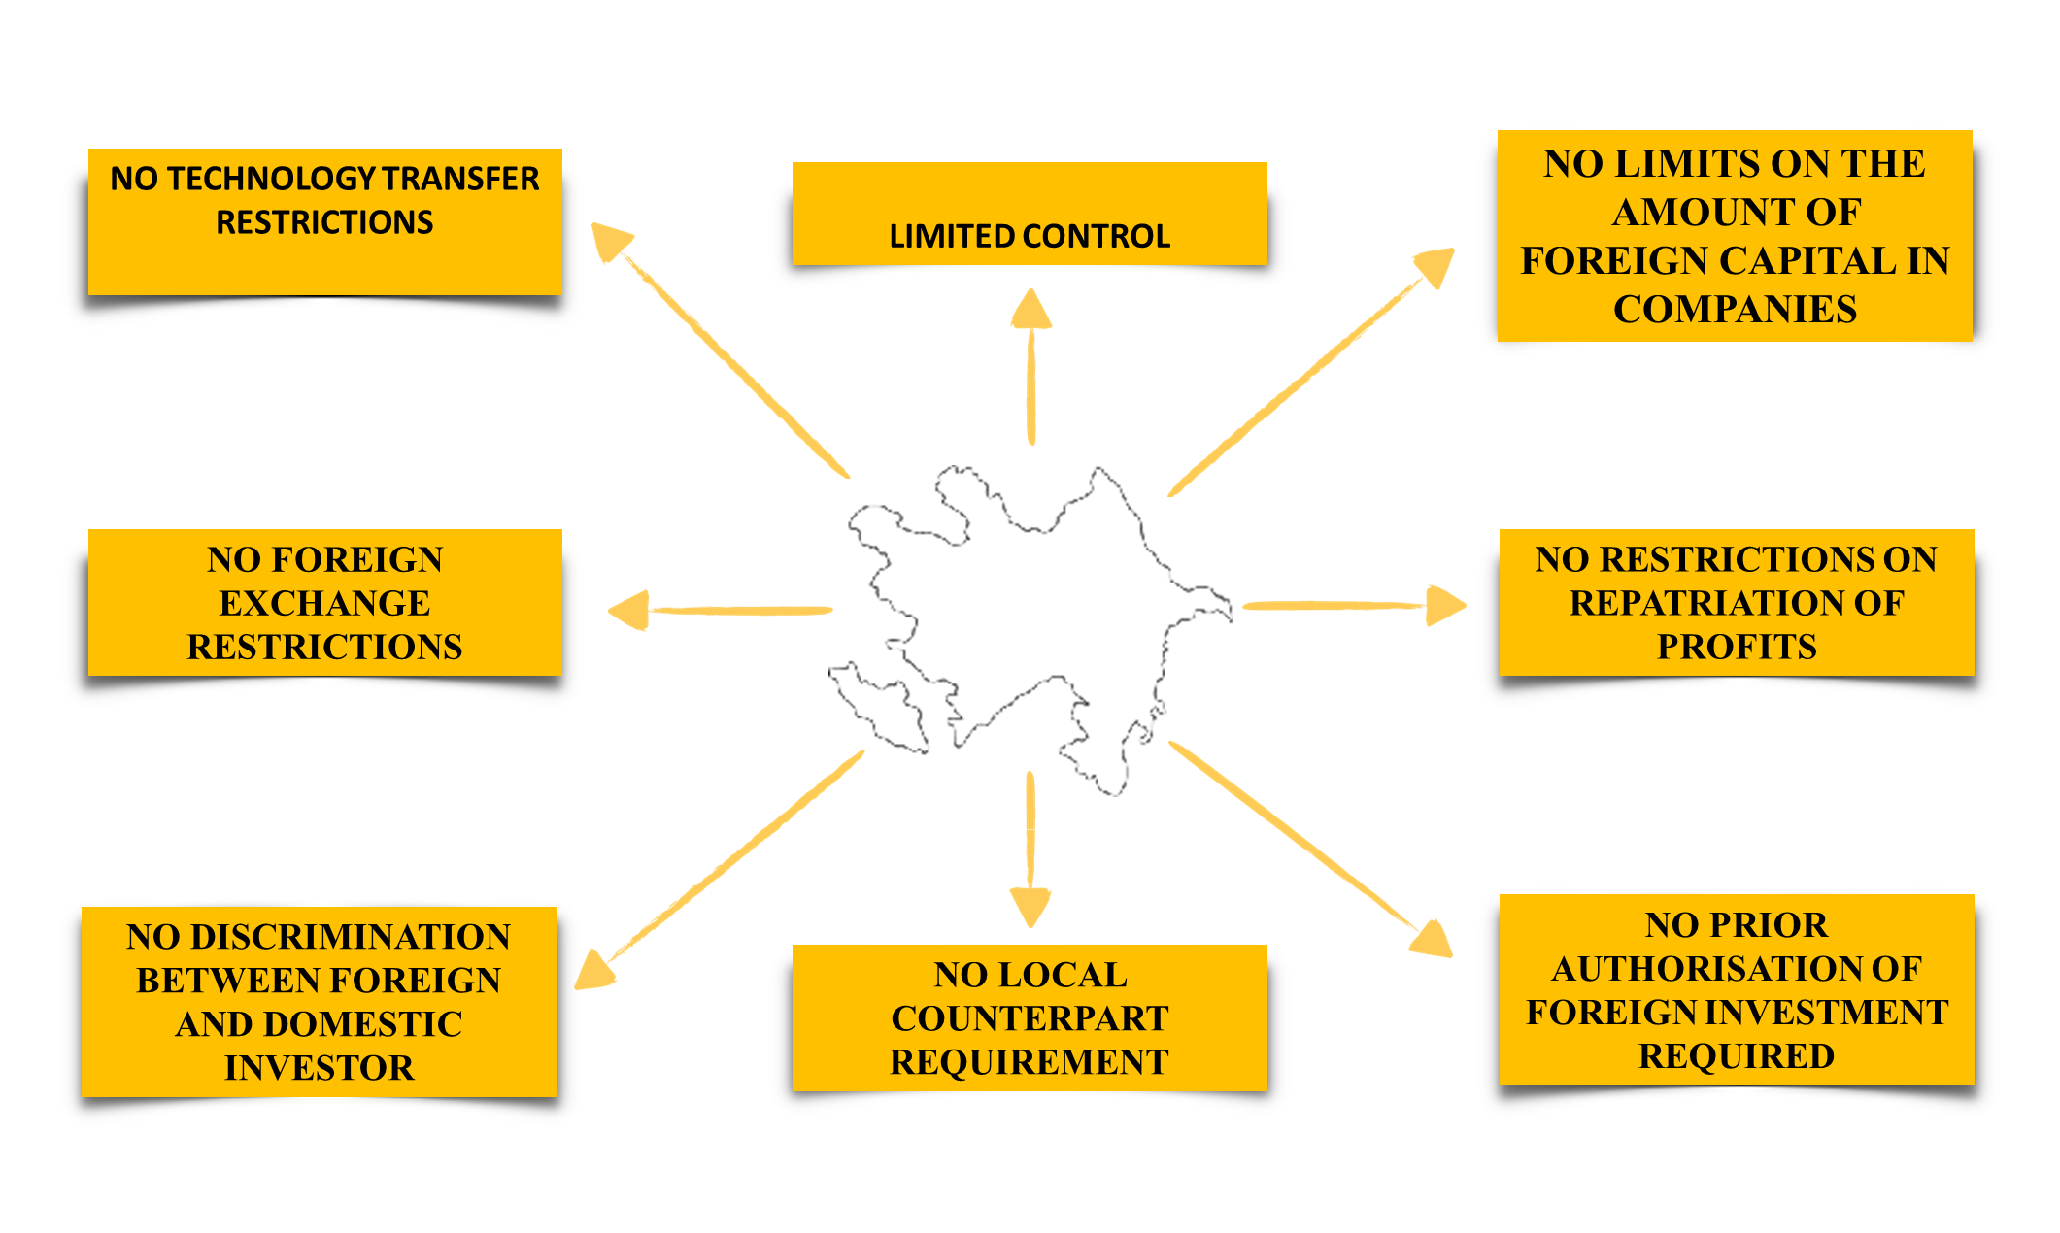
INVESTMENT CLIMATE

Slide 4
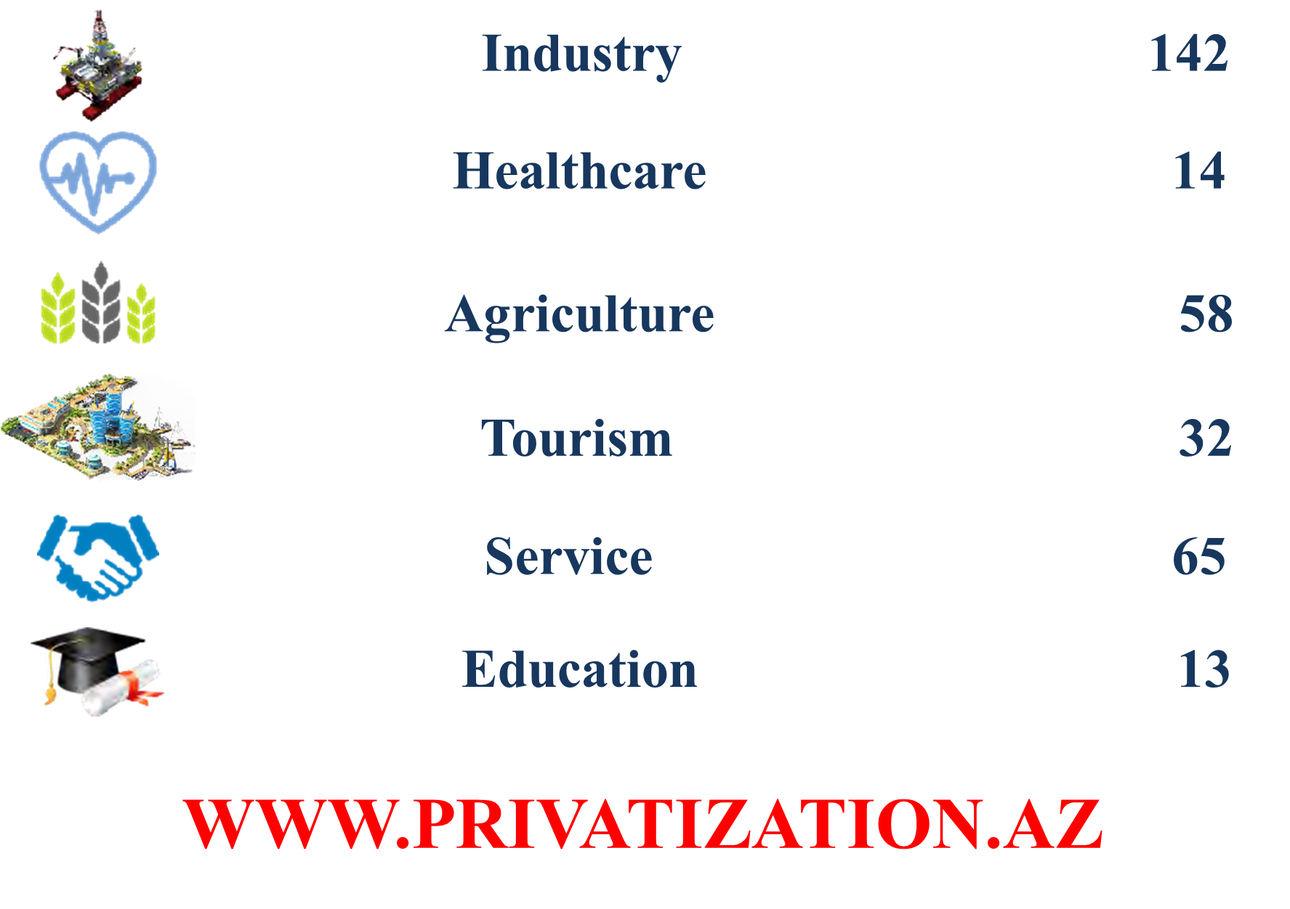
ASSETS OPENED FOR PRIVATIZATION

Slide 5
LEGAL FRAMEWORK
Law on Build, Operate, Transfer (BOT) model for construction infrastructure projects (since 2016)
SCOPE
Investors
Construction, restoration, rebuild, repair, operation and transfer
bridges and tunnels
water reservoirs, water treatment plants
education, health, culture and tourism sports centers, dormitories, leisure and amusement parks
industrial parks, high-tech parks, agro-parks
Investors who put their funds in Azerbaijan in accordance with the BOT model
Exempt from state duties
investment costs will be reimbursed to investors through the purchase of their products by authority or consumers
financial support guaranteed by the government
Validity of contracts is 49 years

Slide 6
STATE AGENCY
State Housing Development Agency of the Republic of Azerbaijan
A legal entity established on November 24, 2016,
The projects aimis to improve the quality of life by meeting the housing needs of Azerbaijani citizens and to contribute to the realization of the State policy for development of the national economy.
The vision is to broaden every opportunity for the country’s citizens to own an affordable flat, based on continuous and sustainable development to hit the targets.

Slide 7
PROMOTIONAL PPP PIPELINE PROJECT PRESENTATION
PROJECT NAME
Affordable Housing System
NAME OF GOVERNMENT SPONSOR
State Housing Development Agency of the Republic of Azerbaijan
THE SECTOR
Construction
PROJECT TYPE
Developing of construction sector after crisis period`
ESTIMATED PROJECT RETURN
10% mark up

Slide 8
PROMOTIONAL PPP PIPELINE PROJECT PRESENTATION
VALUE
1st “Yasamal Residential Complex” Project
110 mln AZN /64.62 mln USD
Hovsan Residential Compex
220 mln AZN/130 mln USD
PROJECT LOCATION
YASAMAL DİSTRİCT, External Circular Road 8
Hovsan district , Airport highway
OPPORTUNITY FOR PRIVATE SECTOR INVOLVEMENT
Within framework of PPP – total 18 mln AZN /10.62 mln USD private investment
23 mln AZN /13.5 mln USD
LAST UPDATED FILE RELATED TO PROJECT
Q3 2018

Slide 9
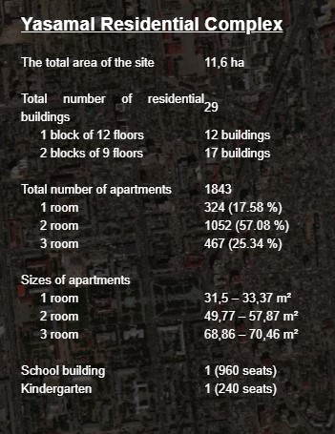
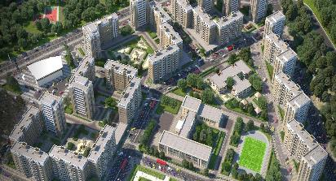
PROJECT DESCRIPTION -ONGOING
Within the framework of the public-private partnership, the private investor will invest roughly 18 mln. AZN/10.62 mln. USD for 1st YASAMAL project
The scope encompasses
the construction of three residential buildings - 10 mln AZN/5.9 mln. USD
Construction of telephone, television and internet lines in the complex area and provision of relevant services to the residents– 1 mln AZN/0.6 mln. USD
construction and management of the shopping center - 7 mln. AZN/4.2mln USD

Slide 10
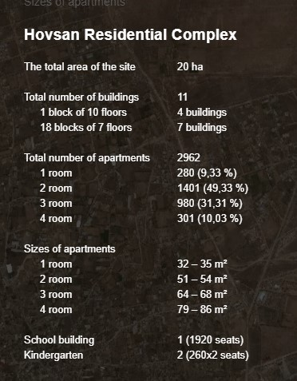
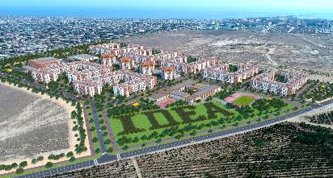
PROJECT DESCRIPTION - ONGOIN
Amounted 22 mln AZN/13.5 mln. USD is planning to be invested by private investors to the construction of the affordable housing complexes to HOVSAN project

Slide 11
Project Stage Info
Stage 1: Initial Government Announcement
INDICATIVE TIMETABLE OF PROJECT DEVELOPMENT N/A
PROJECT LOOKING FOR ADDITIONAL PPF ASSISTANCE No
PROJECT LOOKING FOR ADDITIONAL MDB ASSISTANCE No
IS PROJECT MULTI JURISDICTIONAL? No

Slide 12
Stage 2: Project Investigation
VALUE for the first and second projects projected value is 64 mln and 130 mln USD, respectively
INDICATIVE FUNDING SOURCE
president found and mortgage found (private investors through PPP)
HAVE ANY EXTERNAL ADVISORS BEEN APPOINTED YET Yes
DETAILS OF ADVISORS APPOINTED
E&Y consulting company
IS THE PROJECT CONTAINED IN NATIONAL/SUB NATIONAL INFRASTRUCTURE PLAN OR STRATEGY Yes

Slide 13
Stage 3: Start of Project Feasibility / Business Case
LEGAL ADVISORS APPOINTED YES
FINANCIAL ADVISORS APPOINTED YES
TECHNICAL AND OTHER ADVISORS (INC PROJECT PREPARATION FACILITY) APPOINTED YES
IS A BUSINESS CASE BEING PREPARED? Yes
BUSINESS CASE PREPARED BY Government-Private

Slide 14
Stage 4: Project Feasibility / Business Case Complete
IS THE BUSINESS CASE COMPLETE? Complete
BUSINESS CASE COMPLETION DATE Q1 2018
DETAILS FOR NEXT STEP OF PROJECT
ESTIMATED TIME TO START OF PROCUREMENT started Q4 2016
OTHER KEY PROJECT TIMELINE EVENTS
ESTIMATED RETURN ON EQUITY (%) 10.00%

Slide 15
THANK YOU!
E-MAIL

